Slide 1
Why Do We Need Edge Computing? Motivation & Evolution
Chapter 1

Slide 2
Outline
Background
What is edge computing
Big data & IoT
Centralized cloud
Latency, bandwidth and privacy driver
Definitions
Edge-edge intelligence link
Edge growth
Evolutionary history
Summary & Practice
Distributed databases -> P2P
CDNs -> MEC -> Fog
Cloud-Sea computing
Summary
Practice

Slide 3




Background: Internet of Things
IoT connects physical objects to the Internet — enabling identification, positioning, tracking, monitoring and management without human intervention.
Sensor Technology
RFID Technology
Embedded Systems
Acquires information from the physical world and converts it into output signals — the “senses” of IoT (eyes, nose, skin).
Radio-frequency + embedded tech to automatically identify objects and read data — no human intervention, even in harsh settings.
Hardware + software + circuits in one — from smartwatches to satellites. The “brain” that classifies and processes information.
Sensors are the senses, the network is the nervous system, and the embedded system is the brain that processes what comes in.

Slide 4

Background: Internet of Things to Internet of Everything (IoE)
Cisco introduced the IoE concept in December 2012 — the evolution of IoT for future connectivity.
IoT
IoE
Things-to-thing
Human-to-thing + context
Connects physical objects to the Internet
Distributed architecture: apps, computing & storage
Focus on identification & data collection
Every “thing” gains context awareness & sensing
Billions–trillions of connected nodes
Objects exchange information
Driven by IP, higher bandwidth & IPv6

Slide 5
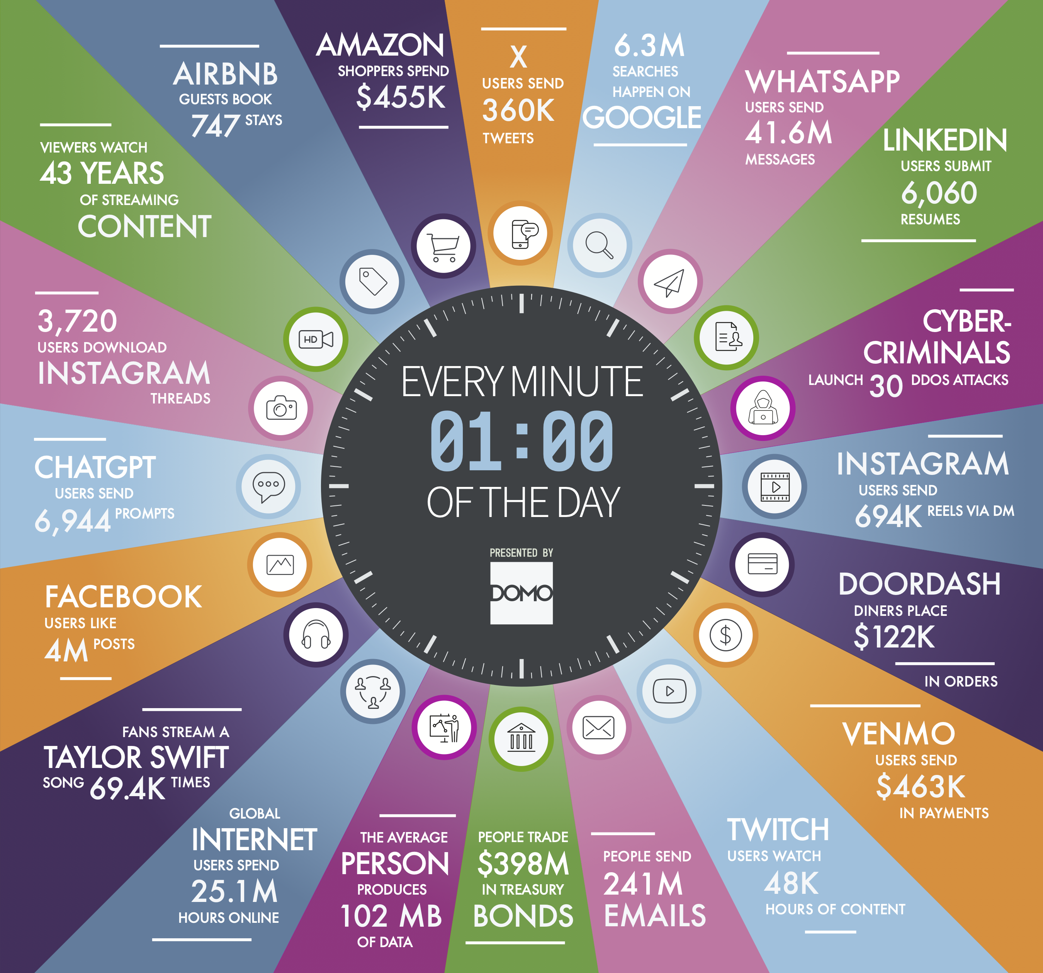
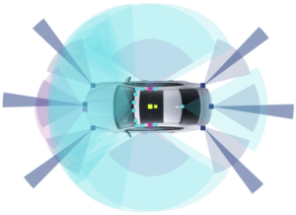
Background: Data Never Sleeps
IoE applications demand short response times and generate enormous, privacy-sensitive data.
A single forward facing radar operating at 2800 MBits / s generates more than 1.26 TB of data per hour, and a typical data collection car generates in excess of 30TB a day.
A two megapixel camera (24 bits per pixel) operating at 30 frames per second generates 1440 Mbits of data every second, so a five camera setup can generate in excess of 24 TB per day.
https://www.domo.com/learn/infographic/data-never-sleeps-11

Slide 6
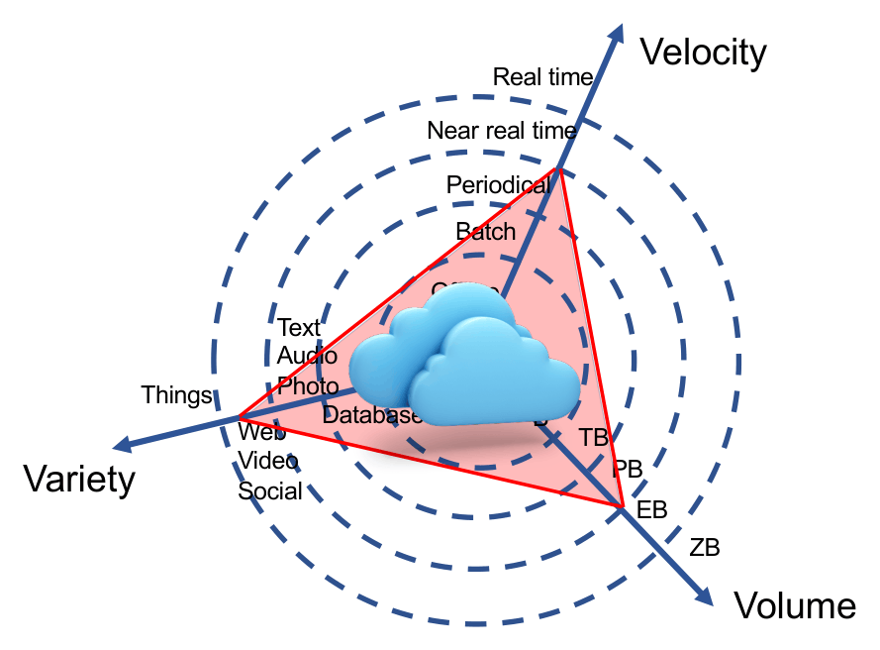



Background: Data Explodes in Three Dimensions
Velocity, Variety, Volume — the cloud paradigm works when data is confined in speed, size and format. IoE removes those limits.
Velocity
How fast data arrives — real-time · periodic · batch
Variety
How many forms it takes — text · audio · photo · video · social
Volume
The increase of data pushes the evolution of edge computing
How much is produced — MB & TB are now the everyday units

Slide 7


Background: Three Drivers
Edge computing’s distinct advantages over cloud for mobile & IoT applications.
Alleviates Bandwidth & Data-Center Pressure
Most IoE data is temporary and never needs long-term storage — devices generate ~2 orders of magnitude more data than is stored. Process it at distributed edges instead of shipping it all upstream.
Enhances Service Responsiveness
Serving computation near the user means low latency through proximity and less jitter via simpler routing. Edge and 5G/6G reinforce each other on throughput, latency and reliability.
Protects Privacy & Enhances Security
~86% of the U.S. public is concerned about data privacy. Keeping sensitive data on edge devices behind local firewalls gives fine-grained control the cloud model can’t.

Slide 8
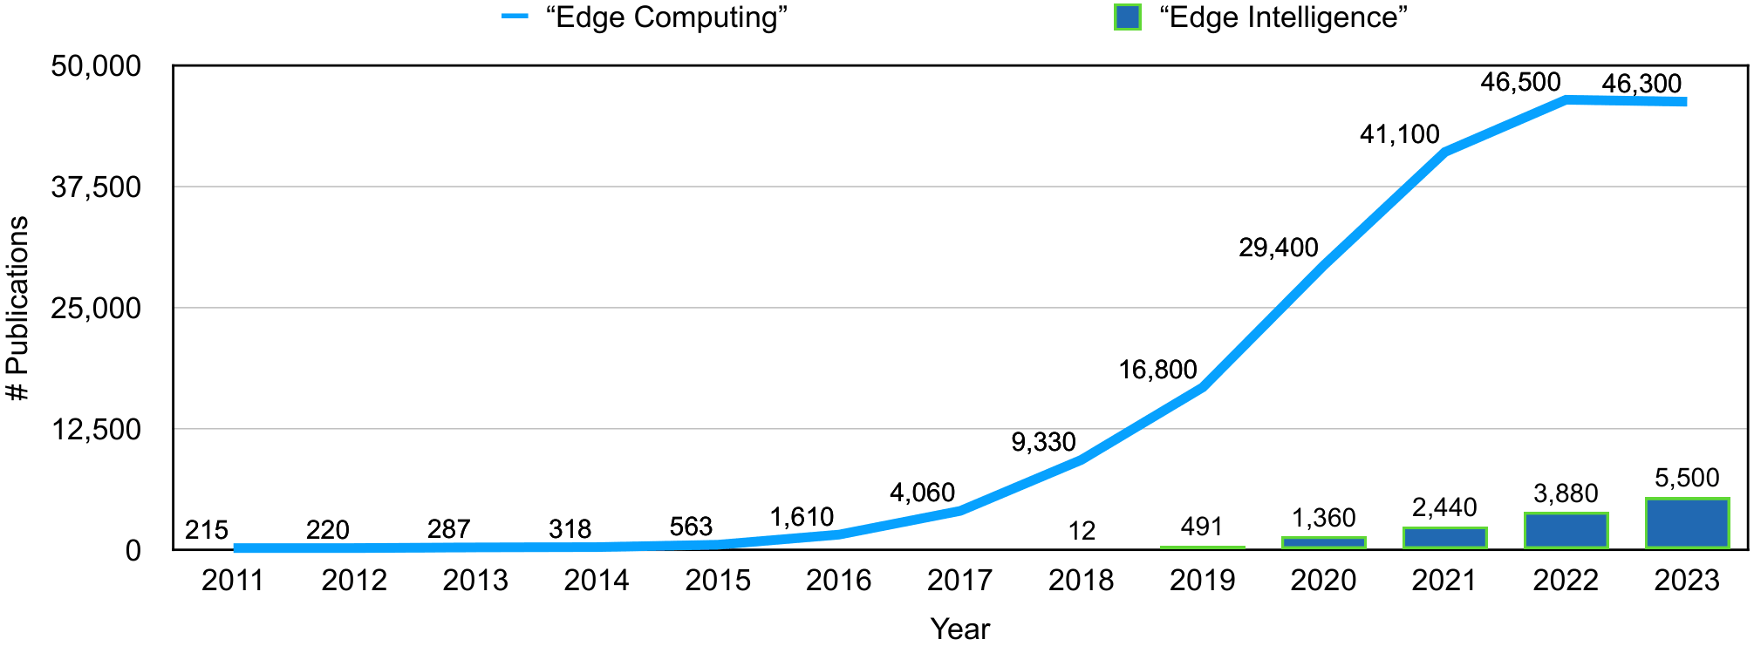
Evolutionary History: Three Stages of Development
Using “edge computing” as a Google Scholar keyword, publications reveal three clear phases.
Technology Preparation before 2015
Dormancy → presentation → definition. Data-oriented models mature.
Rapid Growth since 2015
Papers grow 10×. Government, academia & industry pile in.
Publications for “edge computing” and “edge intelligence.”
Intelligence Integration since 2020
Academia + industry converge; edge meets AI/ML.

Slide 9
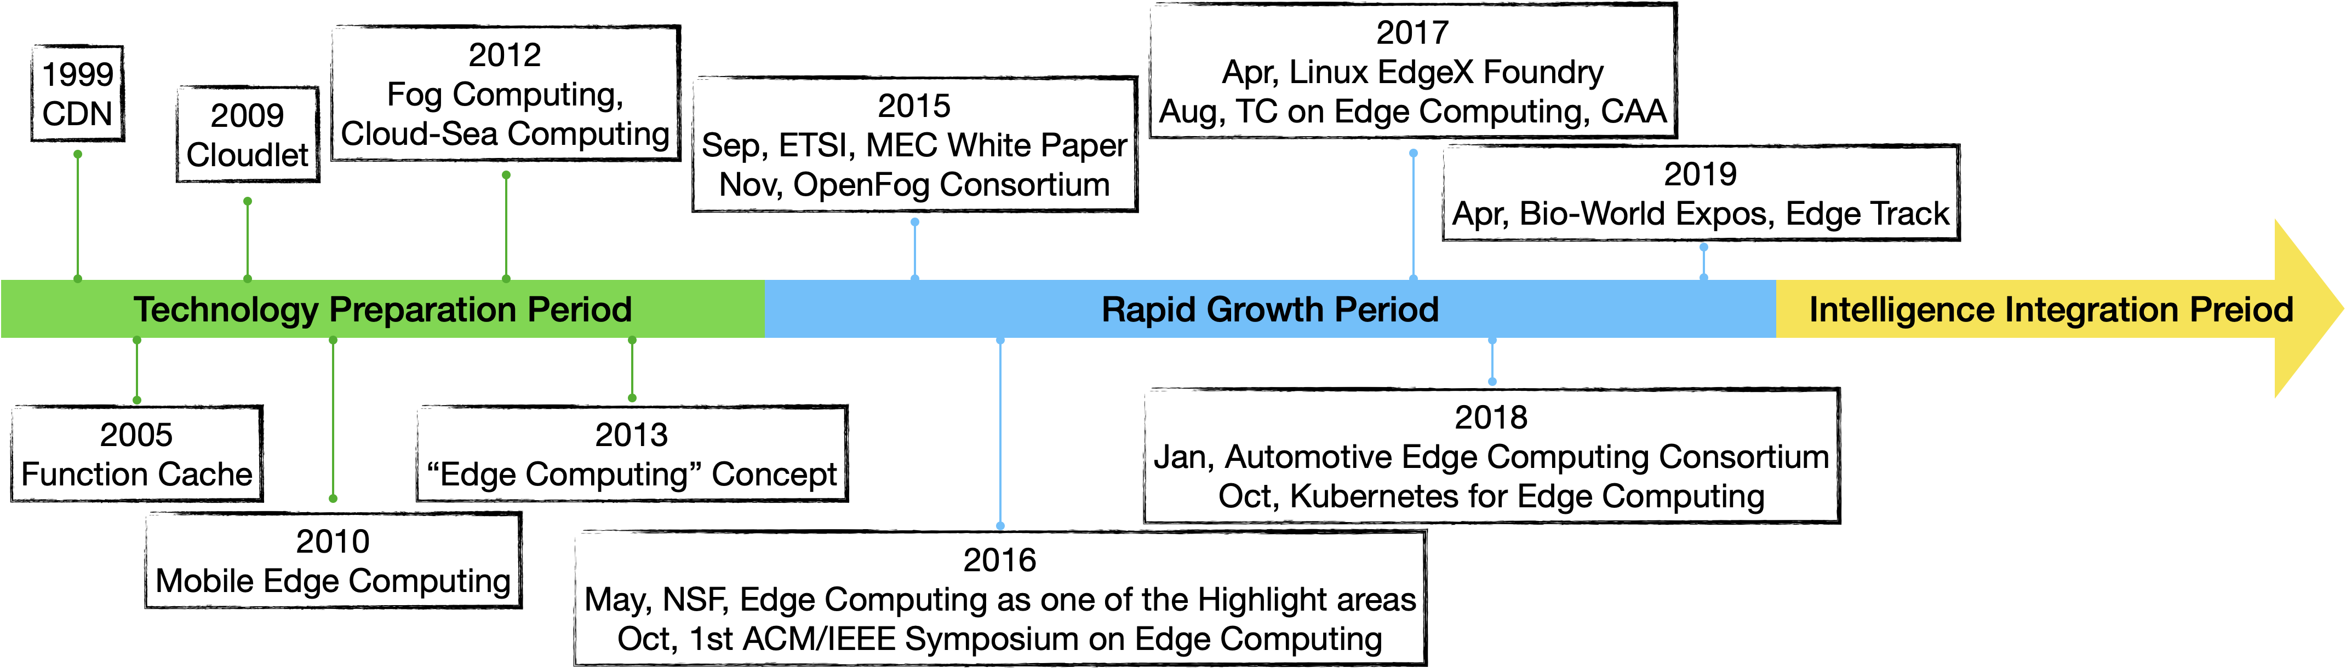
Evolutionary History: Road to the Edge
The evolution of edge computing and key milestones.
Distributed DBs → P2P → CDN → cache/cloudlet → MEC → fog → Cloud-Sea, each shifting computation toward the network edge.

Slide 10

Evolutionary History: Distributed Databases & P2P
Distributed Database Models
Peer-to-Peer (P2P) Models
Database tech + network tech; data spread across many machines
Term coined in 2000 for file-sharing — early “compute at the edge”
Homogeneous vs heterogeneous; SQL, NoSQL, XML, NewSQL
Key ideas: decentralization, scalability, churn tolerance
NoSQL & NewSQL most widely used (Spanner, VoltDB…)
Gave us DHTs, gossip protocols, multimedia streaming
vs edge: less attention to heterogeneous compute; needs lots of space; weaker privacy; consistency is hard
Edge computing extends P2P concepts to network-edge devices — a fusion of P2P and cloud

Slide 11


Evolutionary History: CDNs, Function Cache & Cloudlet
CDN (Akamai, 1998)
Active CDN (ACDN)
Function Cache & Cloudlet
Internet-based caching network. Routes users to the nearest cache server via load balancing — cutting congestion, boosting response speed. The early “edge” = CDN cache servers.
Improves on CDN: apps deploy on any server, with algorithms to replicate & migrate them as needed — no need to predict resource locations in advance.
Function cache (Ravi et al., 2005) caches computation, not just data. Cloudlet (Satyanarayanan et al.) = a trusted, resource-rich “small cloud” at the edge for mobile devices.
Today’s “edge” goes far beyond CDN cache servers — it is any compute/storage/network resource from data source to cloud.

Slide 12


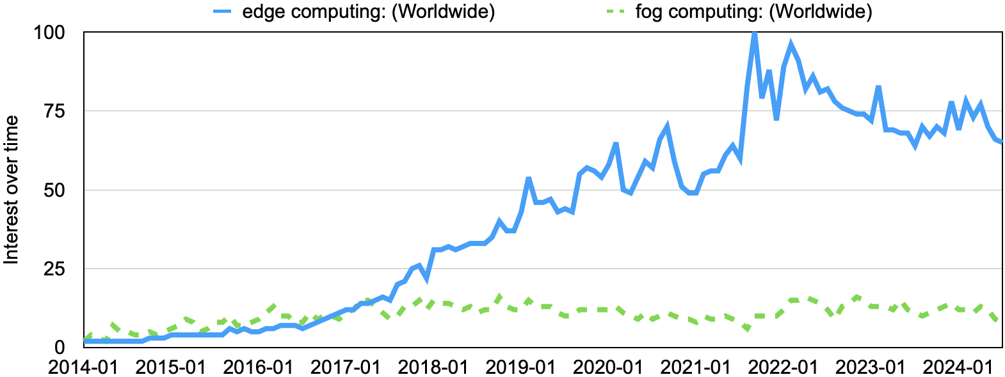
Evolutionary History: Mobile Edge Computing (MEC) & Fog Computing
MEC — standardized by ETSI (2014)
Fog — introduced by Cisco (2012)
IT services + cloud capability inside the wireless access network
A virtualized platform migrating cloud tasks to edge devices
Offload intensive mobile tasks to nearby edge servers → lower latency, higher bandwidth
Adds an intermediate “fog layer” of servers between cloud & devices
The evolution of edge computing and key milestones.

Slide 13

Evolutionary History: Cloud-Sea Computing & Rapid-Growth Surge
Rapid Growth — Key Milestones (2015→2019)
Cloud-Sea Computing
2015
ETSI MEC white paper; OpenFog Consortium founded
“Sea” = augmented client-side of human- & world-facing devices
2016
NSF names edge a highlighted area; 1st ACM/IEEE SEC; ECC founded in Beijing
Integrates the cloud system with the sea system
Focuses on the two ends; edge focuses on the path between them
2017
ETSI → “multi-access edge computing”; Linux EdgeX Foundry launched
2018
Automotive ECC formed; Kubernetes enters the edge (→ KubeEdge)
2019
Bio-IT World adds an edge track — edge reaches healthcare

Slide 14
Edge Computing: No Single Definition
IBM
Cisco
A distributed computing framework that brings enterprise applications closer to data sources — IoT devices or local edge servers.
A model that shifts computing resources from central data centers or public clouds closer to devices — embedded at the edge of provider networks.
Satyanarayanan
Yousefpour et al.
A paradigm where substantial compute & storage — cloudlets, micro data centers, fog nodes — sit at the Internet’s edge near devices/sensors.
Located at the network edge near IoT devices; the edge can be more than one hop away within the local IoT network.
Shi et al., “Edge Computing: Vision and Challenges,” 2016
“Edge computing refers to the enabling technologies allowing computation to be performed at the edge of the network — on downstream data on behalf of cloud services, and upstream data on behalf of IoT services.”
Shi, W., Cao, J., Zhang, Q., Li, Y., & Xu, L. (2016). Edge computing: Vision and challenges. IEEE internet of things journal, 3(5), 637-646.

Slide 15

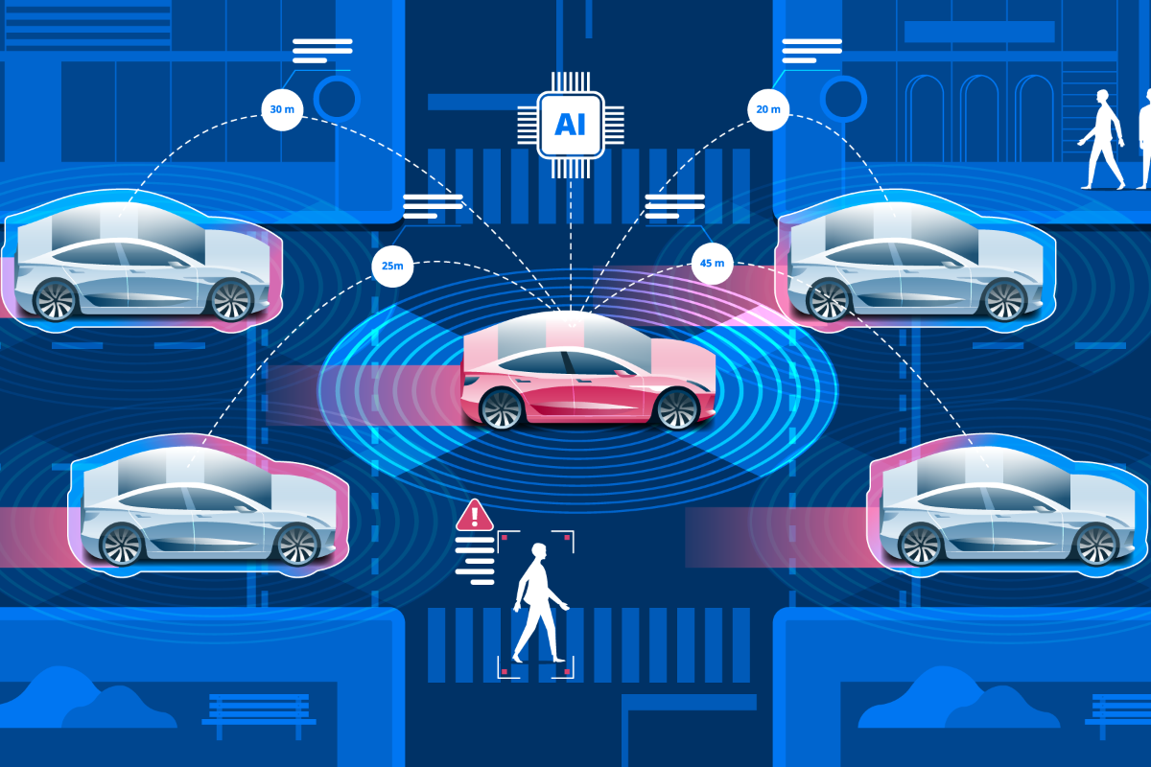
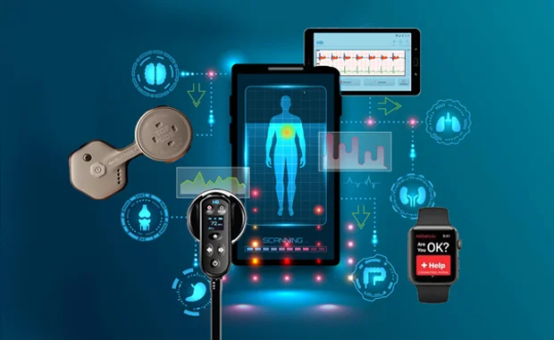
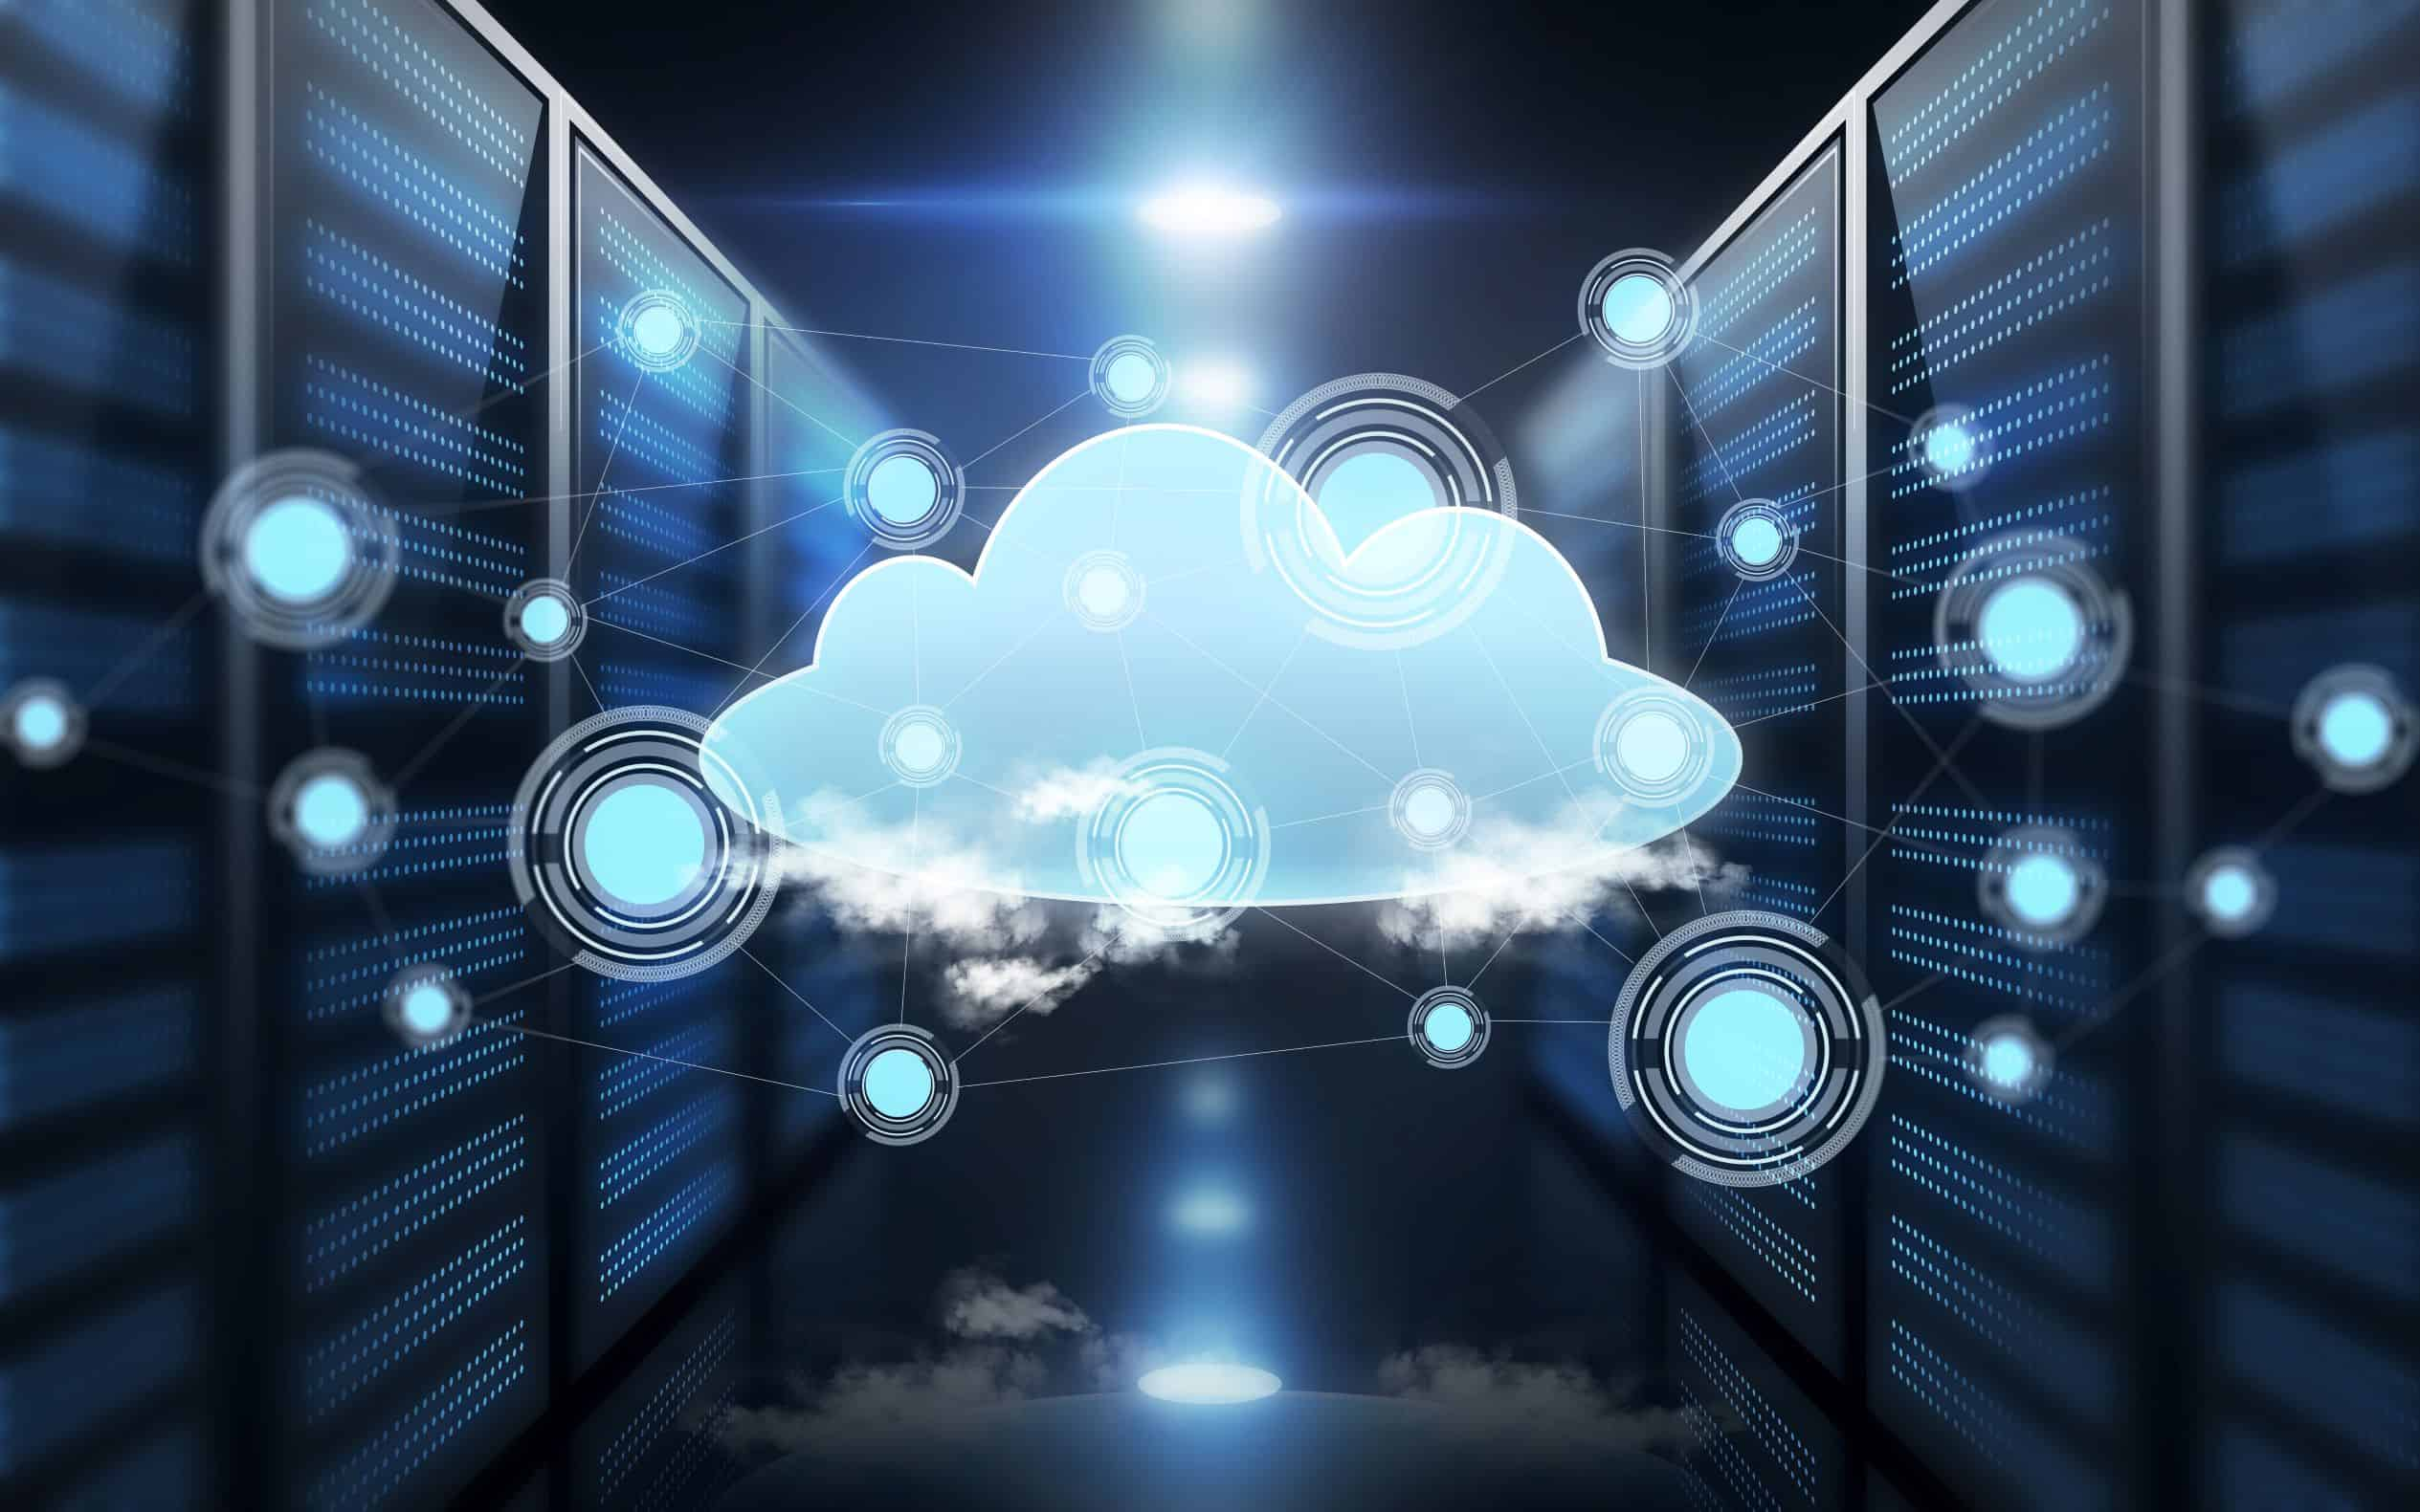
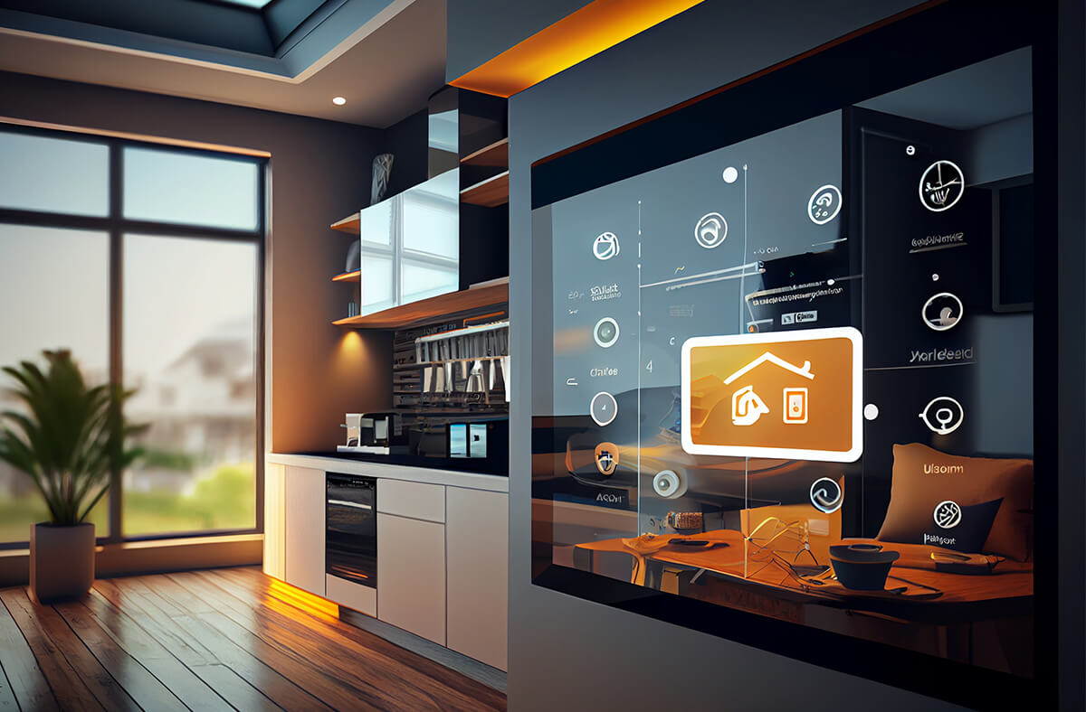
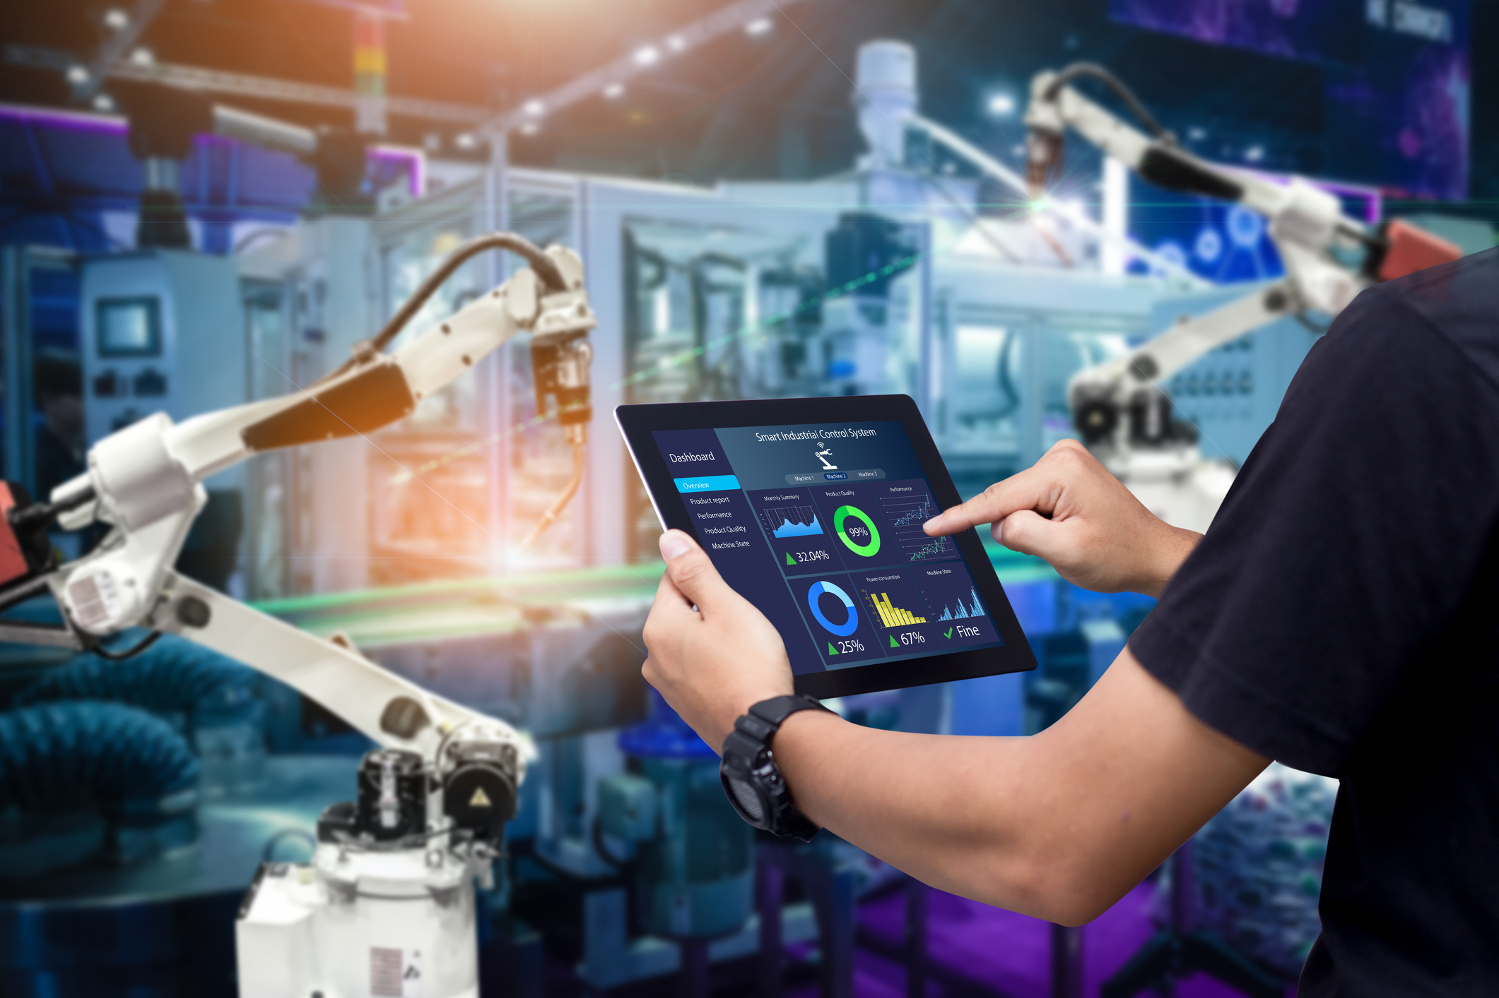
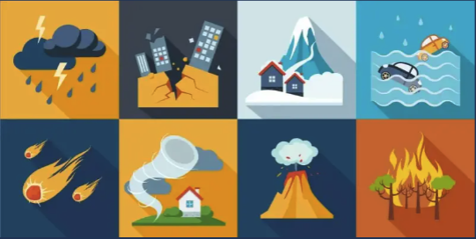
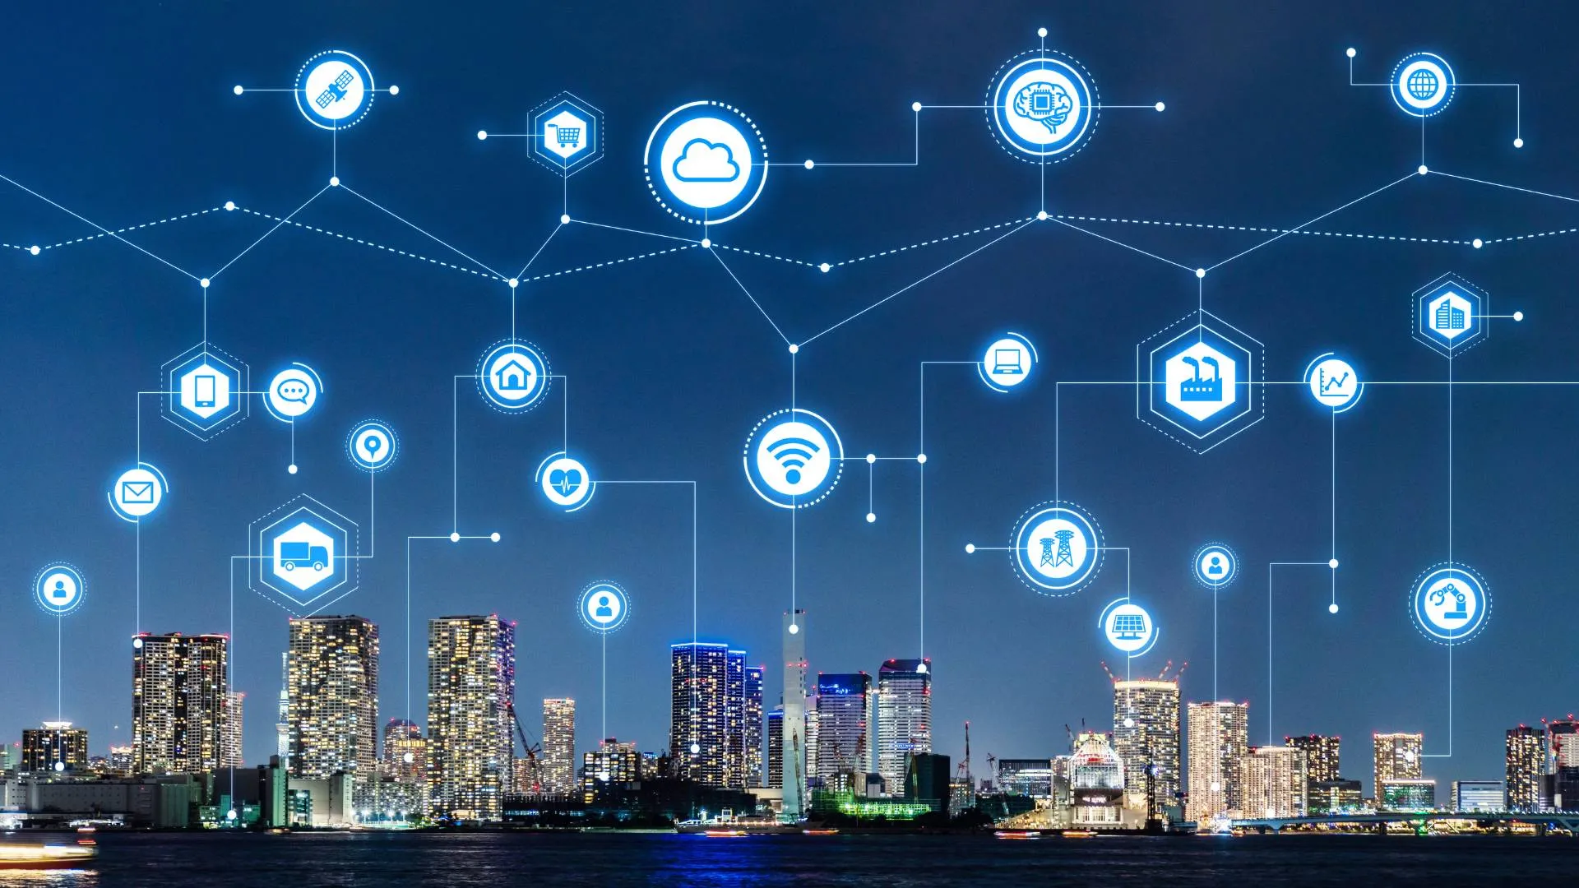
Edge Computing: Along the Path from the Data Source to the Cloud
Autonomous Driving
Connected Health
Edge Computing is a Continuum
Smart Home
Smart Manufacturing
Cloud / Datacenter
Disaster Relief
Smart City

Slide 16
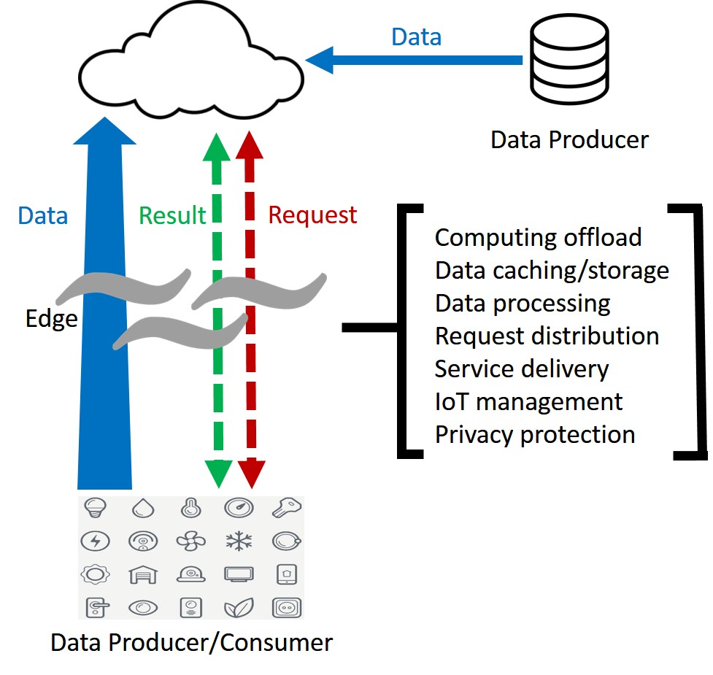
Edge Computing: What the Edge Actually Does
Two-way computing streams
Things are not only data consumers but also data producers.
Computation can be performed at the edge of the network.
On downstream data on behalf of cloud service & upstream data on behalf of IoT services.
Edge Computing Paradigm
Shi, W., Cao, J., Zhang, Q., Li, Y., & Xu, L. (2016). Edge computing: Vision and challenges. IEEE internet of things journal, 3(5), 637-646.

Slide 17

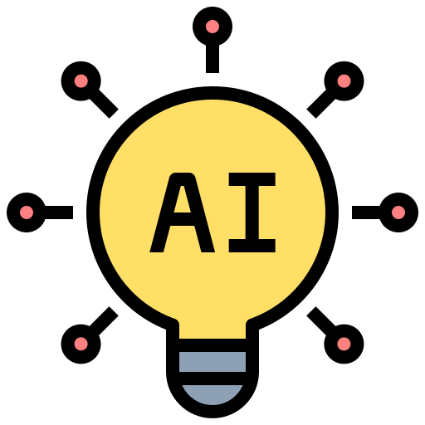


Edge Computing: Edge-Intelligence Link
Edge Computing
+ AI / ML at the Edge
Edge Intelligence
On-demand compute at the data source
Analyze & decide locally, autonomously
Smarter, faster, more efficient systems
Optimization techniques
Pruning · Quantization · Knowledge distillation — shrink AI models to run on edge devices
Application domains
Smart surveillance · autonomous vehicles · health monitoring · industrial IoT · smart agriculture · retail

Slide 18
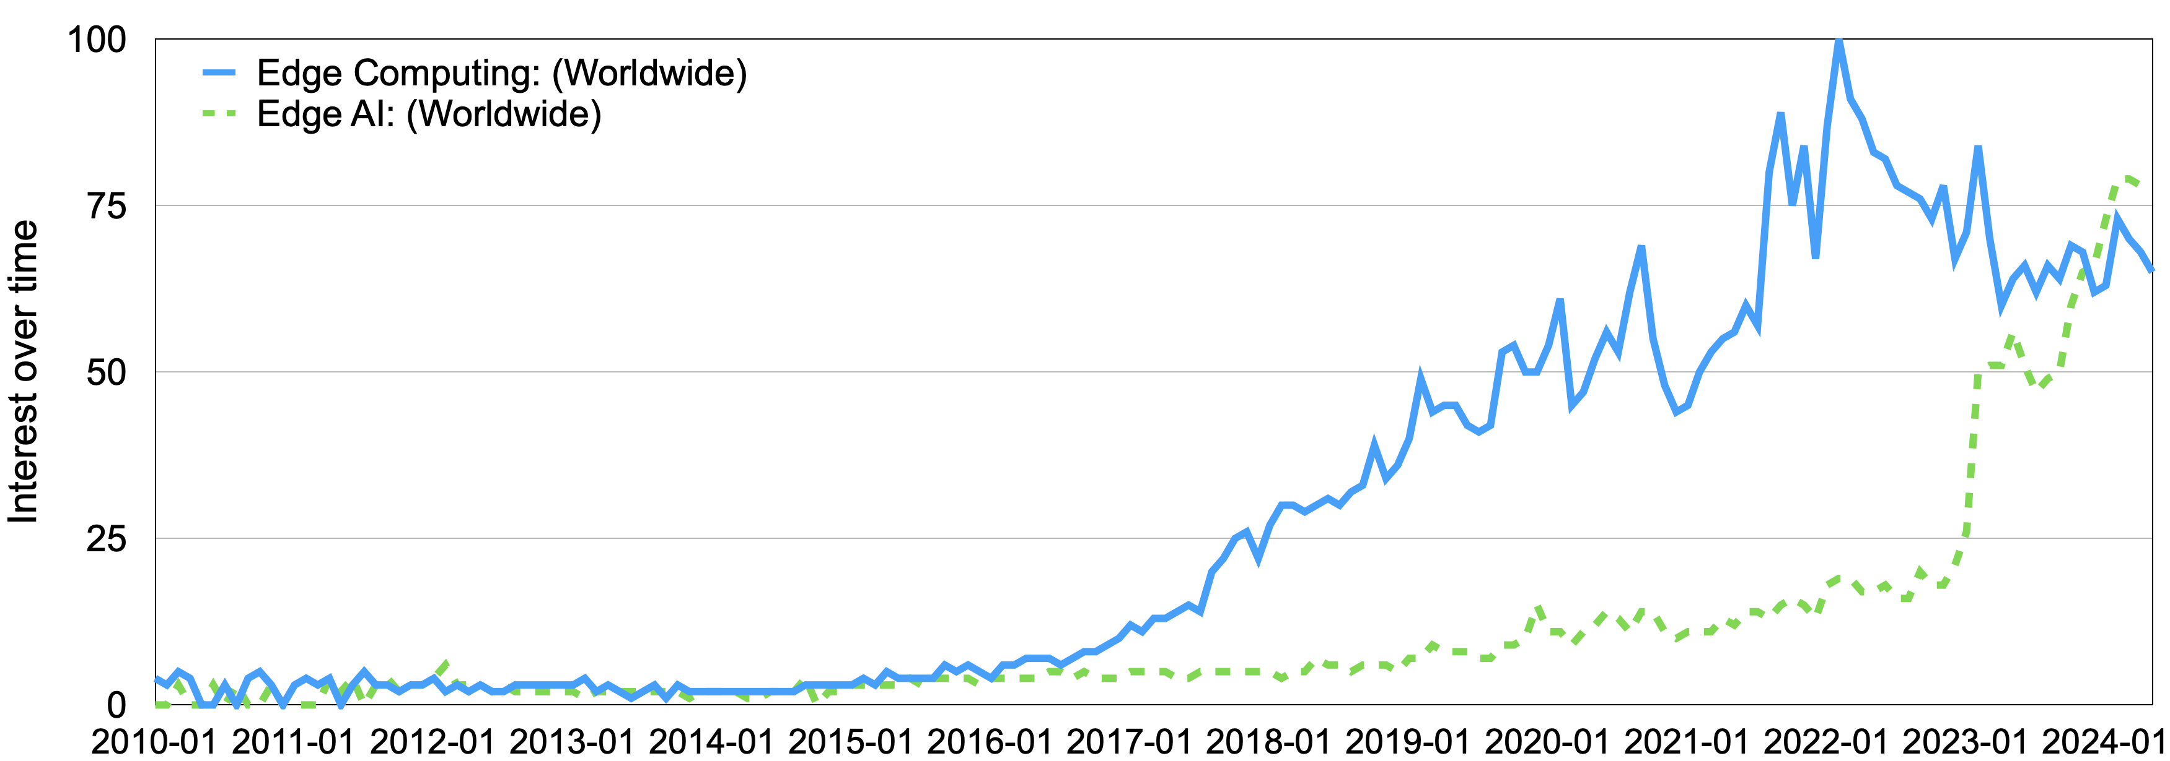


Edge Computing: Edge Growth & the Rise of “Edge AI”
Before LLMs
After LLMs
The shift
Focus was the paradigm itself — architectures, components, hardware/software, challenges.
Powerful models meet tight compute/storage limits at the edge.
Research pivots to enabling edge-based AI by tackling resource constraints.

Slide 19
Summary
Edge computing is a continuum from data sources to cloud data centers.
The edge includes computing, storage, and networking resources along this path.
Edge computing emerged to address challenges in big data processing and the Internet of Everything.
It evolved from earlier models such as P2P, CDN, MEC, fog computing, and Cloud-Sea computing.
Edge computing is closely connected to the development of edge intelligence.

Slide 20
Practice
What is the “edge”?
1
What distinguishes edge computing from traditional cloud computing?
2
What challenges does cloud face with the data volumes from IoE devices?
3
Why is edge computing necessary in the era of the Internet of Everything?
4
5
Give real-world examples for each use case in the continuum (connected health, autonomous driving, smart home/city, smart manufacturing, disaster relief).
From the background & history, what key challenges could arise as edge computing develops?
6

Slide 21
References
Edge Computing Consortium. Introduction of Edge Computing Consortium. http://en.ecconsort ium.net/Uploads/file/20180328/1522232376480704.pdf. Accessed: 2024-07-31.
IBM. What is edge computing? https://www.ibm.com/topics/edge-computing. Accessed: 2024-05-11.
OpenFog Consortium. OpenFog Reference Architecture for Fog Computing. https://www.iicon sortium.org/pdf/OpenFog_Reference:Architecture_2_09_17.pdf. Accessed: 2024-07-31.
Shi, W., Cao, J., Zhang, Q., Li, Y., & Xu, L. (2016). Edge computing: Vision and challenges. IEEE internet of things journal, 3(5), 637-646.
Mahadev Satyanarayanan et al. “The case for VM-based cloudlets in mobile computing”. In: IEEE Pervasive Computing 8. 4 (2009), pp. 14–23.
Li, P., Yang, J., Islam, M. A., & Ren, S. (2023). Making ai less" thirsty": Uncovering and addressing the secret water footprint of ai models. arXiv preprint arXiv:2304.03271.

