Slide 1
Challenges in Edge Computing II
Chapter 7
Topic: Internet of Things | Retail | Autonomous Vehicles

Slide 2
Outline
Internet of Things
Autonomous Vehicles
Mobile gaming & IIoT
MEC Applications
Security and Data Sharing
OpenVDAP & VECFrame
Federated Learning & Computation Offloading
SafeCross & C-V2X CCAD
Retail
Summary & Practice
Smart Retail Applications
SmSH Architecture
RFID / NFC / Bluetooth / LPWAN

Slide 3




Internet of Things
Bringing computational resources closer to data sources cuts latency and boosts data-processing efficiency — vital for real-time IoT.
Mobile gaming
Industrial IoT
Cloud IoT suffers high latency & unreliable links — edge architectures cut latency and lift quality of experience for mobile gaming.
Decentralize processing to cut latency & bandwidth; full/partial offloading + edge AI handle complex computation.
Deep learning on edge
Secure data sharing
Deploy DL models partly on edge servers with a scheduling strategy that maximizes tasks under quality-of-service limits.
Blockchain is proposed for secure IoT data sharing; future work targets 5G network slicing, better load balancing & robust security.
Gopika Premsankar, Mario Di Francesco, and Tarik Taleb. “Edge computing for the Internet of Things: A case study”. In: IEEE Internet of Things Journal 5. 2 (2018), pp. 1275–1284.
Tie Qiu et al. “Edge computing in Industrial Internet of Things: Architecture, advances and challenges”. In: IEEE Communications Surveys & Tutorials 22. 4 (2020), pp. 2462–2488.
J Lin et al. “An edge computing based public vehicle system for smart transportation”. In: IEEE Transactions on Vehicular Technology 69. 11 (2020), pp. 12635–12651. DOI: 10.1109/ TVT.2020.3028497.

Slide 4
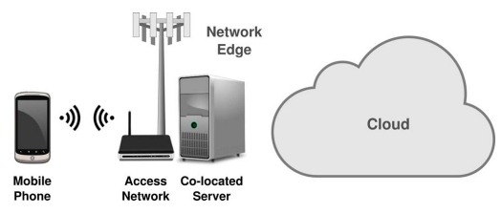

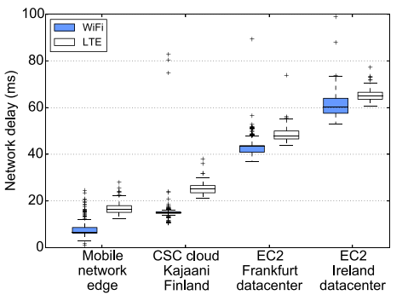
Internet of Things
Mobile gaming
Key characteristics
Application Mobile gaming / AR-VR-style interactive workloads
Why edge Cloud latency hurts responsiveness and user experience
Network edge testbed setup
Approach Offload rendering and processing to a nearby edge server
Benefit Edge deployment provides much lower network delay than distant cloud servers
Network delay <20 ms at mobile edge vs. ~40–70 ms at public cloud
Network delay across server deployments
Gopika Premsankar, Mario Di Francesco, and Tarik Taleb. “Edge computing for the Internet of Things: A case study”. In: IEEE Internet of Things Journal 5. 2 (2018), pp. 1275–1284.

Slide 5
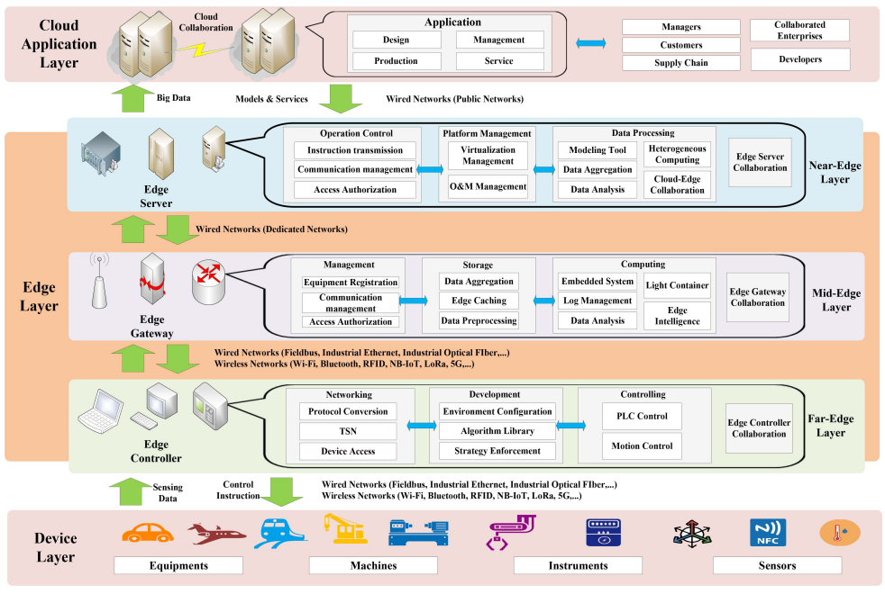








Internet of Things
Industrial IoT (IIoT)
Feature
IoT
IIoT
Objective
Consumption-oriented
Production-oriented
Application scenarios
Smart home, health, localization
Smart factory, logistics, remote
Platform foundation
Self-building
Industrial facilities
Sensors scale
Small to medium
Large to very large
Precision requirement
Low to medium
High to very high
Mobility
Strong
Weak
Data volume
Medium to high
High to very high
Latency tolerance
High
Very low
Edge Computing in IIoT
Qualitative comparison of IoT and IIoT
Tie Qiu et al. “Edge computing in Industrial Internet of Things: Architecture, advances and challenges”. In: IEEE Communications Surveys & Tutorials 22. 4 (2020), pp. 2462–2488.

Slide 6
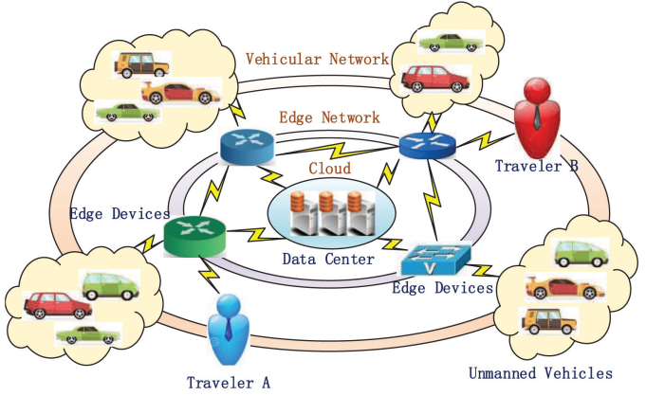
Internet of Things
Public vehicle system for smart transportation
Key characteristics
Rapid edge-benefit estimation helps determine whether moving an application to the edge is actually worthwhile.
Castnet framework estimates edge-computing gains without requiring a full real-world edge deployment.
Evaluates the trade-off between application responsiveness, network/backhaul savings, and edge infrastructure cost.
Targets MEC deployment planning and what-if analysis before committing infrastructure resources.
System model for smart transportation
J Lin et al. “An edge computing based public vehicle system for smart transportation”. In: IEEE Transactions on Vehicular Technology 69. 11 (2020), pp. 12635–12651. DOI: 10.1109/ TVT.2020.3028497.

Slide 7
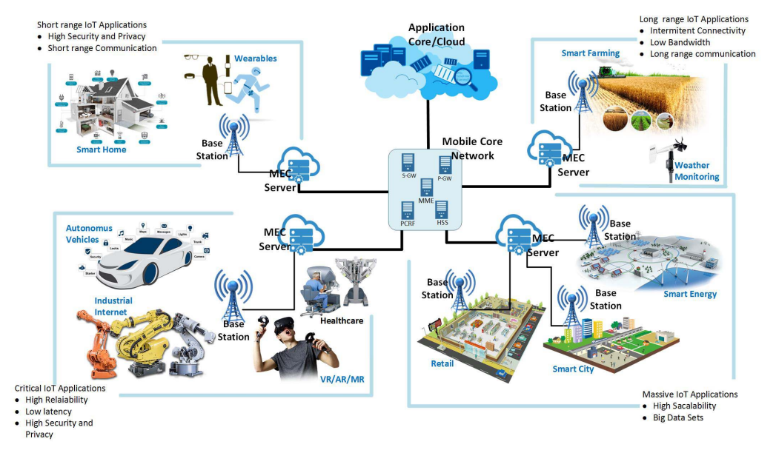
Internet of Things
Application scenario for IoT and multi access edge computing (MEC)
IoT and MEC application scenarios (source)
Pawani Porambage et al. “Survey on multi-access edge computing for Internet of Things realization”. In: IEEE Communications Surveys & Tutorials 20. 4 (2018), pp. 2961–2991.

Slide 8




Internet of Things: Challenges
Offloading & load balancing
Limited edge resources
Distributed IoT devices need advanced load-balancing algorithms.
Constrained compute at the edge caps what runs locally.
Security & privacy
5G integration
Network slicing & 5G integration still being optimized.
Robust protection — blockchain for secure data sharing.

Slide 9
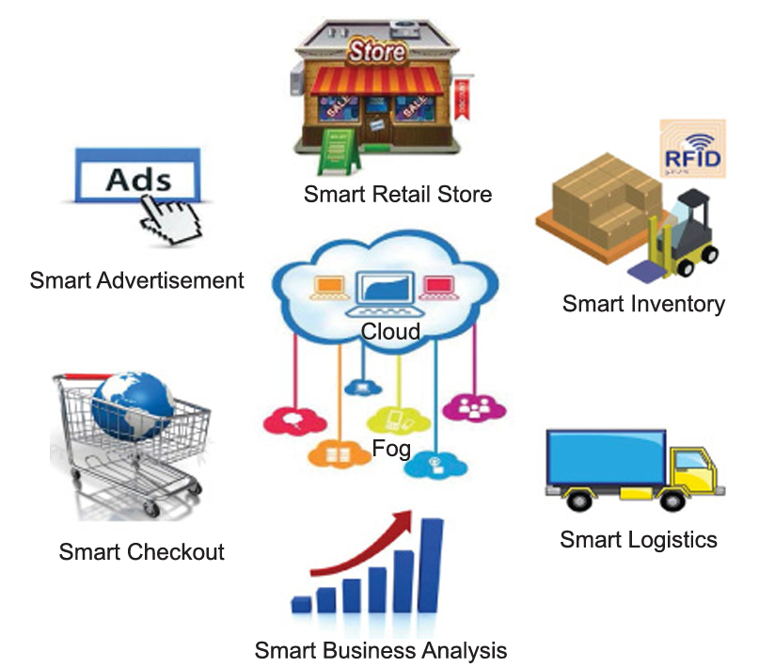




Retail
Six edge-enabled retail functions
Smart advertisement Targeted, real-time promotions in-store.
Smart retail store Track customer traffic & buying patterns locally.
Smart inventory Weight sensors + cameras + RFID auto-signal restock.
Smart checkout Faster, frictionless payment at the edge.
Smart logistics Local processing streamlines supply & delivery.
Smart business analysis On-site analytics for immediate decisions.
High-level view of an IoT-based smart retail
Charith Perera et al. “Fog computing for sustainable smart cities: A survey”. In: ACM Computing Surveys (CSUR) 50. 3 (2017), pp. 1–43.

Slide 10
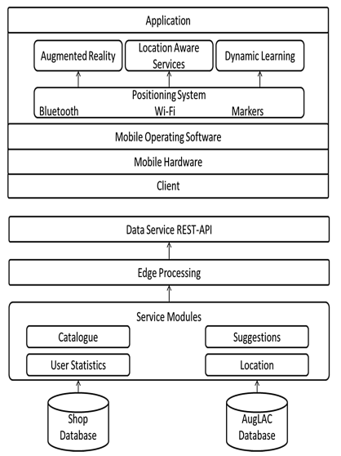



Retail
Smart shop (SmSH). A Smart Shop architecture integrating IoT devices + edge computing for seamless device communication, real-time processing and personalized customer interaction.
Connectivity technologies
RFID Tag-based item identification & tracking.
NFC Near-field taps for checkout & pairing.
Bluetooth Short-range device-to-device links.
LPWAN Low-power wide-area coverage for sensors.
SmSH architecture
M Saravanan and N C Srinidhi Srivatsan. “Intelligent communication between IoT devices on edges in retail sector”. In: Advances in Information and Communication Networks: Proceedings of the 2018 Future of Information and Communication Conference (FICC), Vol. 2. Springer, 2019, pp. 546–562.

Slide 11
Retail
Smart shop (SmSH). A Smart Shop architecture integrating IoT devices + edge computing for seamless device communication, real-time processing and personalized customer interaction.
Implementation phases
1
Customer identification Recognize the shopper on entry.
2
Product selection Track picks & assist in real time.
3
Payment Fast, secure edge-handled checkout.
Reduces latency, enhances security, and extends easily to other business domains.
SmSH architecture (source)
M Saravanan and N C Srinidhi Srivatsan. “Intelligent communication between IoT devices on edges in retail sector”. In: Advances in Information and Communication Networks: Proceedings of the 2018 Future of Information and Communication Conference (FICC), Vol. 2. Springer, 2019, pp. 546–562.

Slide 12
Retail: Challenges
Low latency
Data management
Real-time response to customer behavior in-store.
Analyzing & using real-time data at store level.
Security
Competition pressure
Secure device communication & payment handling.
Brick-and-mortar must match online personalization.

Slide 13
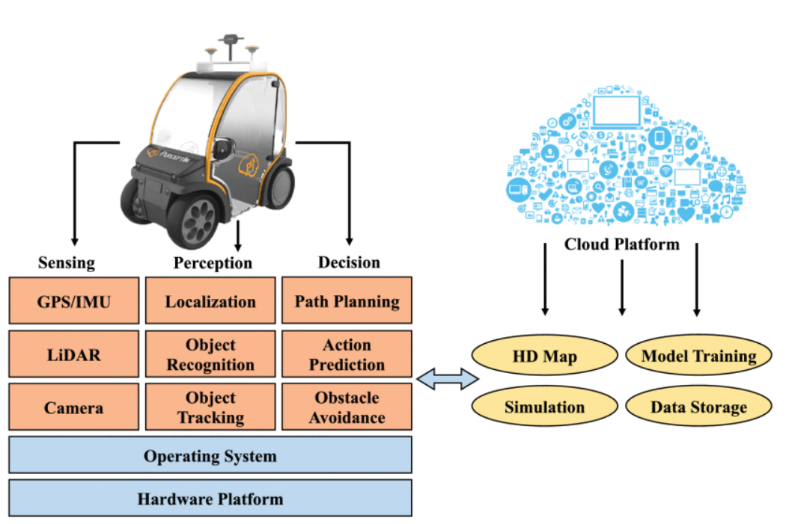



Autonomous Vehicles
The Connected & Autonomous Vehicle Stack (CAVs)
Sensing
GPS/IMU, LiDAR, cameras capture the environment.
Perception
Localization, object recognition & tracking.
Decision
Path planning, action prediction, obstacle avoidance.
Cloud platform
HD maps, simulation, model training, data storage.
High-level view of edge computing for autonomous vehicles
Shaoshan Liu et al. “Edge computing for autonomous driving: Opportunities and challenges”. In: Proceedings of the IEEE 107. 8 (2019), pp. 1697–1716.

Slide 14



Autonomous Vehicles
Edge frameworks for autonomous driving
OpenVDAP
VECFrame
CLONE
Full-stack platform: onboard heterogeneous unit + secure EdgeOSv + edge-aware libvdap; dynamically offloads tasks.
Cooperative object detection & data fusion at the edge via modular containers — boosts throughput 40–350% vs. non-edge.
Federated learning + LSTM: vehicles train locally, share parameters to an edge server. Predicts EV battery failure.
Offloading
SafeCross
C-V2X CCAD
ILP offline + heuristic online offloading to roadside cloud — cuts average latency 34%, lifts localization accuracy up to 7.6×.
Left-turn blind-area warnings via video preprocessing, classification, few-shot learning & model switching.
Cellular V2X collaborative driving — multi-angle perception & edge processing improve lane-keeping and safety.
Qingyang Zhang et al. “OpenVDAP: An open vehicular data analytics platform for CAVs”. In: 2018 IEEE 38th International Conference on Distributed Computing Systems (ICDCS). IEEE, 2018, pp. 1310–1320.
S Tang et al. “VECFrame: A vehicular edge computing framework for connected autonomous vehicles”. In: 2021 IEEE International Conference on Edge Computing (EDGE). 2021, pp. 68–77. DOI: 10.1109/EDGE53862.2021.00019.
Sidi Lu, Yongtao Yao, and Weisong Shi. “Collaborative learning on the edges: A case study on connected vehicles”. In: 2nd USENIX Workshop on Hot Topics in Edge Computing (HotEdge 19), 2019.
Mingyue Cui et al. “Offloading autonomous driving services via edge computing”. In: IEEE Internet of Things Journal 7. 10 (2020), pp. 10535–10547.
B Wu et al. “To turn or not to turn, safecross is the answer”. In: 2022 IEEE 42nd International Conference on Distributed Computing Systems (ICDCS). 2022, pp. 414–424. DOI: 10.1109/ ICDCS54860.2022.00047.
Y He et al. “Towards C-V2X enabled collaborative autonomous driving”. In: IEEE Transactions on Vehicular Technology 72. 12 (2023), pp. 15450–15462. DOI: 10.1109/ TVT.2023.3299844.

Slide 15
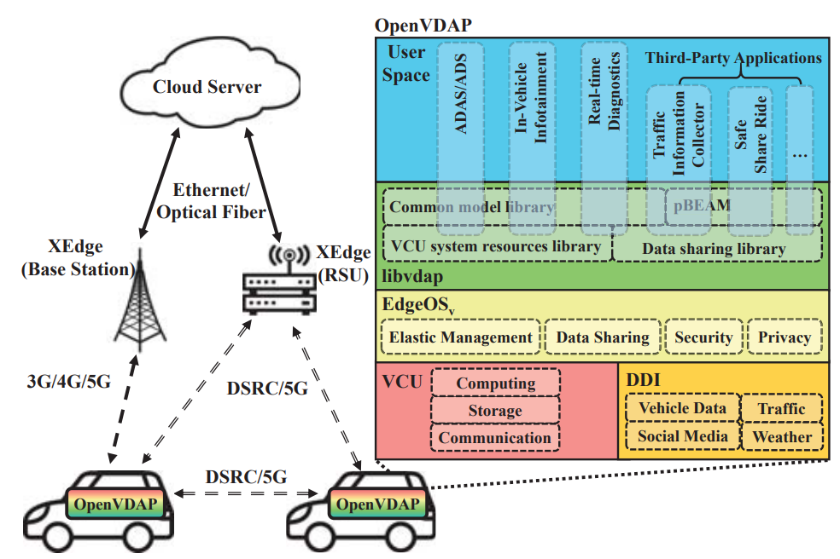
Autonomous Vehicles
OpenVDAP
Key characteristics
Supports dynamic workload offloading and scheduling based on latency, bandwidth, and available computing resources.
Uses a heterogeneous Vehicle Computing Unit (VCU) with CPU, GPU, FPGA, ASIC, storage, and multiple communication interfaces.
Introduces EdgeOSv for elastic resource management, isolation, security, privacy, and data sharing.
Provides libvdap, an edge-aware application library with common AI models and uniform APIs for developers.
Designed as an open-source platform with APIs and real vehicle data for developing and testing CAV applications.
Overview of OpenDAP (source)
Qingyang Zhang et al. “OpenVDAP: An open vehicular data analytics platform for CAVs”. In: 2018 IEEE 38th International Conference on Distributed Computing Systems (ICDCS). IEEE, 2018, pp. 1310–1320.

Slide 16
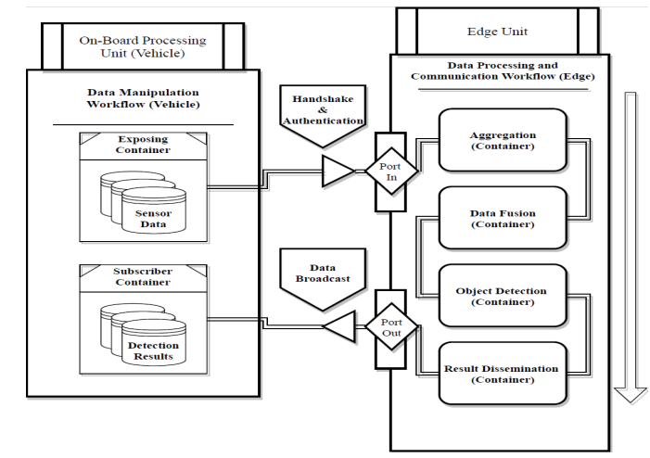
Autonomous Vehicles
VECFrame
Key characteristics
Vehicular edge computing framework for CAVs that combines vehicle, edge-node, and infrastructure resources for cooperative perception.
Designed around three principles: data-friendly, adaptable, and scalable.
Employs a publish–subscribe communication model using MQTT, with Wget used for reliable raw-data transfer.
Supports multi-vehicle data aggregation, sensor fusion, object detection, and result dissemination at the edge.
Experimental results show 41.7% higher MQTT throughput and 350% higher Wget throughput when using edge nodes.
VECFrame container-based workflows (source)
S Tang et al. “VECFrame: A vehicular edge computing framework for connected autonomous vehicles”. In: 2021 IEEE International Conference on Edge Computing (EDGE). 2021, pp. 68–77. DOI: 10.1109/EDGE53862.2021.00019.

Slide 17
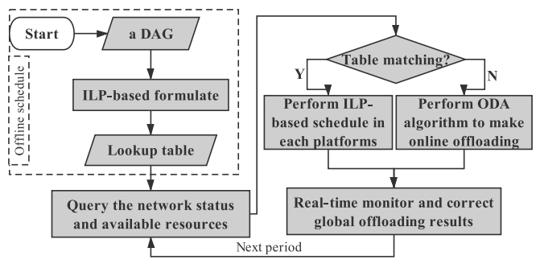
Autonomous Vehicles
Offloading autonomous driving via edge computing
Key characteristics
Three-layer OBU–Edge–Cloud architecture for offloading autonomous-driving computation tasks.
Models autonomous-driving services as DAG-based dependent tasks with execution deadlines and communication dependencies.
Uses offline ILP optimization to find an optimal task partitioning, allocation, and scheduling strategy.
Uses point-cloud compression to reduce communication overhead for LiDAR data transmission.
Overview of offloading autonomous driving services via edge computing (source)
Real deployment reports about 34% lower localization latency compared with OBU-only execution.
Mingyue Cui et al. “Offloading autonomous driving services via edge computing”. In: IEEE Internet of Things Journal 7. 10 (2020), pp. 10535–10547.

Slide 18
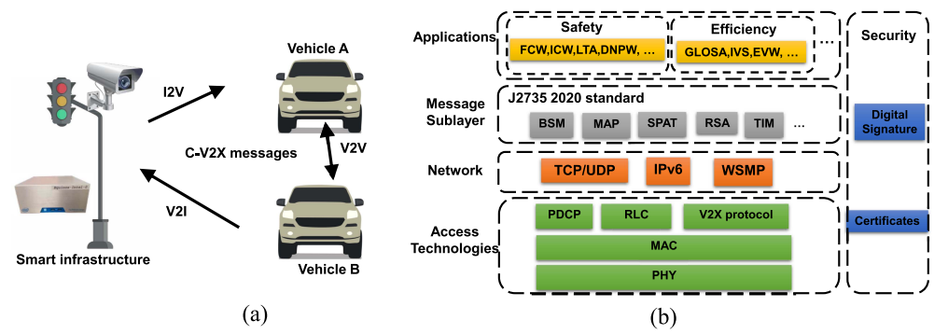
Autonomous Vehicles
C-V2X-enabled collaborative driving framework (CCAD)
Achieves about 15.5 ms C-V2X message latency and approximately 98.8 ms end-to-end latency in the collaborative lane-keeping case study.
CCAD framework overview. (a) C-V2X enabled a collaborative relationship between smart infrastructure and Autonomous vehicles. (b) C-V2X network stack for CCAD applications.(source)
Key characteristics
CCAD that connects vehicles and roadside infrastructure to overcome the limited sensing range of single vehicles.
Relies on standardized C-V2X messages such as BSM, MAP, SPAT, TIM, and PVD instead of transmitting raw sensor data, reducing bandwidth requirements
Y He et al. “Towards C-V2X enabled collaborative autonomous driving”. In: IEEE Transactions on Vehicular Technology 72. 12 (2023), pp. 15450–15462. DOI: 10.1109/ TVT.2023.3299844.

Slide 19
Autonomous Vehicles: Challenges
Computational overhead
Privacy & security
Onboard compute can’t handle data-intensive services alone.
Protect data in a dynamic vehicular environment.
Sensor data volume
Energy & network
Fuse huge streams from cameras, radar & LiDAR.
Resource allocation, energy use & network stability.

Slide 20
Summary
IoT — lower latency with improved efficiency and security.
Retail — personalized services and smarter inventory management.
Autonomous vehicles — real-time decision-making at the edge.

Slide 21
Practice
1
What are the primary challenges of implementing edge computing in autonomous vehicles, and how are they addressed?
2
What are the key benefits of edge computing for IoT ecosystems, particularly in terms of latency and data security?

Slide 22
Project
Create a simulation model to compare the performance of edge computing vs. cloud computing in processing IoT data for autonomous vehicles.
What you’ll do
What to measure
1
Model the scenario AVs generating sensor streams; define edge nodes (roadside units) vs. a cloud datacenter.
Latency End-to-end delay for a driving decision.
2
Implement both paths Route the same workloads through an edge pipeline and a cloud-only pipeline.
Bandwidth Data volume pushed upstream in each design.
3
Vary the conditions Sweep data volume, network latency & task complexity.
Throughput Tasks handled per second under load.
4
Compare results Measure latency, throughput, bandwidth & reliability side by side.
Reliability Behavior as the network degrades.
Example: in CloudSim/iFogSim, feed LiDAR frames through roadside-unit edge nodes vs. cloud-only; expect edge to win on latency as network delay grows.

Slide 23
References
Gopika Premsankar, Mario Di Francesco, and Tarik Taleb. “Edge computing for the Internet of Things: A case study”. In: IEEE Internet of Things Journal 5. 2 (2018), pp. 1275–1284.
Tie Qiu et al. “Edge computing in Industrial Internet of Things: Architecture, advances and challenges”. In: IEEE Communications Surveys & Tutorials 22. 4 (2020), pp. 2462–2488.
J Lin et al. “An edge computing based public vehicle system for smart transportation”. In: IEEE Transactions on Vehicular Technology 69. 11 (2020), pp. 12635–12651. DOI: 10.1109/ TVT.2020.3028497.
Pawani Porambage et al. “Survey on multi-access edge computing for Internet of Things realization”. In: IEEE Communications Surveys & Tutorials 20. 4 (2018), pp. 2961–2991.
Charith Perera et al. “Fog computing for sustainable smart cities: A survey”. In: ACM Computing Surveys (CSUR) 50. 3 (2017), pp. 1–43.
M Saravanan and N C Srinidhi Srivatsan. “Intelligent communication between IoT devices on edges in retail sector”. In: Advances in Information and Communication Networks: Proceedings of the 2018 Future of Information and Communication Conference (FICC), Vol. 2. Springer, 2019, pp. 546–562.
Shaoshan Liu et al. “Edge computing for autonomous driving: Opportunities and challenges”. In: Proceedings of the IEEE 107. 8 (2019), pp. 1697–1716.
Qingyang Zhang et al. “OpenVDAP: An open vehicular data analytics platform for CAVs”. In: 2018 IEEE 38th International Conference on Distributed Computing Systems (ICDCS). IEEE, 2018, pp. 1310–1320.
S Tang et al. “VECFrame: A vehicular edge computing framework for connected autonomous vehicles”. In: 2021 IEEE International Conference on Edge Computing (EDGE). 2021, pp. 68–77. DOI: 10.1109/EDGE53862.2021.00019.
Sidi Lu, Yongtao Yao, and Weisong Shi. “Collaborative learning on the edges: A case study on connected vehicles”. In: 2nd USENIX Workshop on Hot Topics in Edge Computing (HotEdge 19), 2019.
Mingyue Cui et al. “Offloading autonomous driving services via edge computing”. In: IEEE Internet of Things Journal 7. 10 (2020), pp. 10535–10547.
B Wu et al. “To turn or not to turn, safecross is the answer”. In: 2022 IEEE 42nd International Conference on Distributed Computing Systems (ICDCS). 2022, pp. 414–424. DOI: 10.1109/ ICDCS54860.2022.00047.
Y He et al. “Towards C-V2X enabled collaborative autonomous driving”. In: IEEE Transactions on Vehicular Technology 72. 12 (2023), pp. 15450–15462. DOI: 10.1109/ TVT.2023.3299844.

