Slide 1
Privacy & Bias in Edge Computing
Chapter 8

Slide 2
Outline
Privacy concerns & forms
Bias types & causes
New edge privacy risks
Data, location, identity privacy
13 forms of bias
Where bias comes from
Privacy techniques
Bias mitigation
Anonymization & k-anonymity
Differential privacy, HE, FL
Pre / in / post-processing
Open research problems
Summary & Practice

Slide 3







Privacy in Edge Computing
Privacy concerns at the edge
Outsourcing data to third-party edge services splits data ownership from control — raising seven distinct concerns across the cloud/edge/device layers.
Distributed storage
Retained identifiers
Honest-but-curious
Predictable locations
Data split across nodes complicates integrity & invites leakage.
Untrusted operators may keep user-identifiable data after service ends.
Authorized entities exploit their access to harvest sensitive data.
Bringing compute closer makes user location easier to infer.
Decentralized admin
Transmission risk
Uncontrollable sharing
Dispersed devices resist central control — easier to attack.
Raw texts & images can leak while moving between layers.
Once data leaves, the owner loses say over how it’s shared.

Slide 4
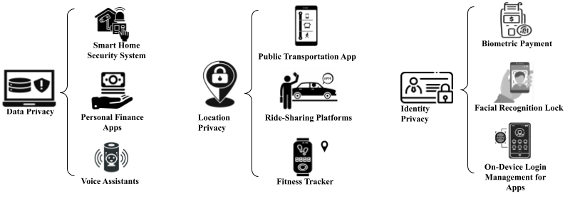


Privacy in Edge Computing
Three forms of privacy
Privacy forms: data, location and identity privacy.
Data privacy
Location privacy
Identity privacy
Protect sensitive data stored, processed or moved across edge servers & devices — smart homes, finance apps, voice assistants.
Curious servers infer location from connection points; movement patterns leak — transit, ride-share, fitness apps.
Protect identity in verification (knowledge, possession, biometric, PUF); a cloned identity exposes all linked data.

Slide 5


Privacy-Preserving Techniques
Data anonymization
Remove or obscure any information that can directly or indirectly identify someone — before data is published. Three core operations:
Data masking
Generalization
Suppression
Change characters in an attribute via shuffling, substitution or encryption.
Replace specific values with consistent ranges to reduce identifiability.
Remove an entire column or tuple when it can’t otherwise be anonymized.
e.g. John.Doe123@example.com → Zzzz.Zzz111@zxxxxzz.zzz
e.g. John Smith, 29, $50,000 → Person 1, 20–30, $50–60k
e.g. Sensitive value → ****

Slide 6
Privacy-Preserving Techniques
K-ANONYMITY: Making each record one-of-k
k-anonymity ensures each record is indistinguishable from at least k–1 others, so no one is identifiable with probability > 1/k. It combines suppression + generalization; the challenge is balancing utility vs. privacy.
Original dataset
Anonymized (2-anonymity)
Name
Age
Gender
Zip
Disease
Name
Age
Gender
Zip
Disease
Dana
24
F
45011
Diabetes
Suppressed
20–25
F
450**
Diabetes
John
30
M
45012
None
Suppressed
26–31
M
450**
None
Jack
28
M
45013
Asthma
2-anonymity
Suppressed
26–31
M
450**
Asthma
Alex
26
M
45014
Hypertension
Suppressed
26–31
M
450**
Hypertension
Chloe
27
F
45015
None
Suppressed
26–31
F
450**
None
Fiona
29
F
45016
Diabetes
Suppressed
26–31
F
450**
Diabetes
Suppressed
20–24
F
450**
Diabetes

Slide 7




Privacy-Preserving Techniques
Differential privacy: Privacy by adding noise
ε-differential privacy. A provably secure method: the output barely changes whether or not any single record is present, so it resists membership-inference attacks — without relying on assumptions about the attacker’s knowledge.
Privacy budget ε
Global sensitivity
Controls how much noise is added — smaller ε means stronger privacy, less utility.
The largest change in a query’s output between two neighboring datasets.
Noise addition
Laplacian mechanism
Random noise proportional to sensitivity (not dataset size) hides individuals.
Adds Laplace-distributed noise; a Gaussian variant gives (ε,δ)-DP.
Edge use: end devices perturb location data (Voronoi cells + local DP) before sending to the nearest edge node — obscuring exact positions while keeping statistical utility.

Slide 8
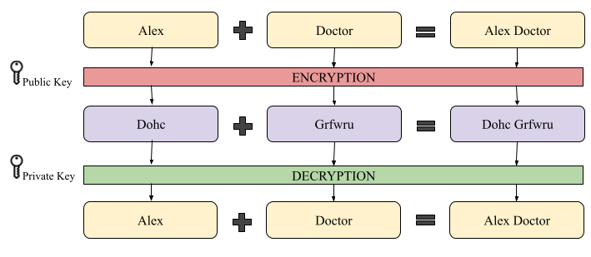


Privacy-Preserving Techniques
Homomorphic Encryption: Computing on encrypted data
Edge use case
Devices encrypt sensitive data locally → the edge server runs heavy computation on the ciphertext → results return to the device, which decrypts them. The server’s power is used without ever exposing plaintext.
Operations on ciphertext (Alex+Doctor) decrypt to the correct plaintext result.
The caveat
The idea.
Additions & multiplications on ciphertext reflect directly on the underlying plaintext — so a third party can process data it can never read. E(m₁)·E(m₂) = E(m₁·m₂).
Homomorphic encryption is computationally heavy and incurs significant latency — often impractical for real-time edge applications.

Slide 9
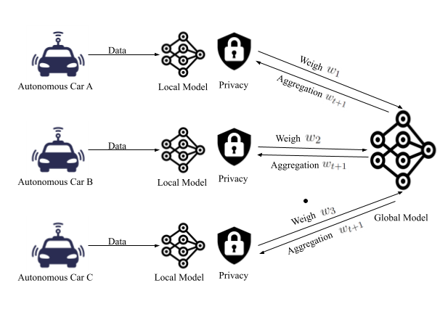



Privacy-Preserving Techniques
Learn together, keep data local
How it works.
A global model lives on an aggregator (e.g. an MEC server). Each node trains locally and sends weight updates the server aggregates them and returns the new global model — repeating until convergence.
Privacy preserved Only parameters are exchanged — raw source data never leaves the device.
AV example Autonomous vehicles fuse GPS, LiDAR & camera data into a shared global model.
Benefits & cost Cuts communication cost, boosts scalability — but needs capable on-device compute.
Federated learning: local models train on-device; only weights are aggregated into a global model.
Swapnil Sadashiv Shinde et al. “On the design of federated learning in latency and energy constrained computation offloading operations in vehicular edge computing systems”. In: IEEE Transactions on Vehicular Technology 71. 2 (2021), pp. 2041–2057.

Slide 10


Privacy-Preserving Techniques
Privacy: Open research problems
FL efficiency
DP for data streams
Lightweight HE
Balance computational cost against privacy for resource-limited edge nodes.
Apply differential privacy to continuous, real-time edge data flows.
Develop homomorphic encryption light enough for constrained devices.
AI-driven anonymization
Security–privacy–trust
Legal & ethical
Use transformers & LLMs to anonymize data without losing utility.
Balance the three across multiple untrusted or semi-trusted parties.
Build legal frameworks that ensure compliance and protect user rights.

Slide 11




Bias in Edge Computing
Bias & the machine learning lifecycle
Bias can enter at every stage
A deviation from a normative standard
Data collection Skewed or low-quality sources.
Bias covers behaviors like gender or racial bias that can harm groups defined by sensitive attributes even with no malicious intent.
At the edge, heterogeneous sensing and conditions break the assumption that local data is independent & identically distributed (IID) — producing biased global models, unfair decisions, and unreliable performance.
Data preparation Labeling, cleaning & sampling choices.
Modeling Objective favors the majority group.
Evaluation Tested on unrepresentative data.
Deployment Used in a different context than trained.

Slide 12

Bias in Edge Computing
Types of bias
Data bias
Algorithmic bias
Statistical bias
Variability & prejudice from uneven source quality.
Algorithm adds or amplifies bias not in the data.
Output deviates from the true estimate.
Sampling bias
Social bias
Historical bias
Nonrandom sampling of subgroups misgeneralizes.
External behavior skews human judgment.
Past societal bias baked into training data.
Representation bias
Training data under-represents some segments.

Slide 13
Bias in Edge Computing
Types of bias
Group bias
Attribute bias
Structural bias
FL performance differs across sensitive-attribute groups (urban vs. rural).
Attribute distributions diverge after network propagation.
Network structure amplifies group differences (job ads by race).
Measurement bias
Evaluation bias
Population bias
Feature selection/measurement skews (self-reported exercise).
Model judged on unrepresentative evaluation data.
User population differs from the intended target population.

Slide 14
Bias in Edge Computing
Causes of biases
Biased datasets
Error-minimizing algorithms
Biased device measurements, historical human decisions, erroneous reports.
Minimizing aggregate error favors majority over minority groups.
Homophily of attributes
Data quality gaps
Race, gender, nationality directly influence predictions.
Missing values, small samples, misclassification & distribution bias.
On-device constraints
Edge bias (FL)
Limited memory, compute & energy propagate bias through design choices.
Each edge overfits its data; closed-world assumption skews the global model.

Slide 15
Bias in Edge Computing
Impact of biases: How bias hits edge algorithms
Edge-cloud computing and FL scale up tasks like object detection — but they are not immune to bias, which degrades their performance in specific ways.
Data class disparity
Heterogeneous generation
Imbalanced labels & biased ground truth cause inaccurate object detection across cooperating devices.
Vehicles, sensors & apps generate data differently; environment adds inconsistency.
Accumulated bias
FL global bias
Distribution shifts during dynamic collection/scheduling — critical in disaster response.
Unreliable wireless biases the model toward well-connected devices, drifting from optimal.

Slide 16



Bias Mitigation
Pre-, In-, and Post-processing
Preprocessing
In-processing
Postprocessing
Fix the data before training
Enforce fairness during training
Adjust the outputs after training
Reweighing — weight groups/outcomes
Suppression — drop sensitive attributes
Massaging — relabel to reduce bias
Multiple imputations — fill missing values
Fairness constraints in the objective
Regularization / fairness regularizer
Bias-aware algorithm choice
Adversarial debiasing; fair representation
Modify predictions for fairness
Balance group & individual fairness
Mind the accuracy–fairness trade-off
Apply fairness performance metrics

Slide 17


Bias Mitigation
Preprocessing
Representative reweighing formulation
Reweighing
Suppression
Assign higher or lower importance to group–outcome combinations to balance representation.
Remove sensitive attributes or selected fields so the model cannot directly use them.
A = sensitive attribute, Y = class label. Underrepresented (A,Y) combinations receive larger weights.
Massaging
Multiple Imputation
Key idea: Improve fairness before training by changing the data distribution—not the learning algorithm.
Modify selected training labels to reduce discrimination before fitting the model.
Estimate missing values to reduce skew caused by incomplete data.
Biased Data
Pre-process
Fairer Training Data
Model

Slide 18

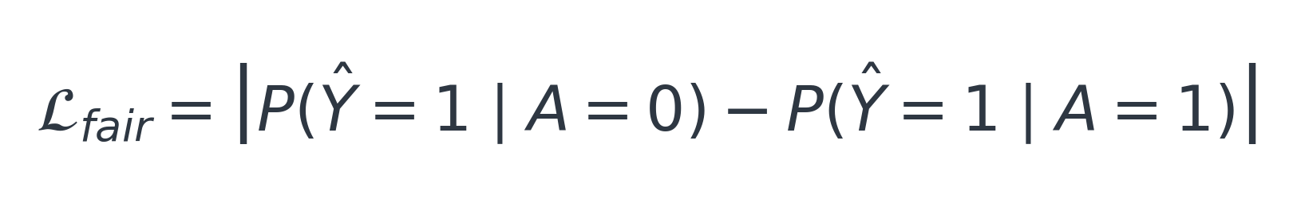
Bias Mitigation
In-processing
Fairness Constraints
Regularization
Fairness-aware objective
Add explicit fairness requirements to the optimization objective.
Penalize discriminatory behavior while optimizing predictive performance.
λ controls the trade-off between predictive accuracy and fairness.
Algorithm Choice
Adversarial Debiasing
Example fairness penalty: demographic parity gap
Prefer learning algorithms that are less likely to amplify existing bias.
Train an adversary to infer the sensitive attribute, then make inference harder.
Fair Representation Learning
Learn internal representations that preserve task-relevant information while reducing dependence on sensitive attributes.
Smaller gap ⇒ more similar positive prediction rates across protected groups.
Training Data
Fairness-aware Learning
Fair Model

Slide 19


Bias Mitigation
Post-processing
Output Adjustment
Group Thresholds
Group-specific decision threshold
Change decisions after the model produces scores or predictions.
Apply group-specific thresholds or decision rules to reduce disparities.
t_{A} is the decision threshold selected for protected group A.
Fairness Targets
Accuracy Trade-off
Example target: equal opportunity
Optimize for group fairness, individual fairness, or a combination of both.
Greater fairness may reduce predictive accuracy.
Reduce the true-positive-rate gap between protected groups.
Training model
Prediction Score
Fairness Adjustment
Final Decision

Slide 20

Bias: Open Research Problems
Multimodal data
Novel metrics
Generative models
Mitigating bias across combined text, image & sensor modalities.
New evaluation metrics that actually capture bias.
Detecting & reducing bias in generative AI.
Interpretability
Dynamic environments
Making models’ bias understandable & explainable.
Achieving fairness as data & conditions shift over time.

Slide 21
Summary
Privacy at the edge remains important despite local processing because distributed systems introduce new risks.
Data, location, and identity privacy are the key forms of privacy that require protection.
Privacy-preserving techniques include anonymization, k-anonymity, differential privacy, homomorphic encryption, and federated learning.
Bias can occur throughout the ML lifecycle, affecting data, algorithms, evaluation, and populations.
Edge algorithms are vulnerable to bias due to class imbalance, heterogeneous data, and unreliable connectivity in federated learning.
Bias mitigation can be applied through preprocessing, in-processing, and postprocessing techniques.
Open challenges include lightweight privacy methods, streaming differential privacy, multimodal bias, and fairness in dynamic environments.

Slide 22
Practice
1
Identify the key factors that contribute to biases in AI models deployed on edge devices and discuss how these biases might manifest in real-world applications.
2
Discuss the potential privacy concerns associated with collecting and processing data at the edge
3
Analyze how biases in edge computing algorithms can impact different user groups, and outline steps to mitigate these biases.
4
Examine the legal measures necessary to ensure privacy protection in edge computing.
5
Discuss the technical challenges of implementing privacy-preserving techniques such as differential privacy and federated learning on edge devices, and how do these challenges affect privacy and bias.

Slide 23




Project
Implement and evaluate a bias mitigation algorithm.
Goal. Take a dataset used by an edge application, measure the bias in a trained model, then implement a mitigation technique and evaluate how fairness and accuracy change.
What you’ll do
What to measure
1
Assess the dataset Identify sensitive attributes & measure class/label imbalance.
Group fairness Performance gap across sensitive-attribute groups.
2
Train a baseline Build a model and record accuracy plus fairness metrics per group.
Individual fairness Similar individuals get similar outcomes.
3
Apply mitigation Add a pre-, in-, or post-processing method (e.g. reweighing, adversarial debiasing).
Accuracy Overall predictive performance after mitigation.
4
Compare Re-measure fairness vs. accuracy; quantify the trade-off.
Trade-off How much accuracy was traded for fairness.
Example: on a health dataset skewed by age, apply reweighing + adversarial debiasing; report the fairness gain and the accuracy cost. (Other options: privacy-preserving app, blockchain for privacy/bias, AI-audit framework.)

Slide 24
References
Swapnil Sadashiv Shinde et al. “On the design of federated learning in latency and energy constrained computation offloading operations in vehicular edge computing systems”. In: IEEE Transactions on Vehicular Technology 71. 2 (2021), pp. 2041–2057.
Abdulmalik Alwarafy et al. “A survey on security and privacy issues in edge-computingassisted Internet of Things”. In: IEEE Internet of Things Journal 8. 6 (2020), pp. 4004–4022.
Priyank Jain, Manasi Gyanchandani, and Nilay Khare. “Big data privacy: A technological perspective and review”. In: Journal of Big Data 3 (2016), pp. 1–25.
Frank Stinar, Zihan Xiong, and Nigel Bosch. “An approach to improve k-anonymization practices in educational data mining”. In: Journal of Educational Data Mining 16. 1 (2024), pp. 61–83.
Le Wu et al. “Learning fair representations for recommendation: A graph-based perspective”. In: Proceedings of the Web Conference 2021. 2021, pp. 2198–2208.

