Slide 1
Future Trends & Emerging Technologies
Chapter 6

Slide 2
Outline
New Paradigms
6G and Edge
Sky computing
Computing power network
Meta computing
Future direction: cross-domain collaboration
Basic characteristics of 6G
Mutual influence of 6G and edge computing
Network slicing and reconfigurable intelligent surfaces
Resource sharing, offloading, applications, and challenges
Integration with AI
Bias mitigation
Why edge computing is needed for LLMs
Training and distributed edge learning
Inference, model splitting, and model caching
Generative AI, applications, and challenges
Edge computing concepts and Open research problems
Typical OEC architectures and Kodan
Collaborative computing, applications, and challenges
Summary & Practice

Slide 3


New Paradigms
Why new paradigms
Limitations of today’s edge
Emerging response
Long-term direction
Resources often remain isolated within one provider.
Cloud platforms may use different architectures and APIs.
Cross-domain trust and security are difficult.
Computing power is distributed across cloud, edge, and device layers.
Sky computing connects heterogeneous clouds.
Computing power networks pool cloud + edge capacity.
Meta computing targets cross-provider collaboration with security.
Sky computing connects heterogeneous clouds.
Computing power networks pool cloud + edge capacity.
Meta computing targets cross-provider collaboration with security.

Slide 4


Sky Computing
Cross-cloud collaboration
Compatibility layer
Intercloud layer
Core idea. Treat multiple cloud providers as one programmable “sky,” reducing provider-specific barriers and enabling applications to move across clouds.
Masks differences in cloud APIs.
Uses common interfaces for storage, networking, and runtime.
Simplifies multi-cloud application development.
Accepts applications and policies.
Selects a cloud based on cost, location, capacity, or time.
Coordinates execution across providers.
Tiemo Bang et al. “SkyPIE: A fast & accurate oracle for object placement”. In: Proceedings of the ACM on Management of Data 2. 1 (2024), pp. 55:1–55:27. DOI: 10.1145/3639310.
Ion Stoica and Scott Shenker. “From cloud computing to sky computing”. In: HotOS '21: Workshop on Hot Topics in Operating Systems, Ann Arbor, Michigan, USA, June, 1–3, 2021. Ed. by Sebastian Angel, Baris Kasikci, and Eddie Kohler. ACM, 2021, pp. 26–32. DOI: 10.1145/3458336.3465301.

Slide 5
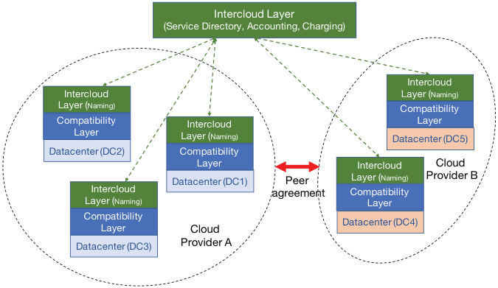
Sky Computing
Cross-cloud collaboration
Key takeaways
Multi-cloud should appear as one coherent service
Internet interoperability motivates the architecture.
Three layers — compatibility, intercloud, and peering.
Reciprocal peering is the key proposed enabler
Sky computing architecture
Ion Stoica and Scott Shenker. “From cloud computing to sky computing”. In: HotOS '21: Workshop on Hot Topics in Operating Systems, Ann Arbor, Michigan, USA, June, 1–3, 2021. Ed. by Sebastian Angel, Baris Kasikci, and Eddie Kohler. ACM, 2021, pp. 26–32. DOI: 10.1145/3458336.3465301.

Slide 6



Computing Power Network (CPN)
Compute as a networked utility
Goal
Evolution
Relation to edge
Package distributed computational power and deliver it where users need it—analogous to electricity flowing through a power grid.
Single data center execution
Scheduling across homogeneous centers
Heterogeneous data-center selection
Coordinated execution across heterogeneous resources
Pools resources across cloud, edge, and device layers.
Supports unified scheduling and resource access.
Still early: full network-wide integration remains an open research problem.

Slide 7
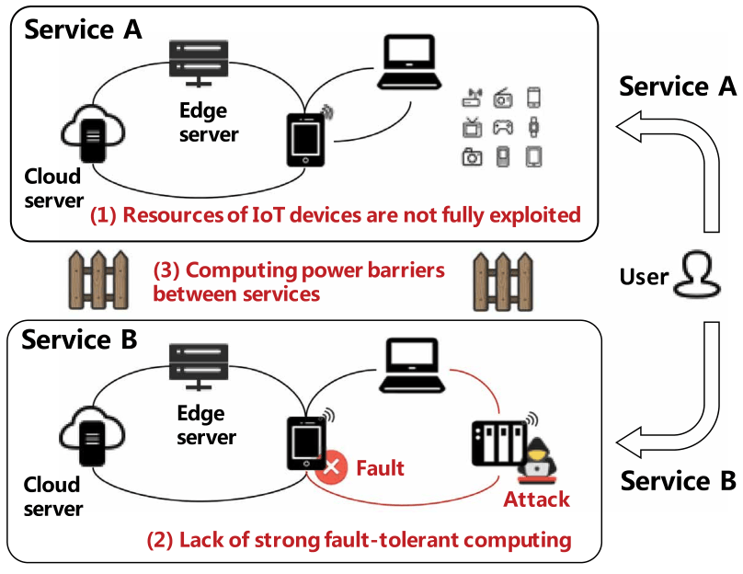
Meta Computing
Cross-domain collaboration
Provider barriers
Underused resources
Nodes across service providers do not automatically interoperate.
Different management and trust domains block collaboration.
IoT and edge resources may be fragmented or idle.
Limited-service capability when each provider acts alone.
Security & resilience
Problems of existing computing paradigms
Cross-provider computation introduces identity, access, settlement, and fault-tolerance challenges.
Meta computing aims for “network-as-a-computer.”
Xiuzhen Cheng et al. “Meta computing”. In: IEEE Network 38. 2 (2024), pp. 225–231. ISSN: 1558-156X. DOI: 10.1109/MNET003.2300092.

Slide 8
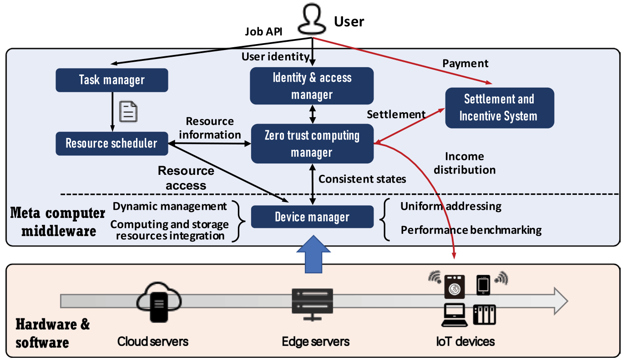
Meta Computing
Zero-trust computing manager
Cross-domain collaboration
Identity and access management for users and devices
Resource scheduling and task management
Distributed ledger for state consistency
Settlement and incentive mechanisms
Device manager
Uniformly addresses cloud servers, edge servers, and IoT devices
Maintains resource and performance information
Supports dynamic management across heterogeneous resources
Problems of existing computing paradigms
Xiuzhen Cheng et al. “Meta computing”. In: IEEE Network 38. 2 (2024), pp. 225–231. ISSN: 1558-156X. DOI: 10.1109/MNET003.2300092.

Slide 9
Comparison
How the new paradigms extend edge computing
Name | Features | Relationship to edge computing
Sky computing | Cross-cloud collaboration | Cloud extensions
Computing power network | Data center and edge integration | Cloud and edge extensions
Meta computing | Cross-service provider collaboration | Cross-domain security extensions
Shared direction: heterogeneous, cross-provider collaboration across the complete device–edge–cloud computing path.

Slide 10
Future Direction: Cross-Domain Edge Collaboration
Research agenda
Interoperability
Trust
Scheduling
Unified path
Common abstractions and APIs across providers, clouds, edge platforms, and devices.
Identity verification, access management, security, and settlement across service providers.
Coordinate heterogeneous resources according to application requirements and available computing capacity.
Coordinate heterogeneous resources according to application requirements and available computing capacity.

Slide 11
Integration with Artificial Intelligence
Why Need Edge Computing
Name | R & D team | Parameter scale
GPT-1 | OpenAI | 0.11 B
GPT-3 | OpenAI | 175 B
GPT-4 | OpenAI | 1.8 T
Sora | OpenAI | 7 B
Gemini 1.5 pro | Google | 175 B
Gemma-2B (opensource) | Google | 2 B
Gemma-7B (opensource) | Google | 7 B
StableDiffusion | Qualcomm | 65 B
Llama (opernsource) | Meta | 7-65 B
ChatGLM (opensource) | Tsinghua University | 6-130 B
Hunyuan | Tencent | 100 B
ERNIE Bot | Baidu | 260 B
Model parameter scales

Slide 12
Integration with Artificial Intelligence
Why Need Edge Computing
Resource limits
Heterogeneity
Privacy & responsiveness
Many IoT endpoints cannot host large models.
Memory, compute, and energy constraints remain severe.
On-device execution may require aggressive compression.
Devices differ in accelerators, memory, network quality, and latency needs.
A fixed deployment strategy cannot fit every endpoint.
Keeping raw data local reduces exposure.
Nearby edge resources can provide low-latency assistance when the endpoint is insufficient.

Slide 13
Training and Fine-Tuning with Edge Computing
Centralized vs Distributed
Centralized edge learning
Federated edge learning
Split learning
Devices upload data to an edge server.
Training happens on distributed edge GPUs or nearby infrastructure.
Practical only where substantial edge compute is available.
Participants train local copies of the model.
Model parameters/updates are exchanged.
Privacy improves, but communication can be heavy for LLM-scale models.
The model is divided into smaller submodels.
Devices train only part of the network.
The full model is coordinated across device, edge, and cloud.
Deepak Narayanan et al. “Efficient large-scale language model training on GPU clusters using megatron-LM”. In: Proceedings of the International Conference for High Performance Computing, Networking, Storage and Analysis. SC '21. New York, NY, USA: Association for Computing Machinery, Nov. 2021, pp. 1–15. ISBN: 978-1-4503-8442-1. DOI: 10.1145/ 3458817.3476209.
Guanqun Wang et al. “Cloud-device collaborative learning for multimodal large language models”. In: Proceedings of the IEEE/CVF Conference on Computer Vision and Pattern Recognition. 2024, pp. 12646–12655.

Slide 14
Federated Learning vs. Split Learning for LLMs
Trade-off
Federated Learning
Split Learning
Each participant trains the full model or a local replica.
Communication is dominated by model updates.
Simple conceptual boundary: data stays local, parameters move.
Different devices execute/train different model partitions.
Different devices focus on training specific model subparts, which are ultimately integrated into a complete model.
The chapter identifies split learning as a potentially more viable paradigm for large models on resource-constrained devices.
For LLM-scale edge learning, partitioning the model can be more realistic than asking every endpoint to host the entire model.
Zheng Lin et al. “Efficient parallel split learning over resource-constrained wireless edge networks”. In: IEEE Transactions on Mobile Computing (2024), pp. 1–16. ISSN: 1558-0660. DOI: 10.1109/TMC.2024.3359040.
Guanqun Wang et al. “Cloud-device collaborative learning for multimodal large language models”. In: Proceedings of the IEEE/CVF Conference on Computer Vision and Pattern Recognition. 2024, pp. 12646–12655.

Slide 15
Efficient LLM Inference at the Edge
Reduce compute + communication
Compression
Speculative decoding
Early exit
Token / feature reduction
Pruning
Quantization
Knowledge distillation
A smaller model first produces a result on the edge device.
Data can then be sent to edge/cloud services to execute the complete large model.
Tabi uses calibrated confidence scores to decide whether a query should be rerouted to the LLM.
Execute only part of the model instead of the entire model when early exiting is possible.
This can reduce inference cost and latency.
Compress intermediate representations.
Reduce transmission cost in split inference.
Qingqing Cao et al. BTR: Binary Token Representations for Efficient Retrieval Augmented Language Models. May 2024. DOI: 10.48550/arXiv.2310.01329. arXiv: 2310.01329 [cs].
Yanxi Chen et al. EE-LLM: Large-Scale Training and Inference of Early-Exit Large Language Models with 3D Parallelism. June 2024. DOI: 10.48550/arXiv.2312.04916. arXiv: 2312.04916 [cs].
Yiding Wang et al. “Tabi: An efficient multi-level inference system for large language models”. In: Proceedings of the 18th European Conference on Computer Systems. EuroSys '23. New York, NY, USA: Association for Computing Machinery, May 2023, pp. 233–248. ISBN: 978-1-4503-9487-1

Slide 16
Split LLM Inference Across Device and Edge
Model partitioning
Device
Early layers process private raw input locally
Compressed activations
Transmit intermediate features instead of raw data
Edge/Cloud
Later layers complete computationally intensive inference
Potential benefit
Main challenge
Less endpoint compute and less exposure of raw private data.
Partition point, feature size, bandwidth, and edge-server load must be optimized jointly.

Slide 17
Model Caching at the Edge
Reuse shared model components
Why caching helps
Where it helps
Example
Fine-tuned large models can share identical submodels. Caching those shared submodels at the edge can reduce memory overhead for learning and inference.
Split learning
Split inference
Distributed edge learning
Batch processing to accelerate inference
TrimCaching explores parameter-sharing edge caching for AI model downloading—a useful building block for collaborative inference
Guanqiao Qu et al. TrimCaching: Parameter-sharing Edge Caching for AI Model Downloading. arXiv:2404.14204 [cs]. May 2024. DOI: 10.48550/arXiv.2404.14204.

Slide 18
Generative AI at the Edge
Why local generation matters
Real-time decisions
Lower bandwidth
Model optimization
Generate or reason locally for autonomous systems and interactive applications.
Process video, audio, and sensor data locally instead of streaming everything to the cloud.
Compression makes generative models more feasible on smartphones and IoT devices.
Hybrid architecture
Lightweight edge processing + offload of heavy generation to nearby servers or cloud.
Guanqiao Qu et al. TrimCaching: Parameter-sharing Edge Caching for AI Model Downloading. arXiv:2404.14204 [cs]. May 2024. DOI: 10.48550/arXiv.2404.14204.

Slide 19
AI Applications and Open Challenges
From capability to trust
Applications
Explainability
Verifiability + trimmability
Robots and multi-robot planning
Autonomous driving and in-vehicle assistants
Industrial design and domain assistants
How can LLMs remain explainable, especially during model splitting and submodel extraction in edge computing?
How can edge execution be verified, and how can selected model modules be trimmed or replaced by smaller models to accelerate inference?
Guanqiao Qu et al. TrimCaching: Parameter-sharing Edge Caching for AI Model Downloading. arXiv:2404.14204 [cs]. May 2024. DOI: 10.48550/arXiv.2404.14204.

Slide 20
6G and Edge
Mutual influence
Edge enables 6G
6G enables edge
Base-station compute for AI-driven wireless optimization
Coordination across multiple base stations
Personalized AI services
Communication, computation, and caching close to users
Higher bandwidth and lower latency for offloading
More flexible resource sharing and mobile edge execution
Integrated sensing and communication
Satellite access integrated into a unified space–ground network

Slide 21
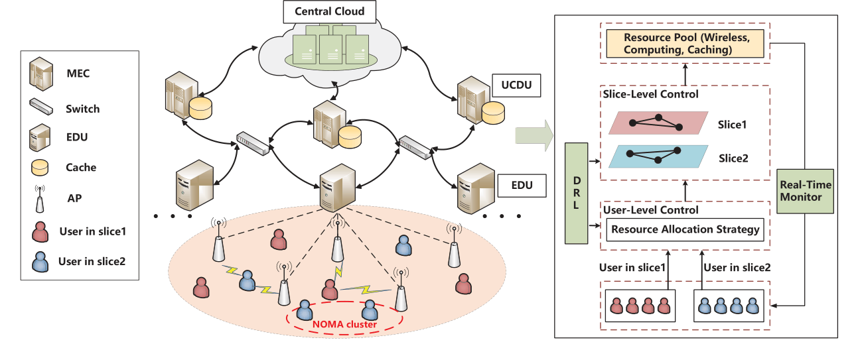
Edge-Enabled Network Slicing for 6G
Why the edge matters
Network slicing
Traffic decisions are most effective near network entry points.
Caching at base stations accelerates data access.
Edge compute supports decentralized control.
Architecture
Jointly allocate communication, computation, and caching resources, combining conventional optimization with multi-agent deep reinforcement learning.
A hierarchical network slicing architecture
Feng Ye et al. “Intelligent hierarchical NOMA-based network slicing in cell-free RAN for 6G systems”. In: IEEE Transactions on Wireless Communications 23. 5 (2023), pp. 4724–4737

Slide 22
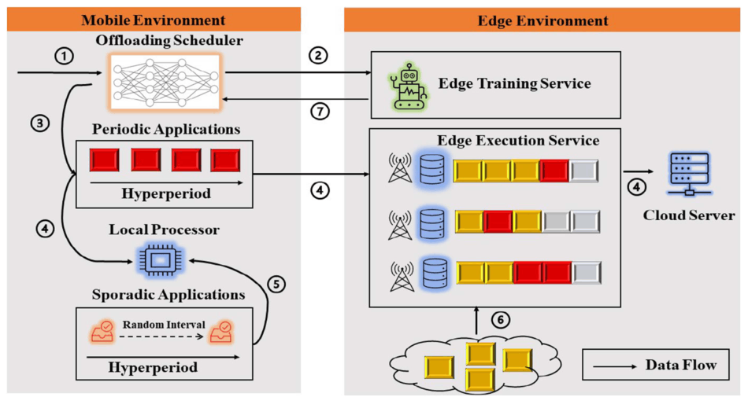
Edge-Enabled Network Slicing for 6G
EdgeGo
Multi-access edge learning-based offloading
Stationary edge servers handle strict real-time tasks.
Mobile edge servers process non-real-time tasks or temporarily augment capacity.
Task offloading and execution are decoupled from one fixed location.
MELO
Reinforcement learning solves real-time offloading/scheduling decisions.
Training can occur on edge servers while inference runs on devices.
Targets real-time task scheduling in 6G-enabled multi-access edge computing.
Architecture of multi-access edge learning-based offloading (MELO). The data that flow in the MEC system include: (1) environment states; (2) training samples; (3) offloading policy; (4) periodic jobs; (5) sporadic jobs; (6) periodic jobs from other mobile devices; and (7) parameters of edge actor network
Hui Huang, Qiang Ye, and Yitong Zhou. “6G-empowered offloading for realtime applications in multi-access edge computing”. In: IEEE Transactions on Network Science and Engineering 10. 3 (2023), pp. 1311–1325. ISSN: 2327-4697. DOI: 10.1109/TNSE.2022.3188921.

Slide 23
6G Applications and Open Challenges
Opportunity
Cloud / edge VR
Sensing + digital twins
Research challenges
High bandwidth plus nearby rendering resources can support richer VR, holographic media, and lighter terminals.
Communication signals can also sense position and motion, enabling factories and other environments to be modeled in real time.
Robust, flexible, and scalable 6G system architecture
Coordination of compute across dense base stations
Privacy for integrated sensing and communication

Slide 24
Edge Computing in Space Exploration
Computation in orbit
Traditional satellite
Orbital edge computing
Why LEO matters
Processes selected data on satellites and can coordinate computation across a constellation before transmitting results to Earth.
Lower latency than higher orbits
Global coverage via constellations
Growing onboard compute capability
Primarily relays signals or sends collected data to Earth. Data processing on orbit is limited, so downlink capacity can become a bottleneck.
OEC advantages and typical architecture
Low latency
Global coverage
Two OEC modes
Satellite constellations can extend computation to regions that lack dense terrestrial cloud or edge infrastructure.
End–edge collaboration: satellite processes sensed data before downlink.
Edge–edge collaboration: satellites share or offload tasks across the constellation.
LEO links can provide low communication latency, especially when services execute on orbit and avoid multiple terrestrial forwarding hops.

Slide 25
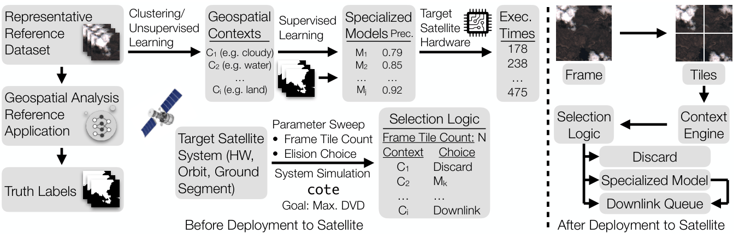
Computing on Satellites
Prelaunch phase
Kodan
Customize models for satellite hardware and mission conditions.
Plan models around processing time, location, and resource limits.
Select what “high-value” data should be retained.
Postlaunch phase
Kodan architecture design
Run onboard models on sensed data.
Transmit only the most valuable or relevant results.
Use scarce downlink bandwidth more effectively.
Bradley Denby et al. “Kodan: Addressing the computational bottleneck in space”. In: Proceedings of the 28th ACM International Conference on Architectural Support for Programming Languages and Operating Systems, Volume 3. ASPLOS 2023. New York, NY, USA: Association for Computing Machinery, Mar. 2023, pp. 392–403. ISBN: 978-1-4503-9918-0.

Slide 26
OEC Collaboration, Applications, and Challenges
Collaborative computing
Applications
Challenges
Decompose user tasks across satellites.
Offload tasks to peer satellites or ground resources.
Optimize energy, communication windows, and execution placement.
Earth observation and remote sensing
AR/VR collaboration with global coverage
Space exploration and distributed in-space processing
Limited research platforms and simulators
Specialized system software / interfaces
Rapidly changing topology and short service windows
Seamless handoff and resource management

Slide 27
Summary
Future edge systems will cross clouds, providers, and administrative domains instead of remaining isolated.
Training, inference, splitting, caching, and generative AI make the edge an active intelligence layer.
Edge compute becomes part of the communications infrastructure, while 6G improves edge mobility and service quality.
OEC moves computation into satellite constellations to reduce downlink pressure and provide global services.

Slide 28
Practice
1
What is the relationship between edge computing and a new distributed computing paradigm, using one as an example?
2
How does edge computing enhance artificial intelligence, particularly large language model technology?
3
What are the main characteristics of 6G, and how do 6G and edge computing technologies influence each other?
4
Discuss the challenges and opportunities of integrating orbital computing technology with edge computing

Slide 29





Project
Deploy large language models, such as Edge-LLM (https://github.com/GATECH-EIC/Edg e-LLM), LlamaEdge (https://github.com/LlamaEdge/LlamaEdge), on heterogeneous hardware and explore the segmentation of specific models at different layers in an edge computing environment, observing the changes in transmission costs and computational costs
What you’ll do
What to measure
1
Deploy an LLM Use Edge-LLM or LlamaEdge as the project model.
Transmission cost Record the transmission cost for each segmentation configuration.
2
Use heterogeneous hardware Run the model in an edge computing environment across different hardware.
Computational cost Record the computational cost for each segmentation configuration.
3
Segment at different layers Explore multiple layer-level segmentation points in the selected model.
Layer-split effect Compare how both costs change when the model is segmented at different layers.
4
Compare configurations Observe how changing the segmentation point changes the project costs.
Hardware comparison Compare the observed costs across the heterogeneous hardware used in the deployment.
Example: Deploy LlamaEdge on heterogeneous hardware, test several layer split points, and report the transmission and computational cost for each configuration.

Slide 30
References
Tiemo Bang et al. “SkyPIE: A fast & accurate oracle for object placement”. In: Proceedings of the ACM on Management of Data 2. 1 (2024), pp. 55:1–55:27. DOI: 10.1145/3639310.
Ion Stoica and Scott Shenker. “From cloud computing to sky computing”. In: HotOS '21: Workshop on Hot Topics in Operating Systems, Ann Arbor, Michigan, USA, June, 1–3, 2021. Ed. by Sebastian Angel, Baris Kasikci, and Eddie Kohler. ACM, 2021, pp. 26–32. DOI: 10.1145/3458336.3465301.
Deepak Narayanan et al. “Efficient large-scale language model training on GPU clusters using megatron-LM”. In: Proceedings of the International Conference for High Performance Computing, Networking, Storage and Analysis. SC '21. New York, NY, USA: Association for Computing Machinery, Nov. 2021, pp. 1–15. ISBN: 978-1-4503-8442-1. DOI: 10.1145/ 3458817.3476209.
Guanqun Wang et al. “Cloud-device collaborative learning for multimodal large language models”. In: Proceedings of the IEEE/CVF Conference on Computer Vision and Pattern Recognition. 2024, pp. 12646–12655.
Qingqing Cao et al. BTR: Binary Token Representations for Efficient Retrieval Augmented Language Models. May 2024. DOI: 10.48550/arXiv.2310.01329. arXiv: 2310.01329 [cs].
Yanxi Chen et al. EE-LLM: Large-Scale Training and Inference of Early-Exit Large Language Models with 3D Parallelism. June 2024. DOI: 10.48550/arXiv.2312.04916. arXiv: 2312.04916 [cs].
Yiding Wang et al. “Tabi: An efficient multi-level inference system for large language models”. In: Proceedings of the 18th European Conference on Computer Systems. EuroSys '23. New York, NY, USA: Association for Computing Machinery, May 2023, pp. 233–248. ISBN: 978-1-4503-9487-1.
Guanqiao Qu et al. TrimCaching: Parameter-sharing Edge Caching for AI Model Downloading. arXiv:2404.14204 [cs]. May 2024. DOI: 10.48550/arXiv.2404.14204.
Feng Ye et al. “Intelligent hierarchical NOMA-based network slicing in cell-free RAN for 6G systems”. In: IEEE Transactions on Wireless Communications 23. 5 (2023), pp. 4724–4737
Hui Huang, Qiang Ye, and Yitong Zhou. “6G-empowered offloading for realtime applications in multi-access edge computing”. In: IEEE Transactions on Network Science and Engineering 10. 3 (2023), pp. 1311–1325. ISSN: 2327-4697. DOI: 10.1109/TNSE.2022.3188921.
Bradley Denby et al. “Kodan: Addressing the computational bottleneck in space”. In: Proceedings of the 28th ACM International Conference on Architectural Support for Programming Languages and Operating Systems, Volume 3. ASPLOS 2023. New York, NY, USA: Association for Computing Machinery, Mar. 2023, pp. 392–403. ISBN: 978-1-4503-9918-0.

