Slide 1
Fundamentals of Edge Computing
Chapter 2

Slide 2
Outline
Distributed Computing
Edge vs Cloud
Middleware, grid, mobile agent
Hadoop/HDFS, MapReduce
Spark, Storm
IaaS / PaaS / SaaS
Edge computing vs cloud computing
Four challenge categories
Basic Concepts & Characteristics
Summary & Practice
Basic concepts
5G/6G
Storage
Lightweight libraries
Edge programming models
Summary
Practice

Slide 3
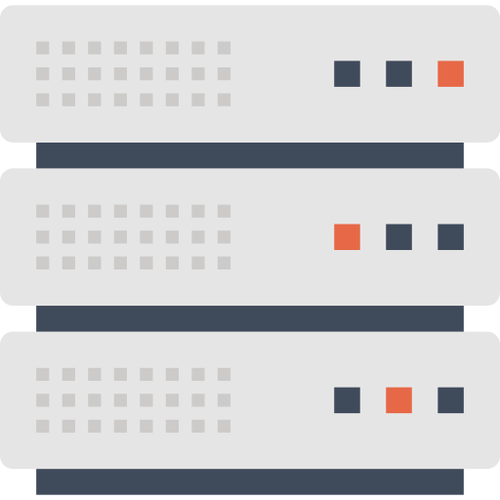
Distributed Computing
Connecting numerous computer nodes via the Internet to break a large task into subtasks distributed across machines. Results are integrated into the final output.
Workstations
Personal Computers
Characteristics
High-performance computation over high-speed networks
Local Area Network
Meets user demand & resource availability
Enables resource sharing among nodes
Wide Area
Network Gateway
File server
Login
Print
An overview of distributed system

Slide 4




Distributed Computing
Connecting numerous computer nodes via the Internet to break a large task into subtasks distributed across machines. Results are integrated into the final output.
Workstations
Personal Computers
Main challenges
Heterogeneity
Scalability
Local Area Network
Fault tolerance
Wide Area
Network Gateway
Concurrency
File server
Login
Print
Edge computing builds on this: it applies distributed-computing principles to process data closer to where it is generated.
An overview of distributed system

Slide 5





Distributed Computing Technologies
Five core technologies underpin distributed computing.
Middleware
Grid Computing
Mobile Agent
Sits between the OS and distributed apps to mask heterogeneity of operating systems and network protocols. Now mostly object-oriented middleware.
Integrates geographically dispersed hardware & software over high-speed networks — e.g. Globus five-layer hourglass, or service-centric OGSA.
Autonomously migrates across heterogeneous networks, locating resources and performing tasks on behalf of clients, spawning subagents as needed.
P2P
Web Service
Links terminal devices and pools idle resources for maximum sharing — open & self-organizing, but faces copyright, management & security issues.
Extends object/component tech over the web. A platform- and language-independent layer so apps on different platforms interoperate.

Slide 6




Distributed System Platforms
Big-data environments drove three widely used platforms
Hadoop
Spark
Storm
Apache framework. Core: HDFS (storage), MapReduce (programming model), HBase (structured table) — the open-source take on Google’s GFS, MapReduce & Bigtable.
UC Berkeley AMP Lab. In-memory computing via Resilient Distributed Datasets (RDDs) — avoids disk I/O between MapReduce steps.
Twitter/X open-source real-time stream processor. Topologies of spouts (read) and bolts (process) arranged in a DAG; multi-language.
Writes intermediate results to disk → slow on iterative jobs
Up to 100× faster than Hadoop, but very memory-intensive
Online ML, real-time analytics, distributed RPC, ETL
Tom White. Hadoop: The definitive guide. O'Reilly Media, Inc., 2012.
Matei Zaharia et al. “Spark: Cluster computing with working sets”. In: 2nd USENIX Workshop on Hot Topics in Cloud Computing (HotCloud 10). 2010.
Apache Software Foundation. Apache Storm. https://storm.apache.org/. Accessed: 2024-07-31.

Slide 7
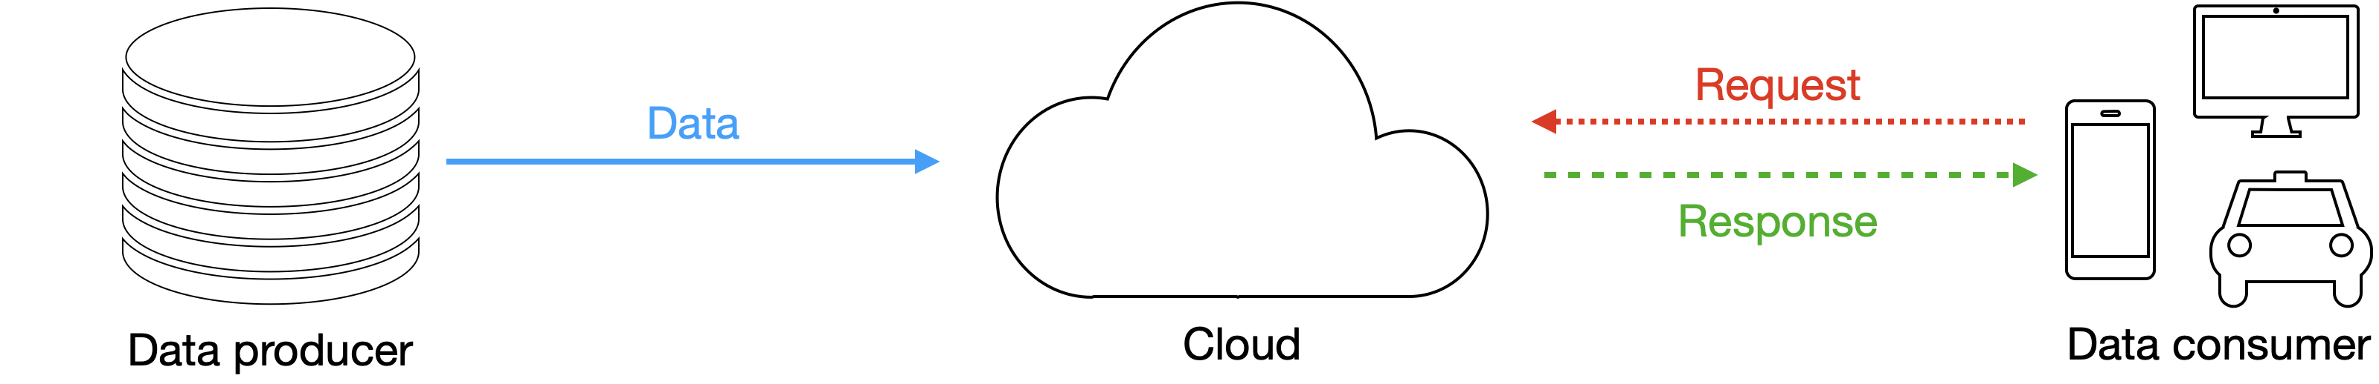


Traditional Cloud Computing Model
In the IoE, source data flows to the cloud and consumers send requests back but this model strains under edge-scale data.
Traditional cloud computing model
Why it falls short in the IoE
Bandwidth overload
Privacy risk
Energy cost
Sending all edge data to the cloud wastes bandwidth & compute
Centralizing data raises protection challenges in IoE
Edge nodes have limited power; GSM/Wi-Fi radios drain a lot

Slide 8
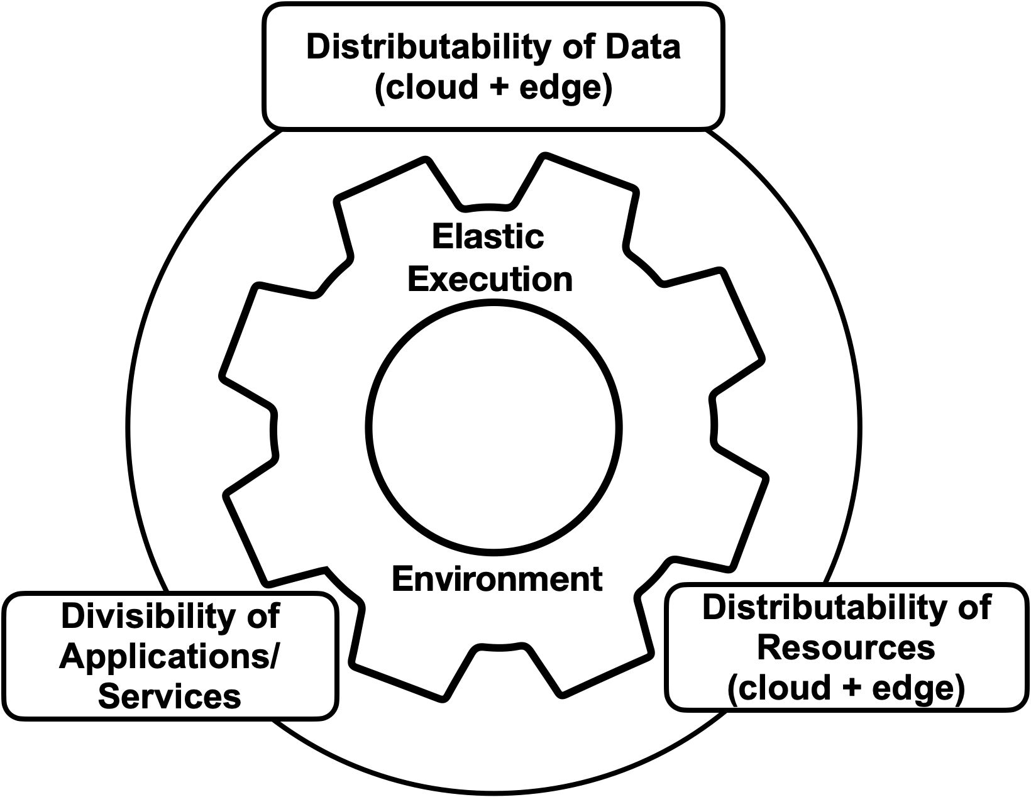


Edge Computing Model
Edge computing runs computation on the network path, on a bidirectional flow: devices are both data producers and consumers.
Three defining requirements
Divisibility of applications/services
Tasks must be decomposable into migratable subtasks that can run at the edge.
Distributability of data
Data must be splittable across sources; without it, the model collapses back to centralized cloud.
Distributability of resources
Compute, storage & communication resources must themselves be distributed to process data at the edge.
Edge computing model characteristics

Slide 9




Key Characteristics
Five technologies make the edge computing model work.
Compute Migration
5G & 6G Communication
Advanced Storage
Minimize data transmitted across the network — preprocess at the edge, allocate tasks by current load, balance energy vs latency vs data volume.
Higher speed, ultra-low latency, massive capacity. Cuts transmission delay when edge devices still must upload to the cloud.
NVM (NAND Flash, PCRAM, RRAM) gives low-latency, high-density storage but software stacks & reliability lag the hardware.
Lightweight Libraries & Kernels
Edge Programming Model
Edge devices can’t run heavy software; containerization (Docker) shares the host kernel for efficient, isolated deployment.
New models needed for heterogeneous nodes — the “computation stream” and Firework model (manager + nodes, shared data views).

Slide 10


Key Characteristics: Compute Migration
The goal is to minimize the data transmitted across the network
The strategy
Key migration decisions
Preprocess at the edge
Which tasks are suitable for migration?
1
Partial or complete preprocessing where data is collected — filter out unnecessary data to cut bandwidth demand.
What migration strategy to use?
2
Allocate by current load
Dynamically distribute tasks by each device’s computational load, so no single device is overloaded.
Which specific tasks to migrate?
3
Balance three factors
Partial or complete migration?
Find the optimal balance of energy consumption, edge computational latency, and volume of data transmitted.
4
Also decide: can the app be migrated · is the required data volume known · can tasks be synchronized post-migration.

Slide 11

Key Characteristics: 5G & 6G Communication
Both aim to deliver higher speeds, ultra-low latency, more reliability, massive capacity, and a more uniform user experience.
5G
6G
Standard development began worldwide in 2019 — the successor to 4G
Still early — expected to succeed 5G
Predicted 1.7B+ subscribers worldwide by 2025 (GSMA)
Even higher speeds & lower latency
vs 4G: more speed & responsiveness, far more devices at high data rates, lower latency
Integrates AI and advanced satellite networks
Benefits autonomous driving, virtual reality and the IoT
Enables AR, high-fidelity mobile holograms, blended physical + digital realities
Why it matters for edge: edge devices still upload intermediate/final data to the cloud. However, 5G/6G cut that transmission delay. Both need scalable architecture with SDN & NFV.

Slide 12


Key Characteristics: Advanced Storage Systems
The speed gap between storage and processors is a bottleneck. NVM (NAND Flash, PCRAM, RRAM) outperforms mechanical drives for edge data.
NVM advantages: high density · low energy consumption · low latency · high read/write speeds — mitigating the I/O limits of existing storage systems.
Three integration challenges at the edge
Tech dev vs software support
Diverse application needs
Reliability in harsh settings
NVM hardware advances faster than its software stacks — a “software bottleneck.” Stacks designed for mechanical drives don’t exploit NVM’s full speed.
Edge demands many storage architectures. Research must maximize performance, energy efficiency & capacity, and simplify management in complex edge settings.
Robust read/write and high data reliability under resource constraints — facing NVM consistency issues, malicious wear attacks, and media lifespan/failure.

Slide 13

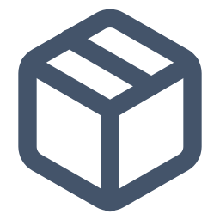

Key Characteristics: Lightweight Libraries & Kernels
Edge devices are constrained by hardware capacity and often cannot run heavy software applications.
The problem
Heavy frameworks don’t fit
Solution: containerization
Running Apache Spark optimally needs ≥ 8-core CPU + 8 GB memory; the lightweight Apache Quarks does only basic tasks, unsuitable for advanced analytics.
Docker virtualizes at the OS level and shares the host system’s kernel. No full OS per instance.
Device heterogeneity
The edge is full of diverse devices from many makers with varying performance, making application deployment complex.
Far more resource-efficient than VMs; isolated environments. with minimal resources
Boosts scalability & deployment speed; consistent environments across dev, test & production.
VMs are too heavy
Traditional VM-based virtualization is too resource-intensive and slow for edge environments, where swift responses are crucial.
Ideal for resource-constrained edge devices.

Slide 14

Key Characteristics: Edge Programming Model
Cloud apps are written once and run on provider servers. Edge nodes are heterogeneous, so traditional programming models are inadequate.
“Computation stream”
New runtime libraries
The data transmission path plus the sequence of computations applied along it at source device, edge nodes and cloud.
Implement language functions & provide runtime support, offering simple application interfaces for the diverse, dynamic edge.
The Firework Model
A programming model designed specifically for edge computing, with two components:
Manager — decomposes service requests into subtasks and distributes them; each runs locally on a participant’s device.
Nodes — offer predefined functional interfaces; register datasets & functions as data views shared across all participants.

Slide 15




Cloud Computing: IaaS / PaaS / SaaS
Cloud computing delivers scalable compute, network & storage from data centers over a network via three service models.
IaaS
PaaS
SaaS
Infrastructure as a Service
Platform as a Service
Software as a Service
Raw compute, storage & networking: manage the OS, runtime and apps.
A managed platform to build & deploy on the provider runs the infrastructure.
Ready-to-use applications delivered over the Internet — nothing to manage.
Cloud characteristics
Large-scale servers
High reliability
Scalability
Virtualization

Slide 16
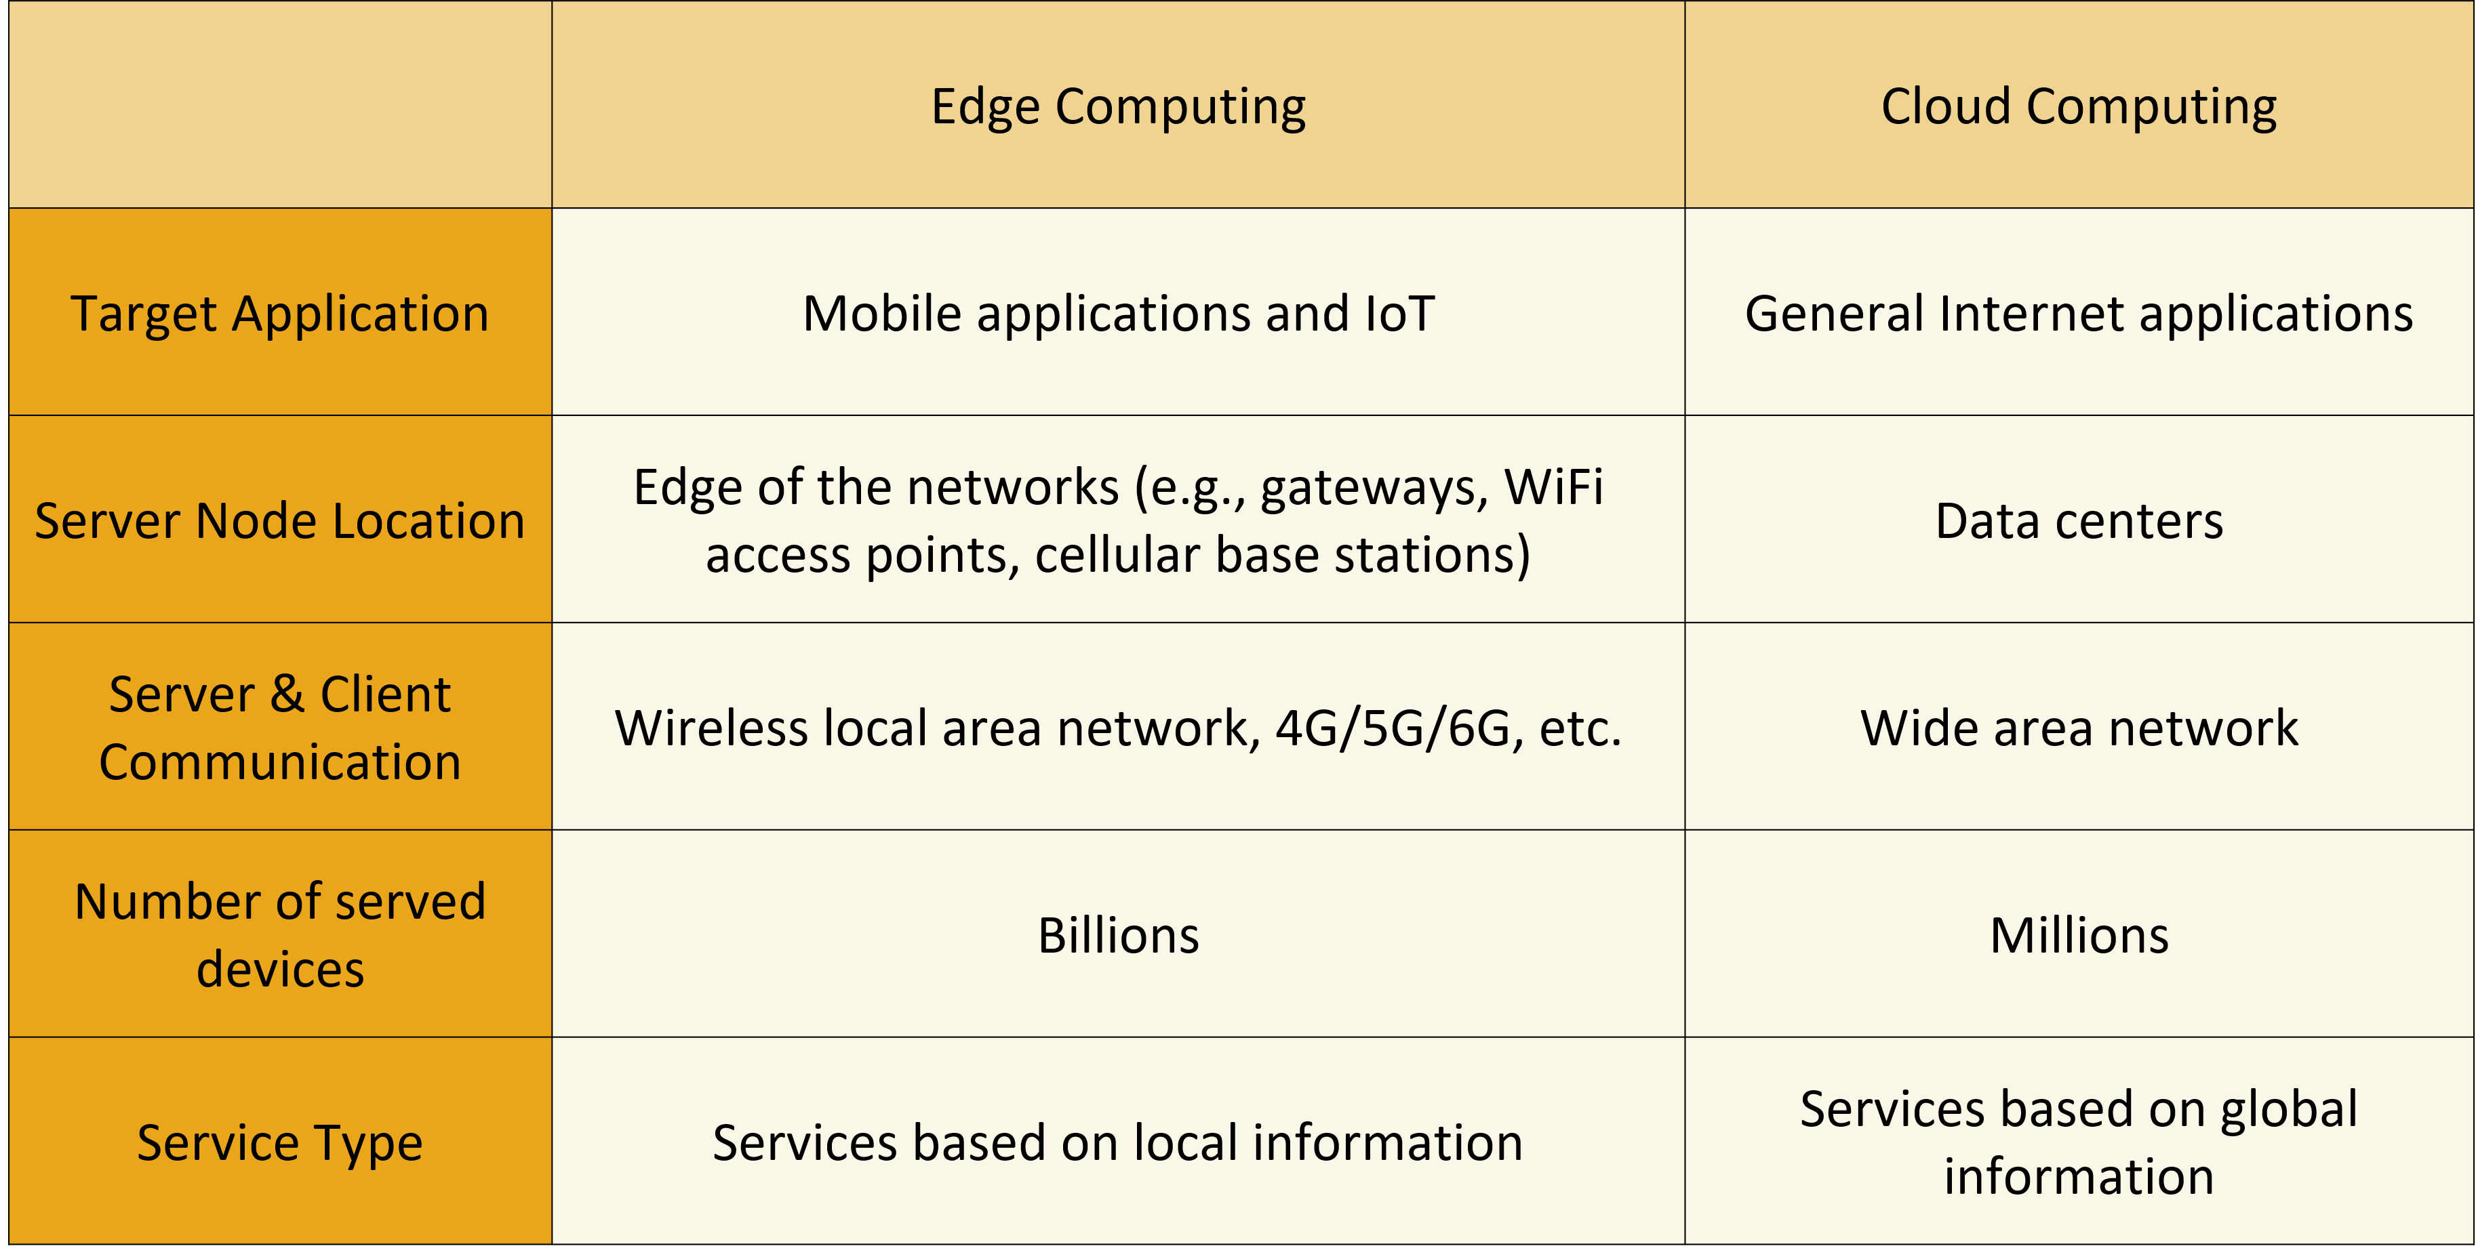
Edge Computing vs Cloud Computing

Slide 17
Benefits
Cloud Computing
Edge Computing
Lower upfront cost
  Get applications to market quickly
Flexible pricing
  Pay-as-you-go
Limitless compute on demand
  React and adapt to changing demands instantly
Simplified IT management
  Users can access IT support and focus on the business’s core needs
Easy updates
  Get the latest hardware, software, and services
Reliability
  Data backup, disaster recovery, business continuity
Save time
  No more configuring private servers and networks
Lower latency
  Reduced data travel.
  Benefit fully autonomous vehicles, augmented reality, etc.
Reduced cost
  LAN: higher bandwidth and storage, lower cost
  Less data needs to travel to the cloud
Model accuracy
  Lower the data size to fed into a cloud model when bandwidth is low
  Data feedback loops can improve edge AI model accuracy
Wider reach
  No need for internet access. Extends the range of computing to previously inaccessible or remote locations
Data sovereignty
  Reduced exposure to cybersecurity attacks, more compliance with data laws

Slide 18
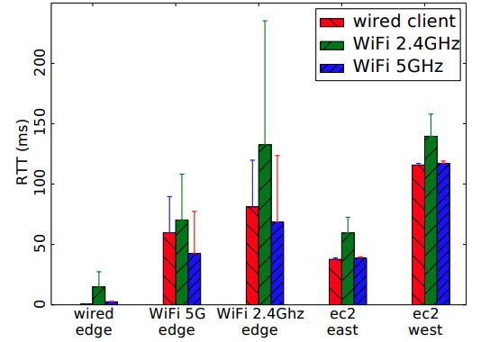
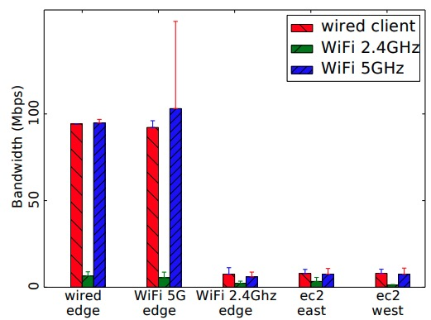
Edge Computing vs Cloud Computing: Latency & Bandwidth
Round-trip time between client and edge/cloud
Bandwidth between client and edge/cloud
Insights: with good connections, edge nodes beat cloud on latency & bandwidth; the cloud remains a backup for saturation & long jobs.
Shanhe Yi et al. “LAVEA: Latency-aware video analytics on edge computing platform”. In: Proceedings of the 2nd ACM/IEEE Symposium on Edge Computing. 2017, pp. 1–13.

Slide 19



Edge Challenges
The 2017 CCC “Grand Challenges in Edge Computing” report groups the open problems into four areas.
Application
Architecture
Real-time processing & communication, security & privacy, incentives & profitability, adaptive app development, and testing tools.
Cage-level security, embracing approximation, trade-off theory, data provenance, QoS at the edge, and testbeds.
Capabilities & Services
Edge Computing Theory
Resource naming & discovery, standardized APIs, intelligent edge services, security & trust, and the edge service ecosystem.
Refining the theoretical foundation & framework so edge computing can better support IoE data processing.

Slide 20
Summary
Fundamental concepts and models of edge computing.
Bidirectional computation flow between edge and cloud.
Computation offloading for efficient task execution.
Key technologies: offloading, 5G/6G, storage, lightweight software, edge programming models.
Edge computing complements and extends cloud computing.
Key advantages and challenges of edge computing.

Slide 21
Practice
What are the key differences between distributed and centralized computing systems?
1
Describe the main functionalities of Hadoop’s HDFS and how it supports distributed data storage.
2
Explain the basic concept of edge computing and its key characteristics.
3
Discuss the complementary relationship between edge computing and cloud computing.
4
5
Identify and explain two main challenges of implementing edge computing systems and propose potential solutions.
6

Slide 22
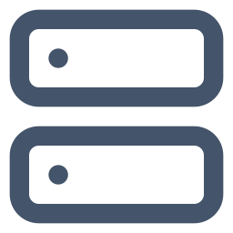




Project
Explore the impact of latency on application performance. Set up a cloud-based application and measure its performance, then replicate the application in an edge computing environment and compare the results. Utilize tools like https://prometheus.io/ for monitoring and https://grafana.com/ for visualization to measure and compare latency.
Experiment Setup
Build one small app
A tiny service — e.g. send an image, get a label back. Package it in a container so it runs the same everywhere.
vs
Cloud
Edge
Once to a cloud region far away (AWS / Azure / GCP), once on a nearby edge device (a laptop or Raspberry Pi).
Deploy it twice
Same application, two locations. Measure how long each takes to respond — and how steady it is.
Send the same requests to both. Use Prometheus to record response times and Grafana to chart them side by side.
Measure & compare

Slide 23



Project
Explore the impact of latency on application performance. Set up a cloud-based application and measure its performance, then replicate the application in an edge computing environment and compare the results. Utilize tools like https://prometheus.io/ for monitoring and https://grafana.com/ for visualization to measure and compare latency.
Deliver a short report answering one question: how much does proximity matter for your app?
Task for completing the project
Build & containerize a small app
Deploy to cloud + edge
Measure latency with Prometheus
Chart it in Grafana
Report median, p95/p99 & jitter
Explain the result & the trade-off

Slide 24
References
Tom White. Hadoop: The definitive guide. O'Reilly Media, Inc., 2012.
Matei Zaharia et al. “Spark: Cluster computing with working sets”. In: 2nd USENIX Workshop on Hot Topics in Cloud Computing (HotCloud 10). 2010.
Apache Software Foundation. Apache Storm. https://storm.apache.org/. Accessed: 2024-07-31.
Shanhe Yi et al. “LAVEA: Latency-aware video analytics on edge computing platform”. In: Proceedings of the 2nd ACM/IEEE Symposium on Edge Computing. 2017, pp. 1–13.

