Slide 1
Edge Architecture & Infrastructure
Chapter 3

Slide 2
Outline
Edge Infrastructure
Networking
Four construction goals
Three layers of edge
Four capabilities
Edge-native progress
Network development process
Four network architectures
Progress & trends
Summary & Practice
Computing Models
Summary
Practice
MEC vs cloudlet
KubeEdge, K3s, Greengrass
Collaboration: continuity

Slide 3




Edge Infrastructure
Edge infrastructure is built to meet four goals that the centralized cloud cannot satisfy alone.
Low latency
Bandwidth efficiency
Process data near the source for fast, real-time response which is essential for time-sensitive applications.
Filter and preprocess locally so only useful data travels upstream, easing network load.
Reliability & resilience
Data privacy & security
Local processing keeps operations running even when the connection to the cloud is disrupted.
Sensitive information is processed and stored locally, reducing exposure and breach risk.

Slide 4
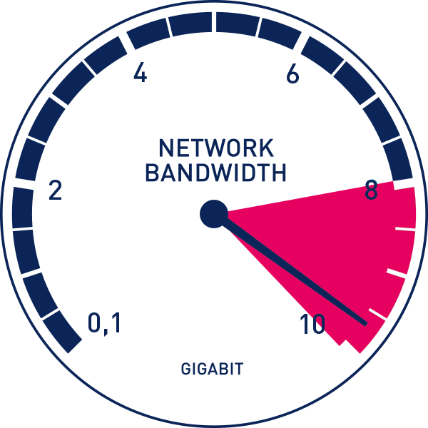

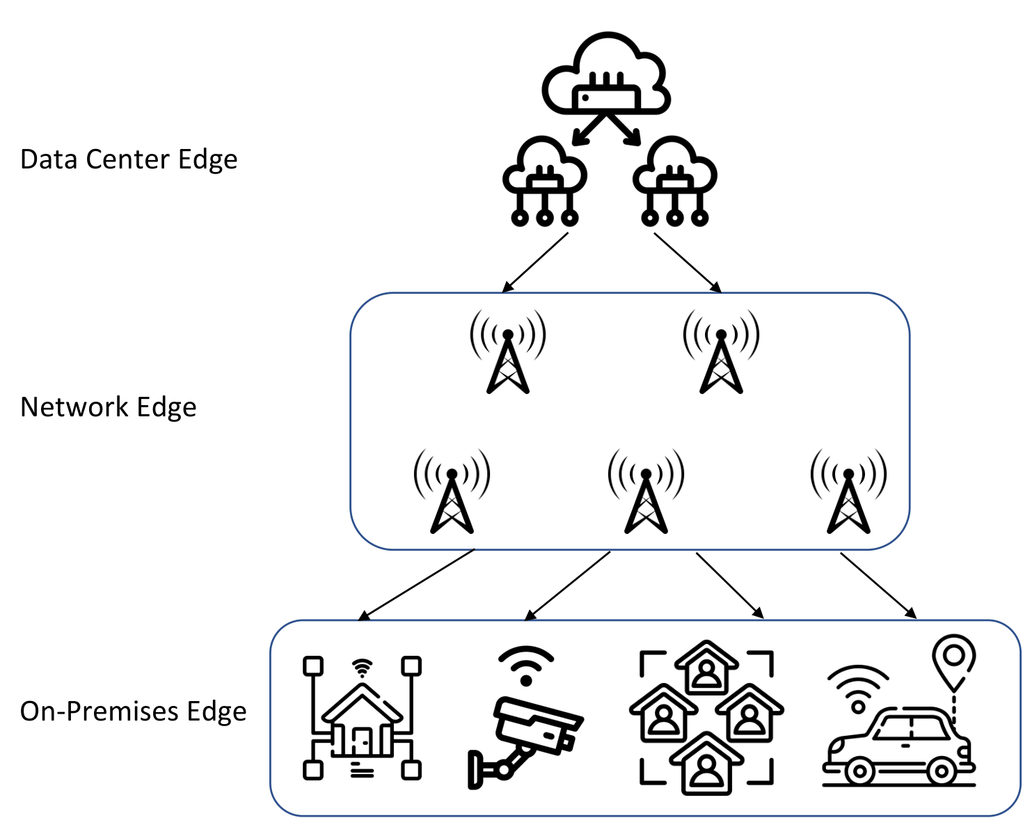
Edge Infrastructure: Three Layers of Edge
On-Premises Edge (Edge Device)
Process at the physical location of the user/data source.
Real-time processing and rapid response (e.g., collision prevention)
Three layers of edge

Slide 5
Edge Infrastructure: Three Layers of Edge
Network Edge (Edge Node)
Expand the reach of computing by leveraging the infrastructure of telecommunication operators.
Enable high-quality service delivery (video streaming, online gaming)
Optimize mobile network and accelerate content delivery.
Local servers, routers, on-site gateways, base station,…
Three layers of edge

Slide 6
Edge Infrastructure: Three Layers of Edge
Data Center Edge
Provide cloud-like computing power but are geographically distributed.
Regional data centers for content delivery, gaming servers, smart city infrastructure, …
The divisions between layers are blurry and flexible
  Overlapping functions
    e.g., data processing, storage, communication; different scales
  Dynamic resource allocation
    Based on current needs
  Distributed nature
    Functions can occur at multiple points along the continuum
  Context-dependent design
Three layers of edge

Slide 7
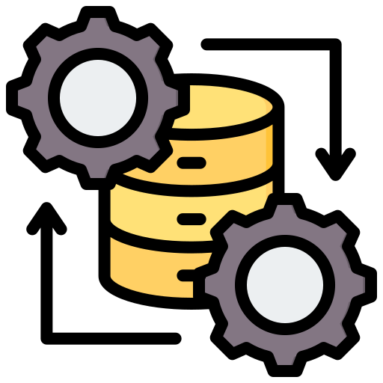
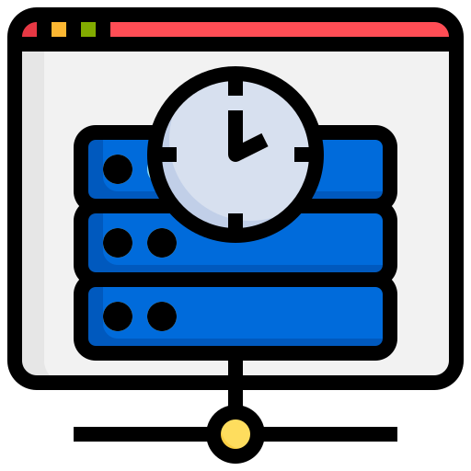
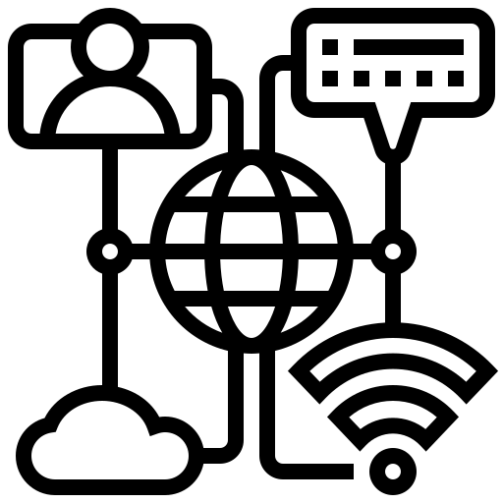

Edge Infrastructure: Four Core Capabilities
Data process
Cache and storage
Communication
Content delivery
Edge data processing involves collecting, filtering, cleansing, transforming, and aggregating data to enable real-time analytics and decision-making.
Edge cache and storage provide fast, secure, and efficient data access through caching and long-term storage, helping reduce latency and support historical analysis.
Edge communication enables fast and reliable data exchange between edge nodes and cloud servers, supporting low-latency and high-throughput applications.
CDNs improve content delivery speed and availability through edge replication, while supporting load balancing, routing, optimization, and security.
Together: data process + storage + networking + content delivery form a self-sufficient node that can operate independently of the cloud.

Slide 8
Edge Infrastructure: Four Core Capabilities
Collection — Gather data from various sources
Filtering — Select relevant data points based on predefined criteria
Cleansing — Remove corrupt or irrelevant data to maintain data integrity
Transformation — Adjust data structure/format for downstream applications
Aggregation — Summarize data into a more manageable and insightful form for analysis
Data processing

Slide 9
Edge Infrastructure: Four Core Capabilities
“Cache and storage is the foundational capability that supports the data lifecycle within edge infrastructure.”
Temporary storage (cache)
  Quick access and retrieval of frequently used data
Permanent storage
  Historical data is vital for trend analysis, long-term planning, or compliance with data retention policies
Design considerations
  Data durability, accessibility, security
  Optimize distributed file systems, object storage, and databases for efficient data storage, management, and retrieval
Cache and storage
Zhao, Y., Zhang, W., Zhou, L., & Cao, W. (2021). A survey on caching in mobile edge computing. Wireless Communications and Mobile Computing, 2021(1), 5565648.

Slide 10
Edge Infrastructure: Four Core Capabilities
Low-latency communication by
  Reduced travel distance
  Technology support like 5G, Wi-Fi, and fiber networks
Improved performance by
  Enable local data processing
  Improve bandwidth efficiency
  Increase network scalability
Communication

Slide 11




Edge-Native: The Direction of Travel
Infrastructure is evolving from “cloud extended to the edge” toward edge-native systems designed for the edge from the ground up.
Cloud-native, pushed out
Edge-native
Cloud tools adapted for the edge
Designed for constraints & heterogeneity
Heavier footprint, cloud assumptions
Lightweight, resilient, autonomous
Edge treated as a remote cloud site
Aware of location, mobility & context
What’s driving it
Lightweight runtimes
5G & beyond
Edge AI
Containers & unikernels sized for edge hardware
Ultra-low latency unlocking new edge workloads
Models optimized to run inference on-device

Slide 12

Computing Models: Mobile/Multi-access Edge Computing (MEC)
Mobile -> Multi-access Edge Computing

Slide 13


Computing Models: Cloudlet Computing
Providing localized, powerful computing resources near mobile devices
Serve as small-scale data centers
  Offloading computation-intensive tasks from mobile devices to enhance performance and extend battery life
Akamai Cloudlet
Satyanarayanan, M. (2013, June). Cloudlets: at the leading edge of cloud-mobile convergence. In Proceedings of the 9th international ACM Sigsoft conference on Quality of software architectures (pp. 1-2).

Slide 14



Computing Models: Edge Platforms
KubeEdge
K3s
AWS Greengrass
Extends Kubernetes to the edge. Syncs cloud & edge, supports offline autonomy of edge nodes, and manages devices via a device twin.
A lightweight, certified Kubernetes distribution (<100 MB) built for edge & IoT — low resource use, simple to install and operate.
Extends AWS to edge devices — run Lambda functions, ML inference & messaging locally, syncing with the cloud when connected.
Bring familiar cloud-native tooling (containers, orchestration) to the edge, with offline autonomy for unreliable links.

Slide 15
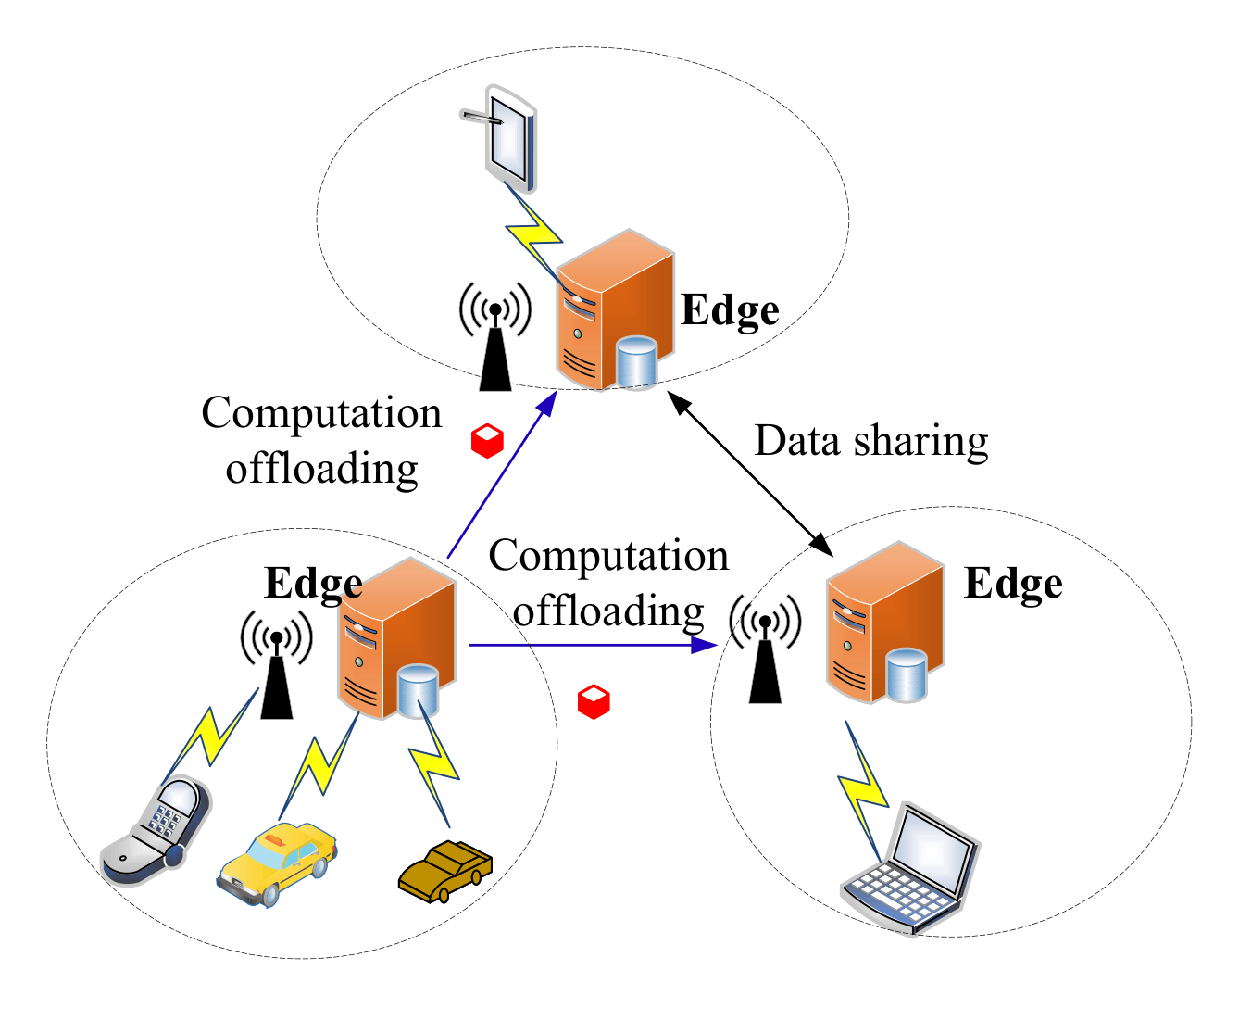
Computing Models: Edge-to-Edge
Direct interaction and coordination to enhance performance, reliability, and scalability.
  Edge nodes communicate with each other to share data, balance workloads, and provide redundancy.
  Efficient resource allocation and management enabled by decentralized protocols and frameworks.
Edge-to-edge

Slide 16
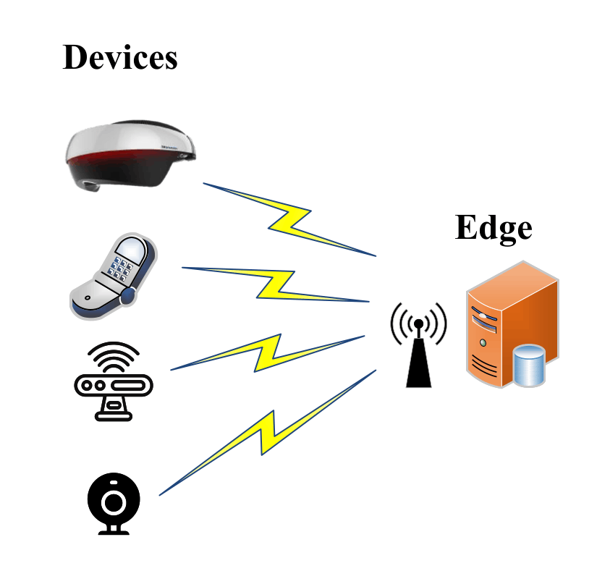
Computing Models: Edge-to-Device
The pivotal way to improve device performance and extend battery life
  Computation-intensive tasks are offloaded to nearby edge nodes.
Edge-to-device

Slide 17
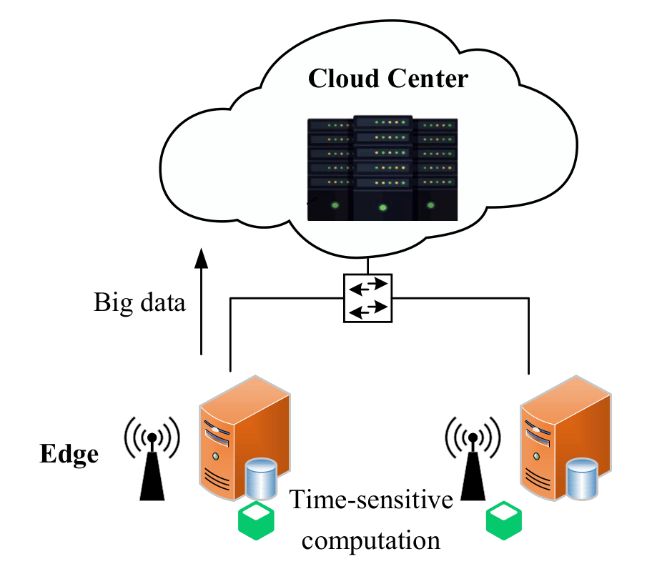
Computing Models: Edge-to-Cloud
A balanced approach to data processing and storage.
  Cloud resources can handle peak loads and extend data storage
  Edge performs critical, time-sensitive computations
Edge-to-cloud

Slide 18
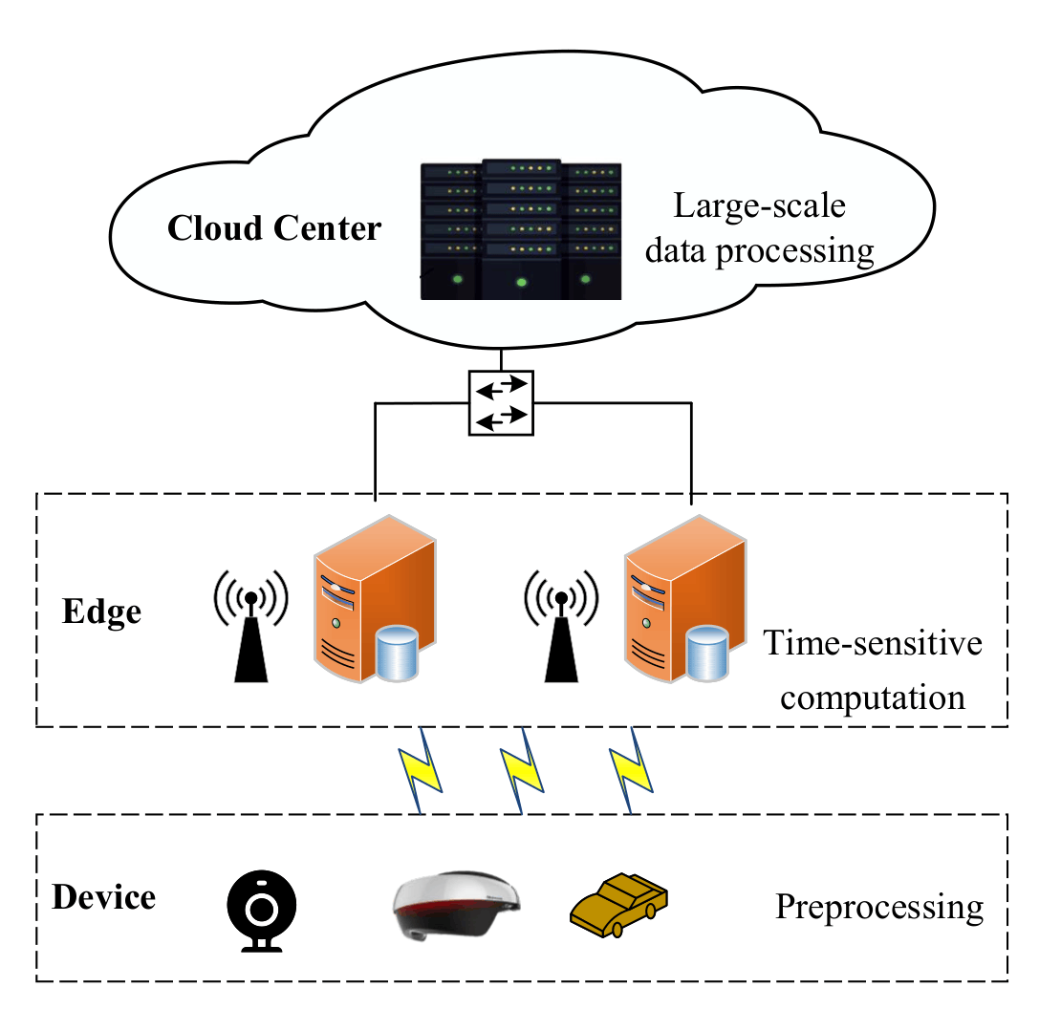
Computing Models: Cloud-Edge-Device
A holistic approach where tasks are distributed across the cloud, edge nodes, and edge devices based on their computational requirements and latency sensitivity.
  Cloud handles large-scale data processing and long-term storage
  Edge nodes perform intermediate processing and provide low-latency response
  Edge devices focus on data collection and immediate user interactions
Cloud-Edge-Device

Slide 19




Networking: Network Development Process
Networking and edge computing have converged through “network cloudification”
Integrate compute + network
NFV & virtualization
MEC + NFV integration
5G & network slicing
Early work fused computing and network infrastructure inside data centers with high-speed interconnects.
ETSI NFV abstracts network & compute over a common virtualization layer; MANO handles orchestration.
MEC apps and VNFs share the same virtual infrastructure; NFV MANO manages MEC.
3GPP/5G adds NFV + SDN + network slicing — multitenant virtual networks converging network & edge.

Slide 20
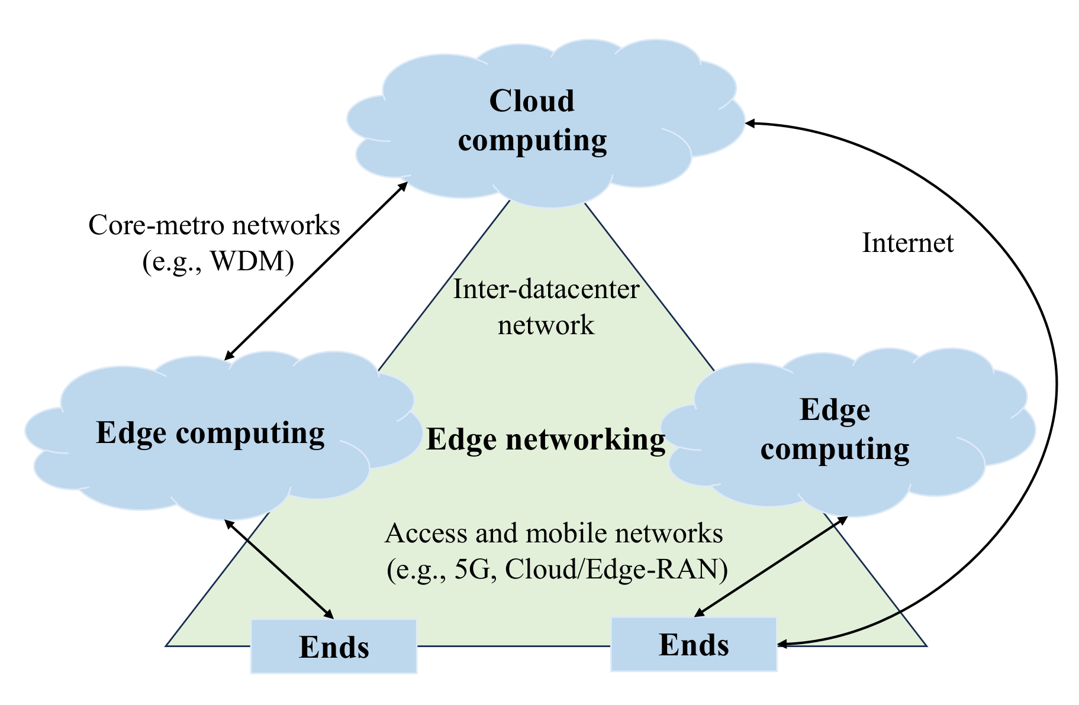
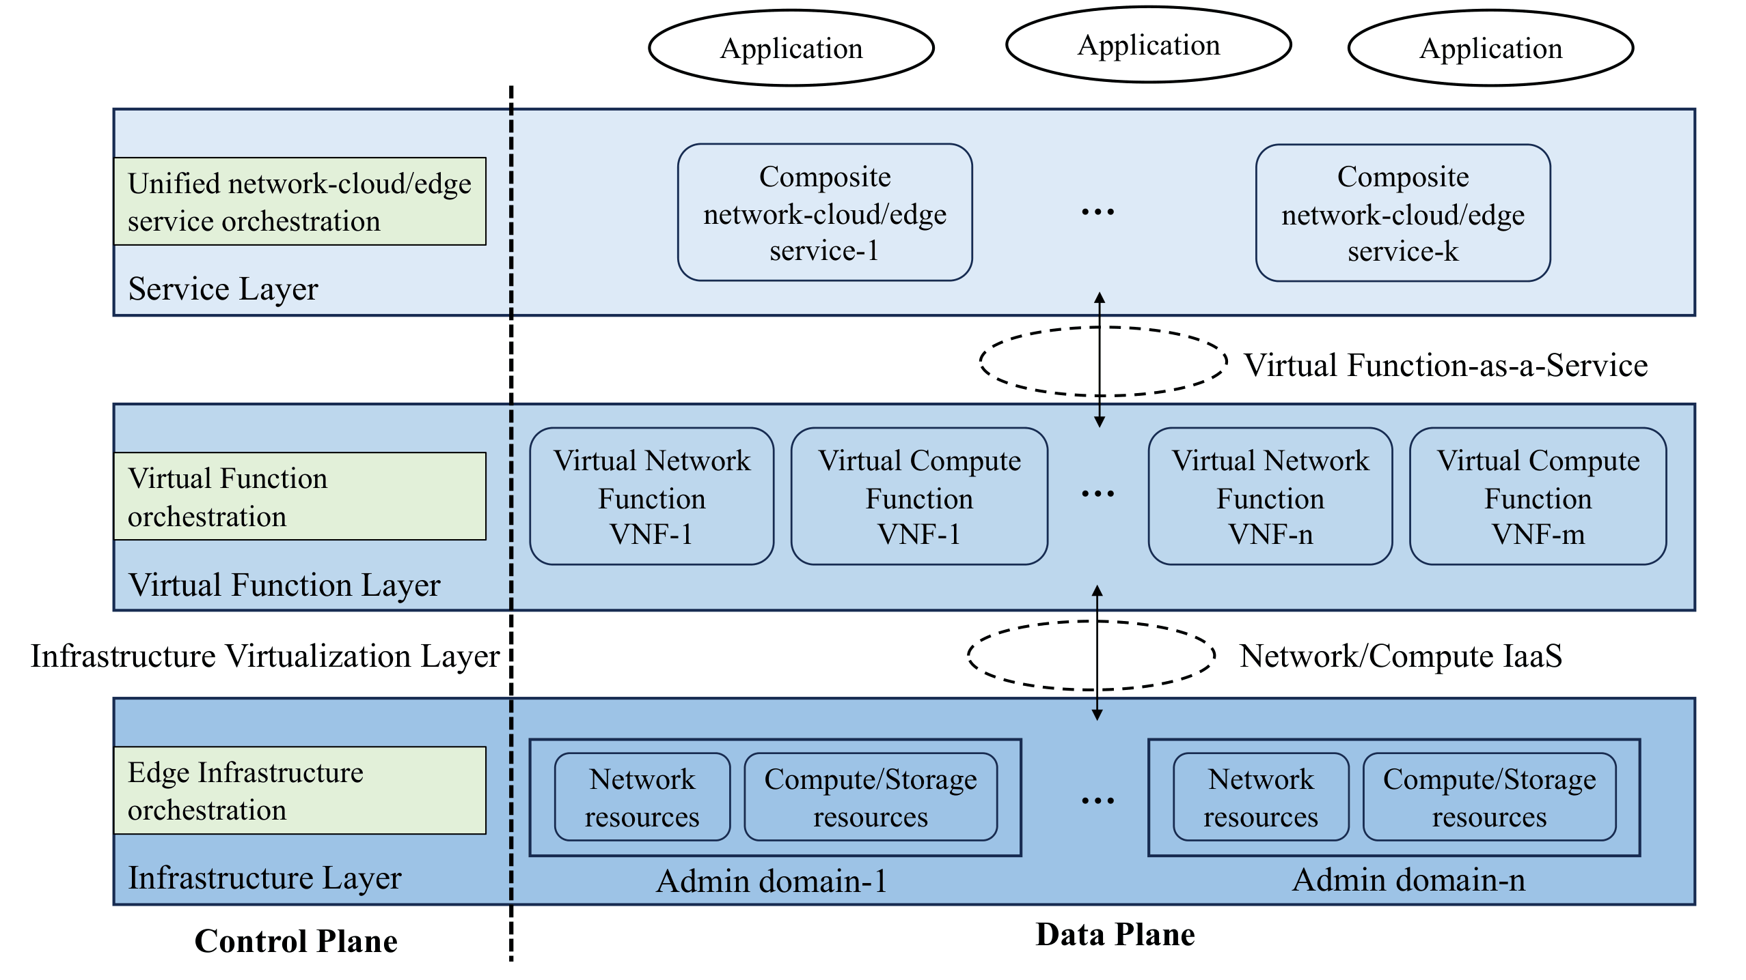
Networking: Edge Computing & Network Integration
Edge computing and networking
Architectural framework for edge-network integrations

Slide 21
Networking: Progress & Trends
Network cloudification
Network slicing
From dedicated appliances to commodity data-center-like systems running virtual network functions as software.
Multitenant virtual networks on shared infrastructure — a promising path to converge networking with cloud/edge.
Unified orchestration
SDN + softwarization
Managing resources & functions across both network and edge, provisioning services that span both domains.
Programmable, service-based architectures making the network flexible enough to co-host computing.

Slide 22
Summary
Built for low latency, bandwidth efficiency, reliability & privacy — across three layers (data center, network, on-premises) with data process, cache and storage, networking & CDNs. Bidirectional computation flow between edge and cloud.
MEC vs cloudlet; platforms like KubeEdge, K3s & Greengrass; and collaboration models (edge-edge, edge-device, edge-cloud, cloud-edge-device) that deliver continuity & unity.
Networking is the backbone. Through NFV, MEC integration, 5G & network slicing, networks and edge computing are converging into unified, programmable platforms.

Slide 23
Practice
Discuss the different grades/layers of edge infrastructure. How do these layers contribute to the overall efficiency and scalability of an edge computing system?
1
Compare and contrast mobile edge computing (MEC) and multi-access edge computing (MEC).
2
What are collaborative edge computing models, and in what scenarios are they most beneficial?
3
What factors should be considered when choosing the right edge computing model for a specific application? Provide examples to support your explanation.
4
5
6

Slide 24



Project
Build a demo system for cloud-edge-device collaboration, with the functions of device side data collection, edge-side preprocessing data, and cloud batch data processing.
Device (Data collection)
Edge (Preprocessing)
Cloud (Batch processing)
The data flows one way: device collects → edge preprocesses → cloud batch-processes. Each layer does the job it is best suited for.

Slide 25





Project
Explore the impact of latency on application performance. Set up a cloud-based application and measure its performance, then replicate the application in an edge computing environment and compare the results. Utilize tools like https://prometheus.io/ for monitoring and https://grafana.com/ for visualization to measure and compare latency.
Task for completing the project
Device: script a sensor (or emulator) that emits raw readings
Wire them together — device → edge → cloud messaging
Edge: a Pi / VM cleans, filters & aggregates the stream
Show it working end-to-end with sample data
Cloud: batch-process the aggregated data (e.g. daily stats, model)
Explain the result

Slide 26
References
Zhao, Y., Zhang, W., Zhou, L., & Cao, W. (2021). A survey on caching in mobile edge computing. Wireless Communications and Mobile Computing, 2021(1), 5565648.
Satyanarayanan, M. (2013, June). Cloudlets: at the leading edge of cloud-mobile convergence. In Proceedings of the 9th international ACM Sigsoft conference on Quality of software architectures (pp. 1-2).
Mohammad Babar et al. “Cloudlet computing: Recent advances, taxonomy, and challenges”. In: IEEE Access 9 (2021), pp. 29609–29622.
Qiang Duan and Shangguang Wang. “Network cloudification enabling network-cloud/fog service unification: State of the art and challenges”. In: 2019 IEEE World Congress on Services (SERVICES). Vol. 2642. IEEE. 2019, pp. 153–159.

