Slide 1
Edge Intelligence I: Foundations & The Substrate
Chapter 4
Topic: What is Edge Intelligence | Hardware | Software

Slide 2
Outline
What is Edge Intelligence
Software
AI meets the edge
Training vs inference
Why intelligence moves out
Frameworks & runtimes
Lite & mobile engines
Development stack
Computing Models
Summary & Practice
Summary
Practice
CPU & GPU baseline
ASIC, FPGA, Jetson
Performance metrics

Slide 3
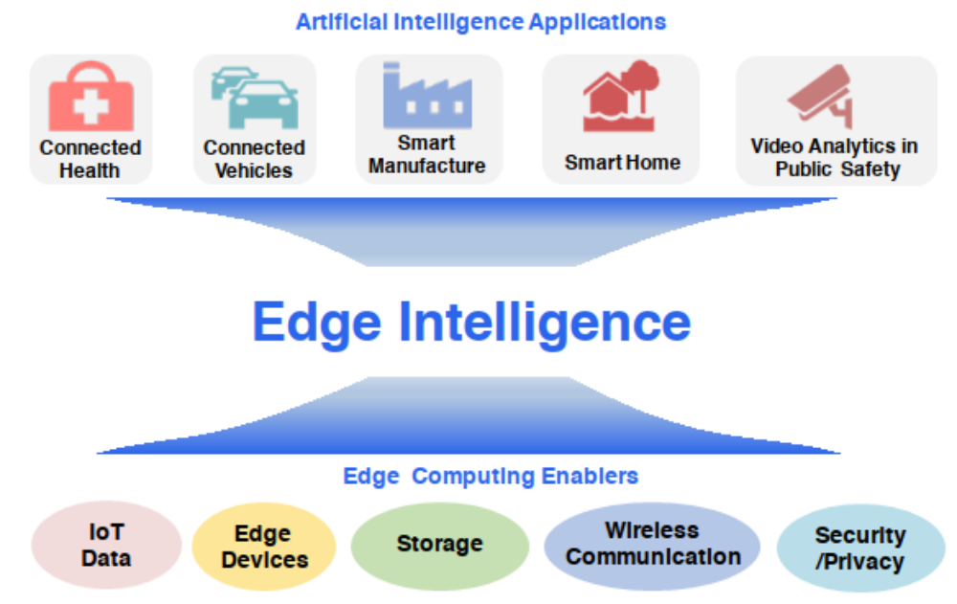

Edge Intelligence: Motivation
Pushed by edge computing
IoT data, edge devices, storage, wireless links and on-device security make it feasible to run AI where data is born.
Pulled by AI applications
Connected health, vehicles, smart manufacturing, smart homes and video analytics all demand real-time, on-site inference.
The edge handles video, speech, time-series and sensor data with no round-trip to the cloud.
Motivation of edge intelligence

Slide 4


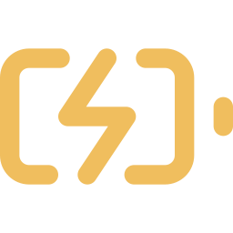

Edge Intelligence: Definition
Edge intelligence is the capability of edge devices to execute artificial-intelligence algorithms locally, acquiring, storing and processing data with ML at the network edge.
Because hardware differs, every edge has a different EI capability — captured by the ALEM tuple:
Accuracy
Latency
Energy
Memory
Quality of the model’s output (e.g. mAP, BLEU). Compression trades some of it away.
Inference time per task — the measure of edge performance under load.
Extra power drawn while running inference on the device.
Footprint of the model in memory during execution.
International Electrotechnical Commission. Edge Intelligence. https://www.iec.ch/basecamp/e dge-intelligence. Accessed: 2024-05-27. 2024

Slide 5
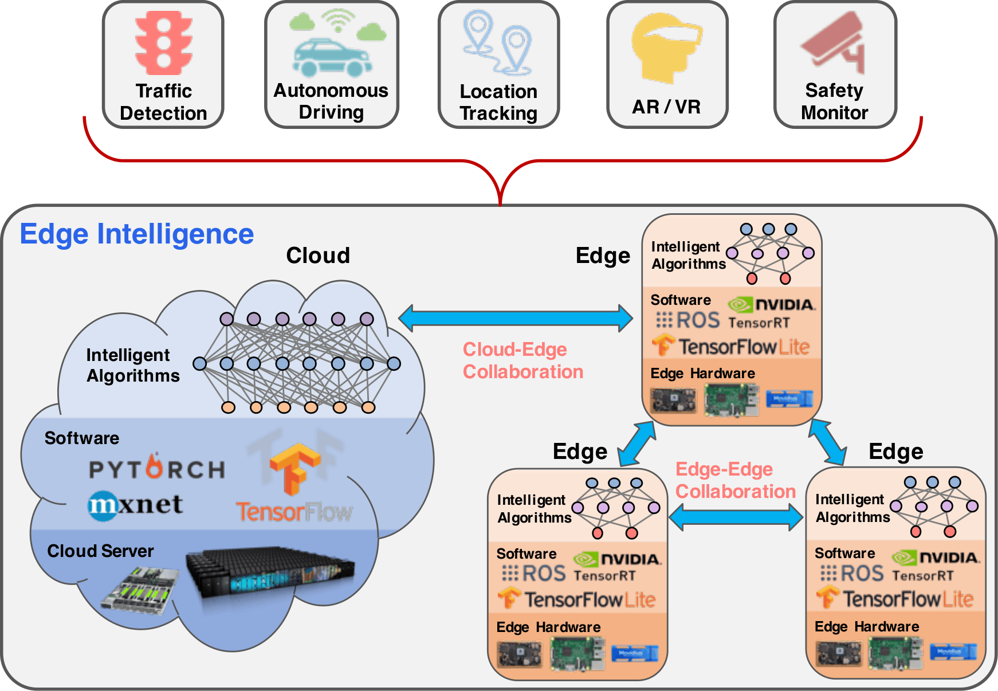


Edge Intelligence: Collaboration
Two ways Edges cooperate
Cloud – Edge
Train in the cloud, download to the edge for inference. Edges may retrain locally via transfer learning and push updates back to a global model — e.g. DDNN spans cloud and edge.
Edge – Edge
Edges split one heavy job by compute power or divide a task by context. A phone predicts you’re nearly home and cues the thermostat: hard alone, easy in concert.
Edge Intelligence

Slide 6
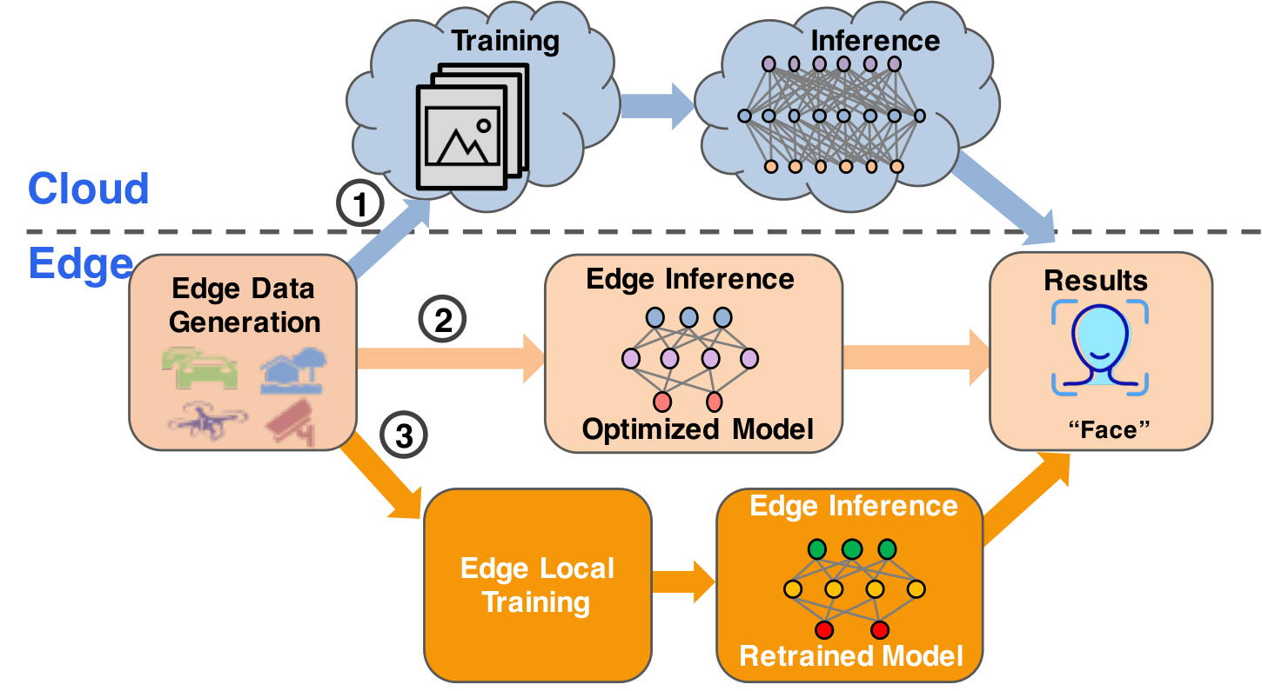



Edge Intelligence: Data Flows
Three ways to use edge data
Cloud training
Upload to cloud, train on multi-source data, infer, return result. Traditional machine intelligence.
Edge inference
Run the cloud-trained model on-device against local data. The current EI dataflow.
Edge local training
Retrain on-device with transfer learning to build a personalized model. The future of EI.
Dataflow of edge intelligence

Slide 7




Edge Intelligence: Case For EI
Why intelligence moves to the edge
Latency
Bandwidth
Decisions happen next to the data. No cloud round-trip for face ID, speech, or driving.
Raw video and sensor streams stay local; only results or model updates travel.
Privacy
Reliability
Sensitive data is processed on-device, lowering the risk of interception or leakage.
Works offline and near the source. Resilient when the network is weak or down.

Slide 8





Hardware: Case For EI
Unlike cloud data centers, edge devices run under tight compute and power budgets. Five families cover the field.
CPU
GPU
FPGA
ASIC
Neuromorphic
Flexible, everywhere
Massively parallel
Reconfigurable
Fixed-function
Brain-inspired
General control & light inference
Deep learning, autonomous systems
Custom, adaptive AI workloads
Peak efficiency: TPU, VPU, NPU
Spiking, sensory, cognitive

Slide 9
Hardware: CPU & GPU
CPU
GPU
Serial, general-purpose control logic
Runs the OS, orchestration, glue code
Handles light or infrequent inference
Ubiquitous — every edge device has one
Poor throughput on dense tensor math
Thousands of cores for parallel math
The workhorse for deep-learning training
Strong on batched, high-throughput inference
Jetson brings GPU compute to the edge
Costs the most power of the edge options

Slide 10
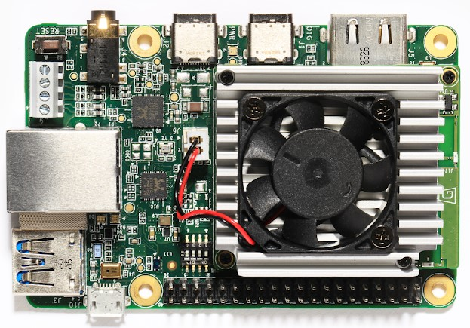
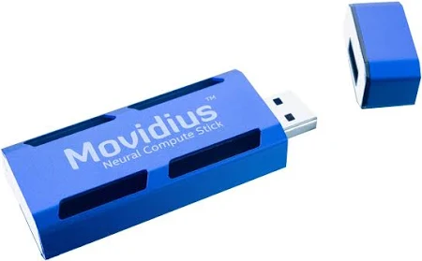
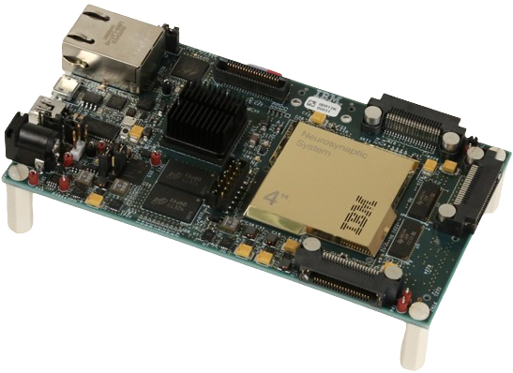
Hardware: ASIC
An ASIC is hard-wired for a specific task, sacrificing flexibility for the best accuracy, latency and energy in its niche.
TPU
VPU
Neuromorphic
Google Edge TPU
Intel Movidius Myriad X
IBM TrueNorth · Intel Loihi
Tensor Processing Unit tuned for TensorFlow inference — image classification & object detection at very low power.
16 SHAVE cores + a neural engine, >1 TOPS. Vision-centric: facial recognition, visual SLAM, low-power detection.
Brain-inspired, highly parallel & efficient — real-time pattern recognition, robotics, cognitive computing.

Slide 11
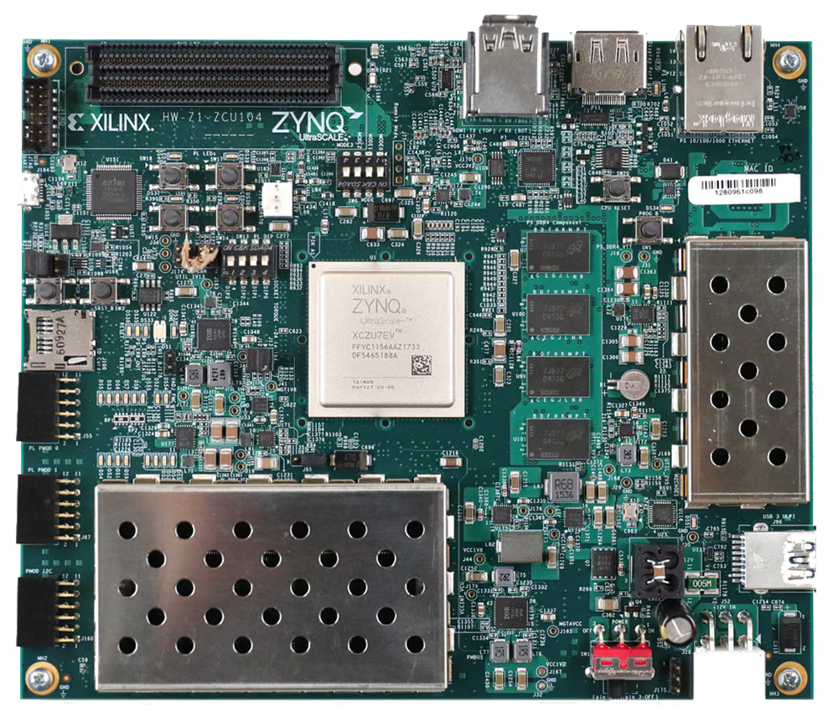
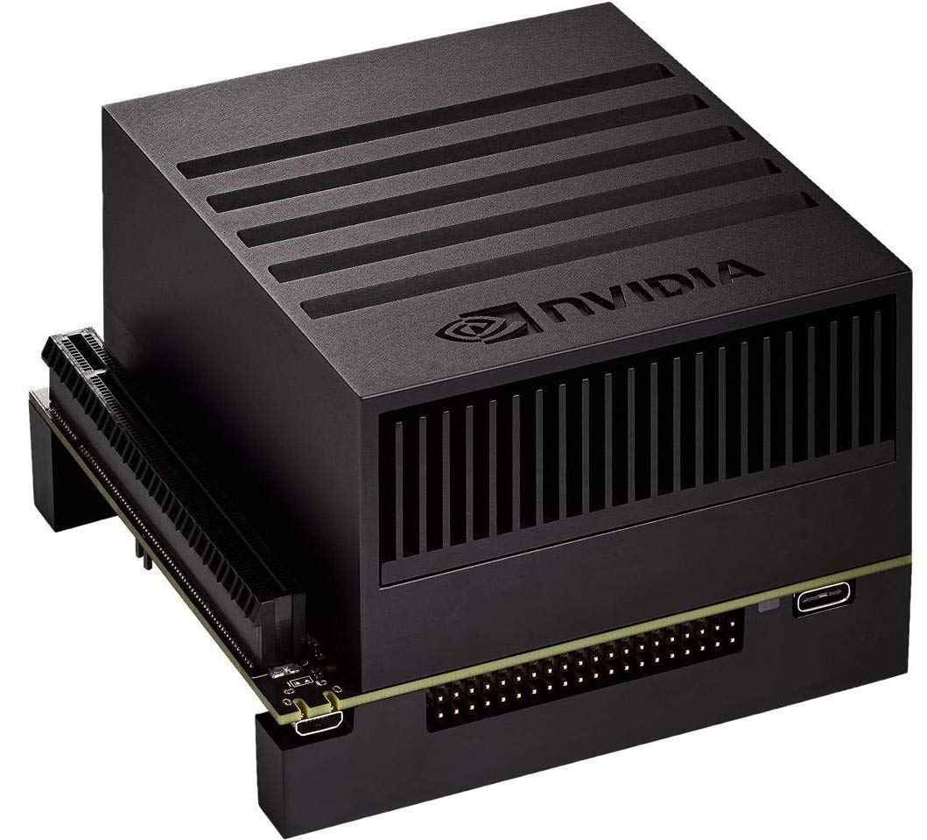
Hardware: FPGA & GPU
FPGA
Jetson
Xilinx (Alveo, MPSoC) & Intel (Agilex, Stratix 10)
Arm cores + programmable logic → real-time, low-power
ESE ran sparse LSTM faster & greener than CPU/GPU
Studies find FPGA well-suited to EI workloads
Jetson Nano — 472 GFLOPs at just 5–10 W
AGX Xavier — 512-core Volta GPU + 8-core CPU
CUDA + TensorRT accelerate robotics & AV workloads
Jetson Orin (2022) scales to complex edge AI

Slide 12


Hardware: Comparison of Hardware Types for Edge AI Applications
Type
Sub-type
Examples
AI performance
Power eff.
Latency
Key applications
ASIC
TPU
Google TPU,
Google Edge TPU
Excellent for AI inference, optimized for TensorFlow
Very low
Real-time AI inference, image classification, object detection
VPU
Intel Movidius
Myriad X
High for vision-centric AI tasks
Low
Facial recognition, visual SLAM, low-power object detection
Neuromorphic chip
IBM TrueNorth,
Intel Loihi
Efficient for brain-inspired AI models
Very low
Cognitive computing, robotics, sensory processing
FPGA
—
Xilinx UltraScale+,
Intel Stratix
High, customizable for specific AI workloads
Low to moderate
Custom AI models, adaptive AI tasks
GPU
—
Jetson Nano,
AGX Xavier
High, particularly in parallel processing tasks
Medium
Deep learning, autonomous systems, AI research
Power efficiency
= high
= moderate
= very high
= extremely high

Slide 13


Software: Frameworks
Cloud Frameworks Don’t Fit the Edge
Cloud-first
Edge-optimized
Built to train at scale
Built to infer on-device
TensorFlow, Caffe, MXNet, PyTorch
Large datasets, learn millions of weights
Run on GPU / CPU / FPGA / TPU clusters
Resource-hungry — a poor fit for edges
Same inference, far fewer resources
Small-scale, real-time input data
Installed on phones, Pi, laptops, servers
Optimized kernels & quantization
TensorFlow Authors. TensorFlow Lite. https://www.tensorflow.org/lite. Accessed: 2024-05-21. 2024.
Tianqi Chen et al. “MxNet: A flexible and efficient machine learning library for heterogeneous distributed systems”. In: arXiv preprint arXiv:1512.01274 (2015).

Slide 14

Software: Lite/Mobile Runtime
TensorFlow Lite
ONNX Runtime
Google’s mobile/edge runtime — fused, quantized kernels cut latency.
Cross-platform engine (Meta + Microsoft); runs on Jetson, FPGA, NPU, AGX.
Core ML
QNNPACK / XNNPACK
Apple’s on-device package — minimal memory & power
Meta & Google low-level kernels for quantized & float inference.
OpenVINO
Vitis AI · FINN
Intel toolkit — converts TF/PyTorch models, deploys across Intel HW.
Xilinx FPGA stacks — optimize, compile & quantize for the fabric.
Azure IoT Edge
SageMaker Neo · TensorRT
Microsoft — deploy & manage cloud-native AI workloads on devices.
AWS & NVIDIA — compile once, accelerate inference on target HW.
Amazon Web Services, Inc. Amazon SageMaker Neo: Train Once, Run Anywhere. https://aws.amazon.com/sagemaker/neo/. Accessed: 2024-08-21. 2024.
AMD Xilinx. Vitis AI. https://www.xilinx.com/products/design-tools/vitis/vitis-ai.html. 2024.
Apple Inc. Core ML Documentation. https://developer.apple.com/documentation/coreml. Accessed: 2024-05-20. 2024.
Google. XNNPACK. https://github.com/google/XNNPACK. GitHub repository. 2024.
Intel. OpenVINO Toolkit Overview. https://www.intel.com/content/www/us/en/developer/tools/openvino-toolkit/overview.html. Accessed: 2024-07-10. 2024.
Dukhan Marat, W. Yiming, and L. Hao. QNNPACK: Open source library for optimized mobile deep learning. 2018.
Microsoft. Azure IoT Edge. https://azure.microsoft.com/en-us/products/iot-edge. Accessed: 2024-07-10. 2024.
NVIDIA Corporation. TensorRT. https://developer.nvidia.com/tensorrt. Accessed: 2024-05-20. 2024.
ONNX Runtime Developers. ONNX Runtime. https://onnxruntime.ai/. 2021.
Yaman Umuroglu et al. "FINN: A framework for fast, scalable binarized neural network inference". In: Proceedings of the 2017 ACM/SIGDA International Symposium on Field-Programmable Gate Arrays. 2017, pp. 65–74.

Slide 15


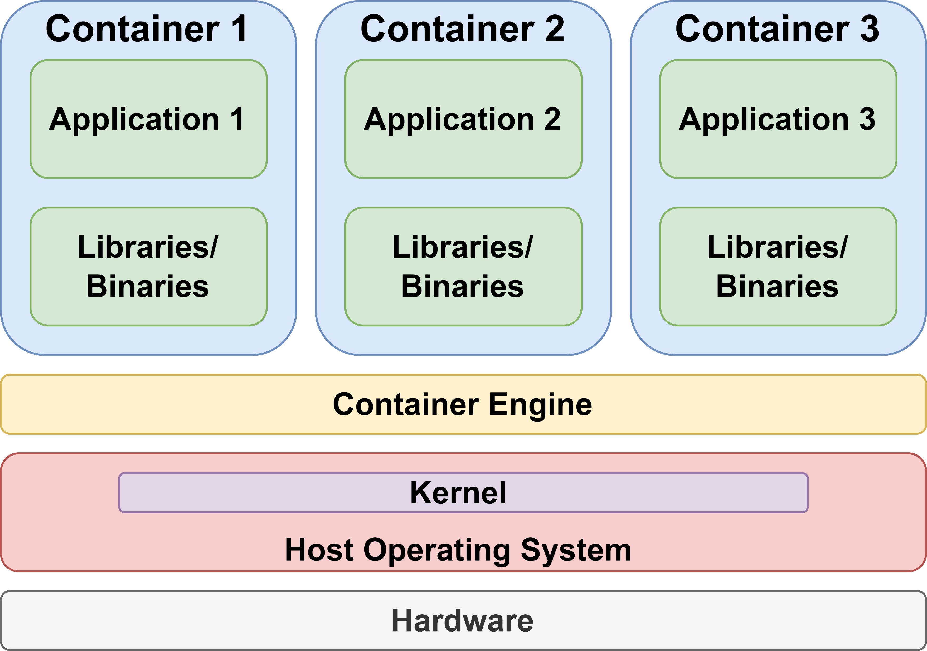
Software: Deployment
Runtimes & Containers: The Stack
Running Environments
Containers
TinyOS — event-driven OS for sensor networks
ROS / ROS 2 — robotics; DDS messaging, no master
AWS IoT Greengrass — deploy AI to fleets of devices
OpenVDAP · EdgeOS_H — vehicle & smart-home stacks
SageMaker Edge — compile & manage models on devices
PYNQ — Python on Xilinx Zynq FPGA + Arm SoCs
Bundle code, runtime, libraries & deps into one portable unit.
Share the OS kernel — small, resource-efficient, easy to migrate.
Engines: Docker, RKT, LXD, Kubernetes.
Container architecture over a shared kernel

Slide 16
Summary
Edge intelligence is the capability of edges to run AI algorithms locally, measured by ALEM (Accuracy, Latency, Energy, Memory).
Cloud-edge and edge-edge collaboration split training and inference across the continuum.
CPU, GPU, FPGA, ASIC (TPU/VPU) and neuromorphic chips trade flexibility for efficiency.
Lite runtimes, edge OSs and containers turn silicon into portable, efficient intelligence.

Slide 17
Practice
How does edge hardware differ from traditional data-center hardware?
1
Discuss the advantages and challenges of implementing machine learning at the edge?
2
What are the key considerations in choosing an edge application development framework?
3
5
6

Slide 18
References
International Electrotechnical Commission. Edge Intelligence. https://www.iec.ch/basecamp/e dge-intelligence. Accessed: 2024-05-27. 2024.
TensorFlow Authors. TensorFlow Lite. https://www.tensorflow.org/lite. Accessed: 2024-05-21. 2024.
Tianqi Chen et al. “MxNet: A flexible and efficient machine learning library for heterogeneous distributed systems”. In: arXiv preprint arXiv:1512.01274 (2015).
Amazon Web Services, Inc. Amazon SageMaker Neo: Train Once, Run Anywhere. https://aws.amazon.com/sagemaker/neo/. Accessed: 2024-08-21. 2024.
AMD Xilinx. Vitis AI. https://www.xilinx.com/products/design-tools/vitis/vitis-ai.html. 2024.
Apple Inc. Core ML Documentation. https://developer.apple.com/documentation/coreml. Accessed: 2024-05-20. 2024.
Google. XNNPACK. https://github.com/google/XNNPACK. GitHub repository. 2024. Intel.
OpenVINO Toolkit Overview. https://www.intel.com/content/www/us/en/developer/tools/openvino-toolkit/overview.html. Accessed: 2024-07-10. 2024.
Dukhan Marat, W. Yiming, and L. Hao. QNNPACK: Open source library for optimized mobile deep learning. 2018.
Microsoft. Azure IoT Edge. https://azure.microsoft.com/en-us/products/iot-edge. Accessed: 2024-07-10. 2024.
NVIDIA Corporation. TensorRT. https://developer.nvidia.com/tensorrt. Accessed: 2024-05-20. 2024.
ONNX Runtime Developers. ONNX Runtime. https://onnxruntime.ai/. 2021.
Yaman Umuroglu et al. "FINN: A framework for fast, scalable binarized neural network inference". In: Proceedings of the 2017 ACM/SIGDA International Symposium on Field-Programmable Gate Arrays. 2017, pp. 65–74.

