Slide 1
Edge Intelligence II: Model Compression
Chapter 4
Topic: Pruning | Quantization | Knowledge Distillation

Slide 2
Outline
Pruning
Knowledge Distillation
Background
Unstructured vs. structured
Pattern-based & channel-level pruning
Industry examples
Teacher → student
Distill & student loss
Schemes
Summary & Practice
Quantization
Combined techniques
Summary
Project
FP32 → INT8 precision
QAT vs. PTQ workflows
Granularity and SOTA techniques

Slide 3
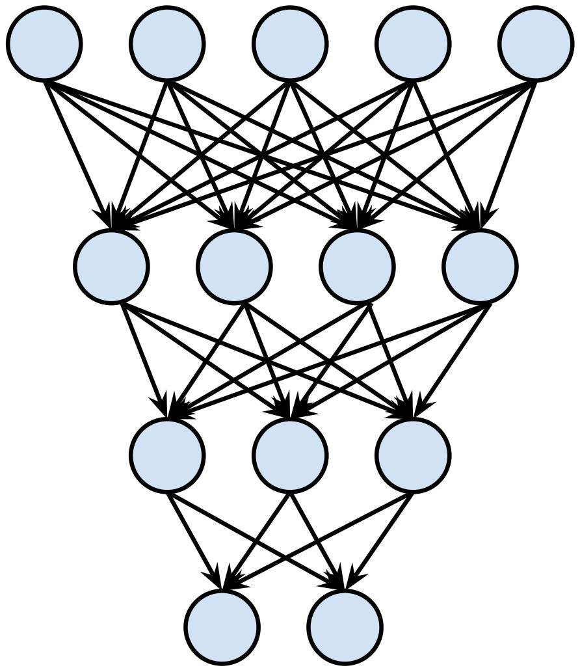
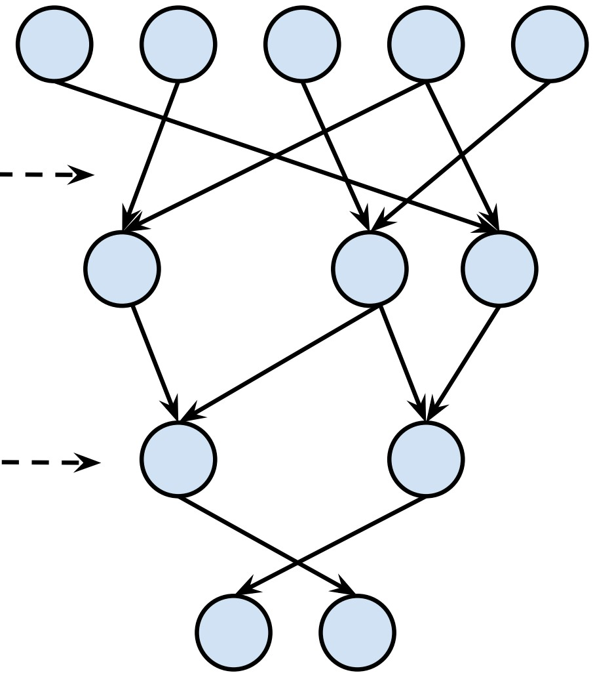
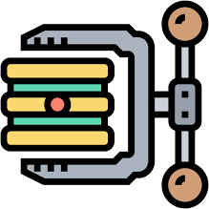
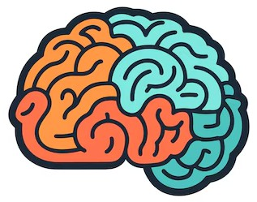
Bridge the Gap
The performance gap
Deep networks are large in parameters and complex in structure — fine on data-center GPUs, but too heavy for the limited compute, memory and power of edge devices.
Training
Inference
Compression closes the gap.
It accelerates inference and shrinks models — with low implementation cost and a natural complement to hardware acceleration.
Training
Inference
Model compression (pruning, sparsity, quantization, etc.)

Slide 4
Pruning: Background
Publications (total)
5000
4,354
3750
3,341
# Publications
2500
2,320
Rapidly increased since 2015
1,650
Optimal Brain Damage
1250
884
342
376
482
407
534
20 28 59 64 81¹¹⁸
122
143
156
189
215
0
1989
1990
1991
1992
1993
1994
1995
1996
1997
1998
1999
2000
2001
2002
2003
2004
2005
2006
2007
2008
2009
2010
2011
2012
2013
2014
2015
2016
2017
2018
2019
2020
2021
2022
2023
Data source
LeCun, Y., Denker, J., & Solla, S. (1989). Optimal brain damage. Advances in neural information processing systems, 2.

Slide 5
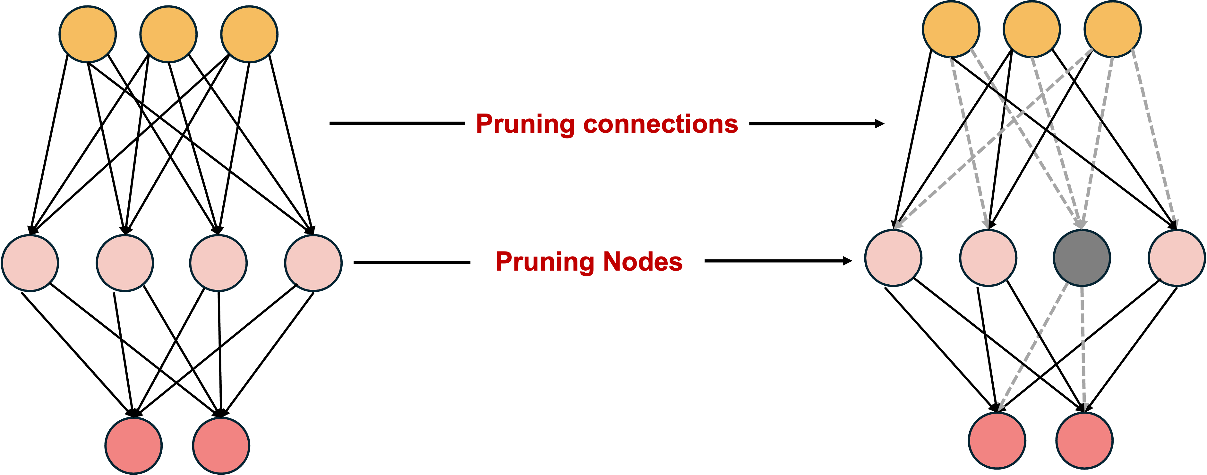

Pruning: Background
Cut the connections which is less value
The classic three-steps
1
Train
Train the network normally — weight magnitude signals importance.
Overview of pruning
2
Prune
Zero out weights below a threshold, cutting the least-important connections.
Inspired by biology.
In mammals, many synaptic connections form in infancy; the rarely used ones weaken and disappear as the brain matures — exactly what pruning does to a network (Han et al.).
3
Fine-tune
Fine-tune the survivors to recover any lost accuracy. Repeat to balance ratio vs. accuracy.

Slide 6
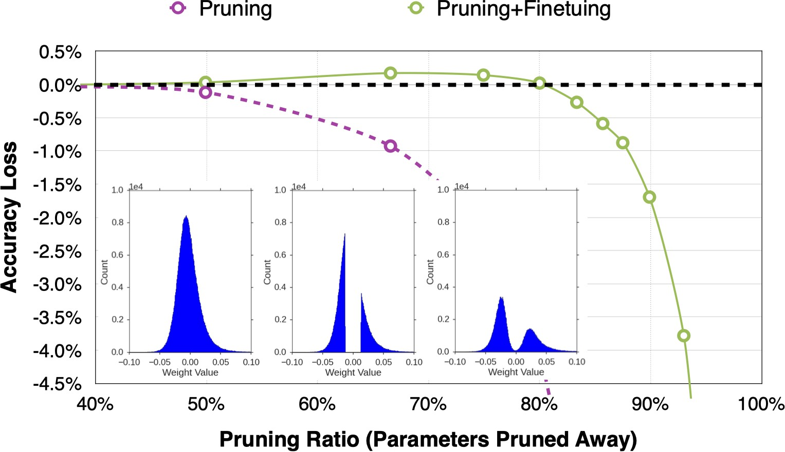
Pruning: Background
Make neural network smaller by removing synapses and neurons
Overview of pruning
Train Connectivity
Prune Connections Train Weights
Han, S., Pool, J., Tran, J., & Dally, W. (2015). Learning both weights and connections for efficient neural network. Advances in neural information processing systems, 28.

Slide 7


Pruning: Granularity
Unstructured vs. Structured Pruning
Unstructured
Structured
Prunes individual weights / connections
Prunes whole filters, channels or layers
Finest granularity — remove any redundant weight
Highest compression flexibility
Leaves an irregular, sparse structure
Harder to accelerate on real hardware
Coarser granularity — remove whole units
Yields a smaller, regular dense network
Real speedups on existing SW / HW
May drop accuracy → fine-tune to restore

Slide 8
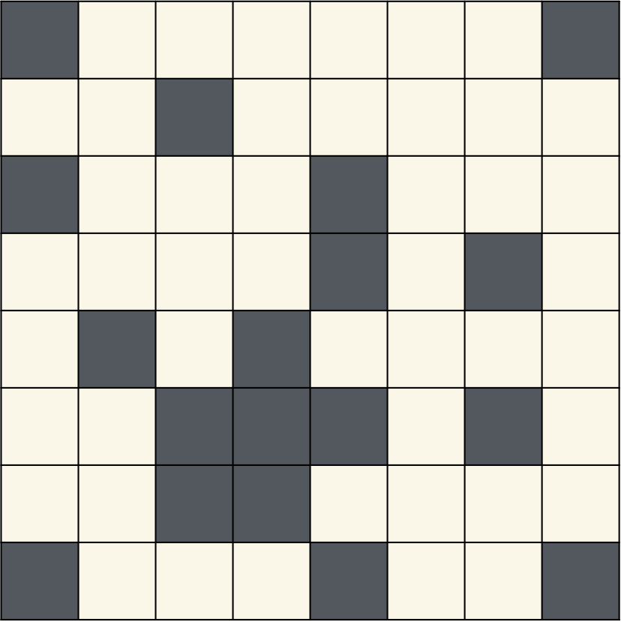
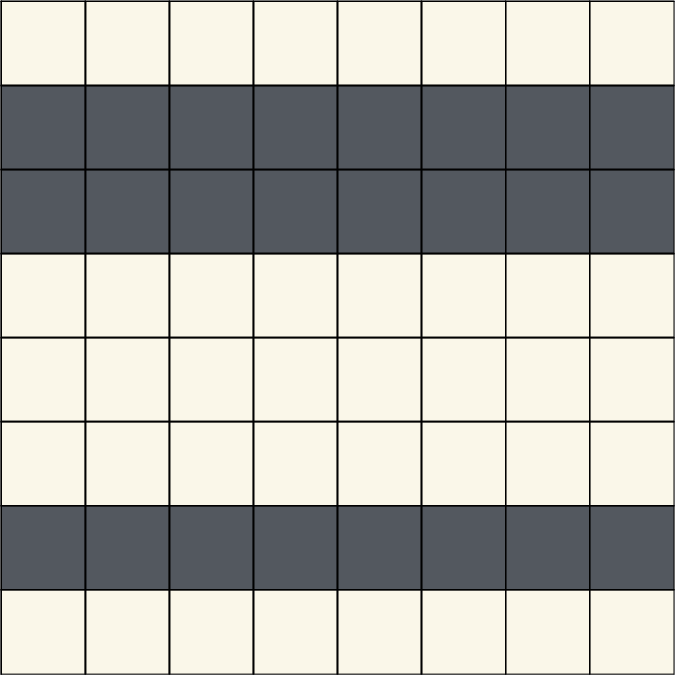
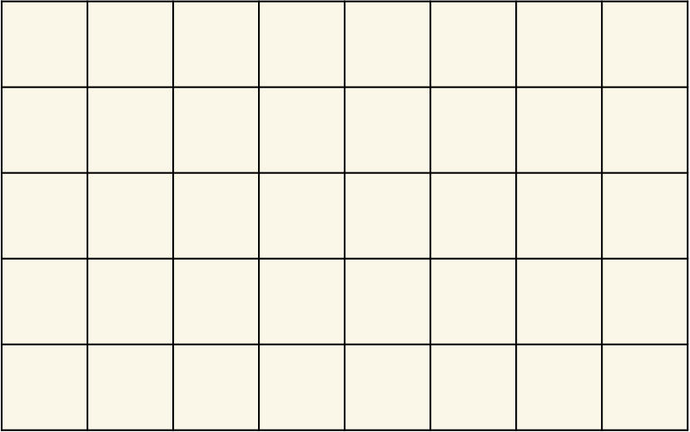
Pruning: Granularity
Unstructured vs. Structured Pruning
Preserved
Pruned
Unstructured Pruning
Structured Pruning

Slide 9
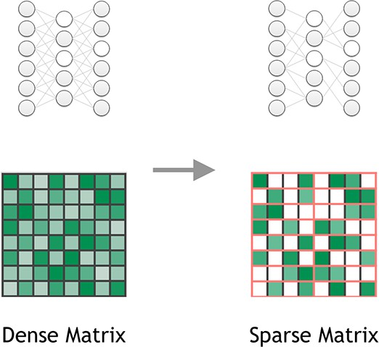
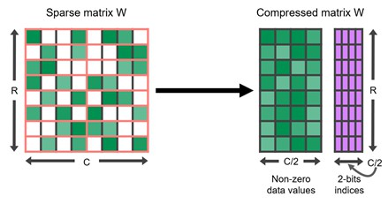
Pruning: Granularity
Pattern-based pruning
For each contiguous M elements, N of them is pruned.
A classic case is 2:4 sparsity (50% sparsity)
It is supported by NVIDIA’s Ampere GPU Architecture (~2x speed up)
Usually maintains accuracy
N:M sparsity

Slide 10
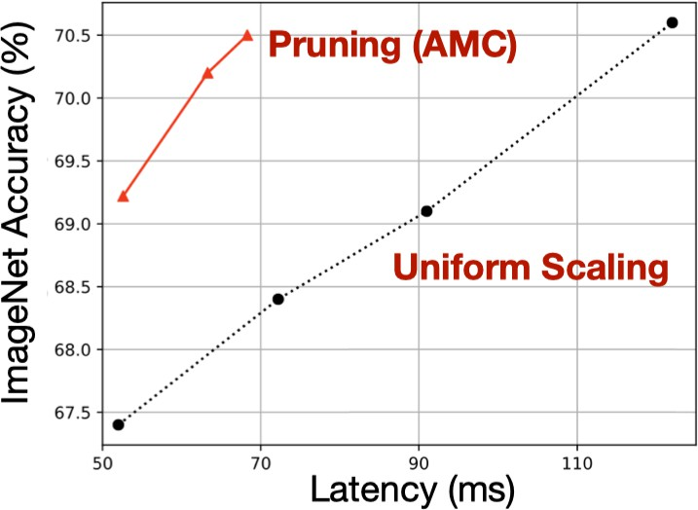
Pruning: Granularity
Channel-level pruning
Pro: Direct speed up due to reduced channel numbers (leading to an NN with smaller #chanels)
Con: smaller compression ratio
Layer 0
Layer 1
Layer 2
Layer 3
Layer 4
Sparsity=0.5
Sparsity=0.3 Sparsity=0.7 Sparsity=0.2 Sparsity=0.3
Channel prune
… #channels
… #channels
Wisely choose the pruning ratio for different layer is better than uniformly sample the different layers.
He, Y., Lin, J., Liu, Z., Wang, H., Li, L. J., & Han, S. (2018). AMC: Automl for model compression and acceleration on mobile devices. In Proceedings of the European conference on computer vision (ECCV) (pp. 784-800).

Slide 11
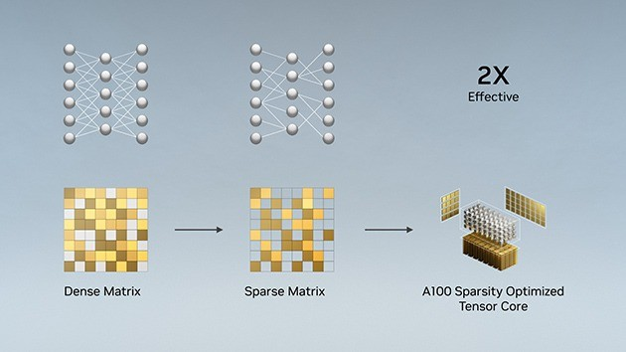

Pruning: Industry Examples
Hardware support for sparsity
2: 4 sparsity in A100 GPU
2X peak performance
1.5X measured BERT speedup

Slide 12
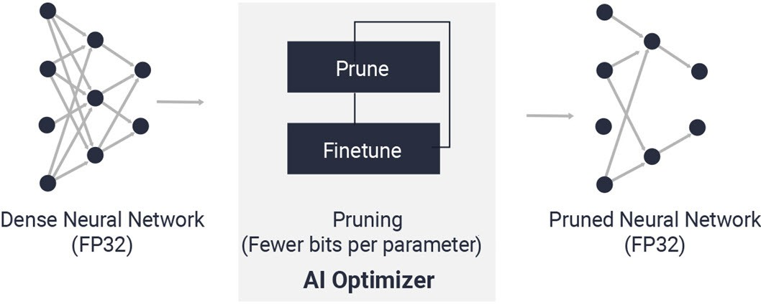


Pruning: Industry Examples
Hardware support for sparsity
Reduce model complexity by 5X to 50X with minimal accuracy impact
Vitis AI Optimizer
Han, S. (2017). Efficient methods and hardware for deep learning (Doctoral dissertation, Stanford University).

Slide 13
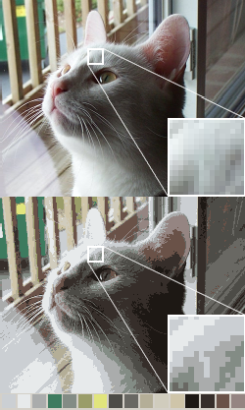
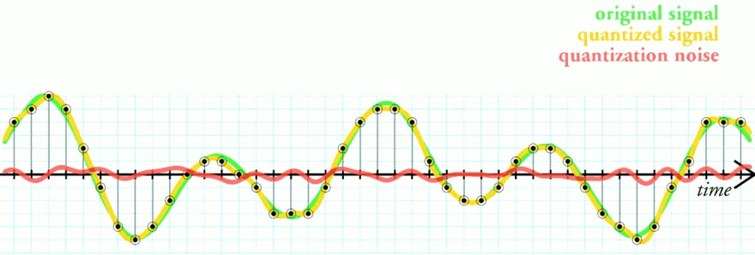


Quantization: Definition
Quantization is the process of constraining an input from a continuous or otherwise large set of values to a discrete set.
Quantization (Wiki)
The difference between an input value and its quantized value is referred to as quantization error.
Original image vs. 16-Color image
Color quantization (Wiki)

Slide 14
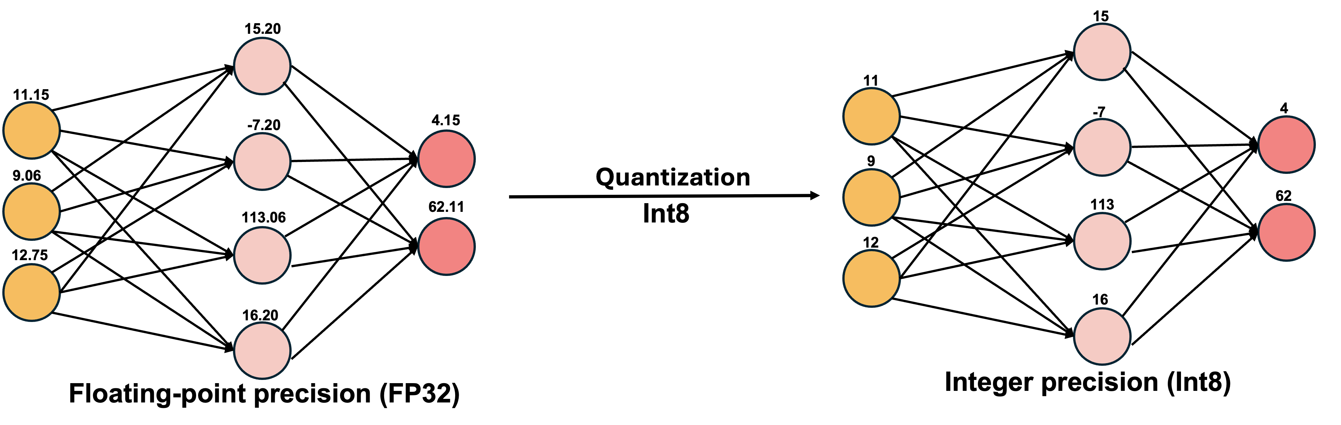

Quantization: Floating-Point to Integers
The core idea
Convert floating-point storage & compute to integers. A weight that needed FP32 is represented as INT8 after quantization — roughly 4× smaller.
Overview of quantization
High precision matters in training (subtle gradients) — not at inference, where weights are fixed.
Networks are robust to noise; quantization is just a controlled form of noise.
Many parameters simply don’t need full precision.
FP32 → INT8 cuts model size ~4×, memory bandwidth and energy — the default in industry.

Slide 15
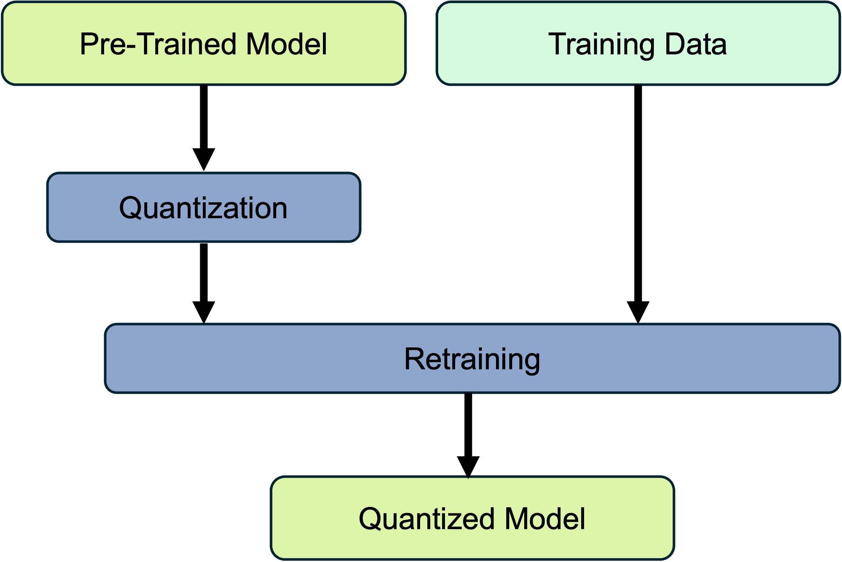
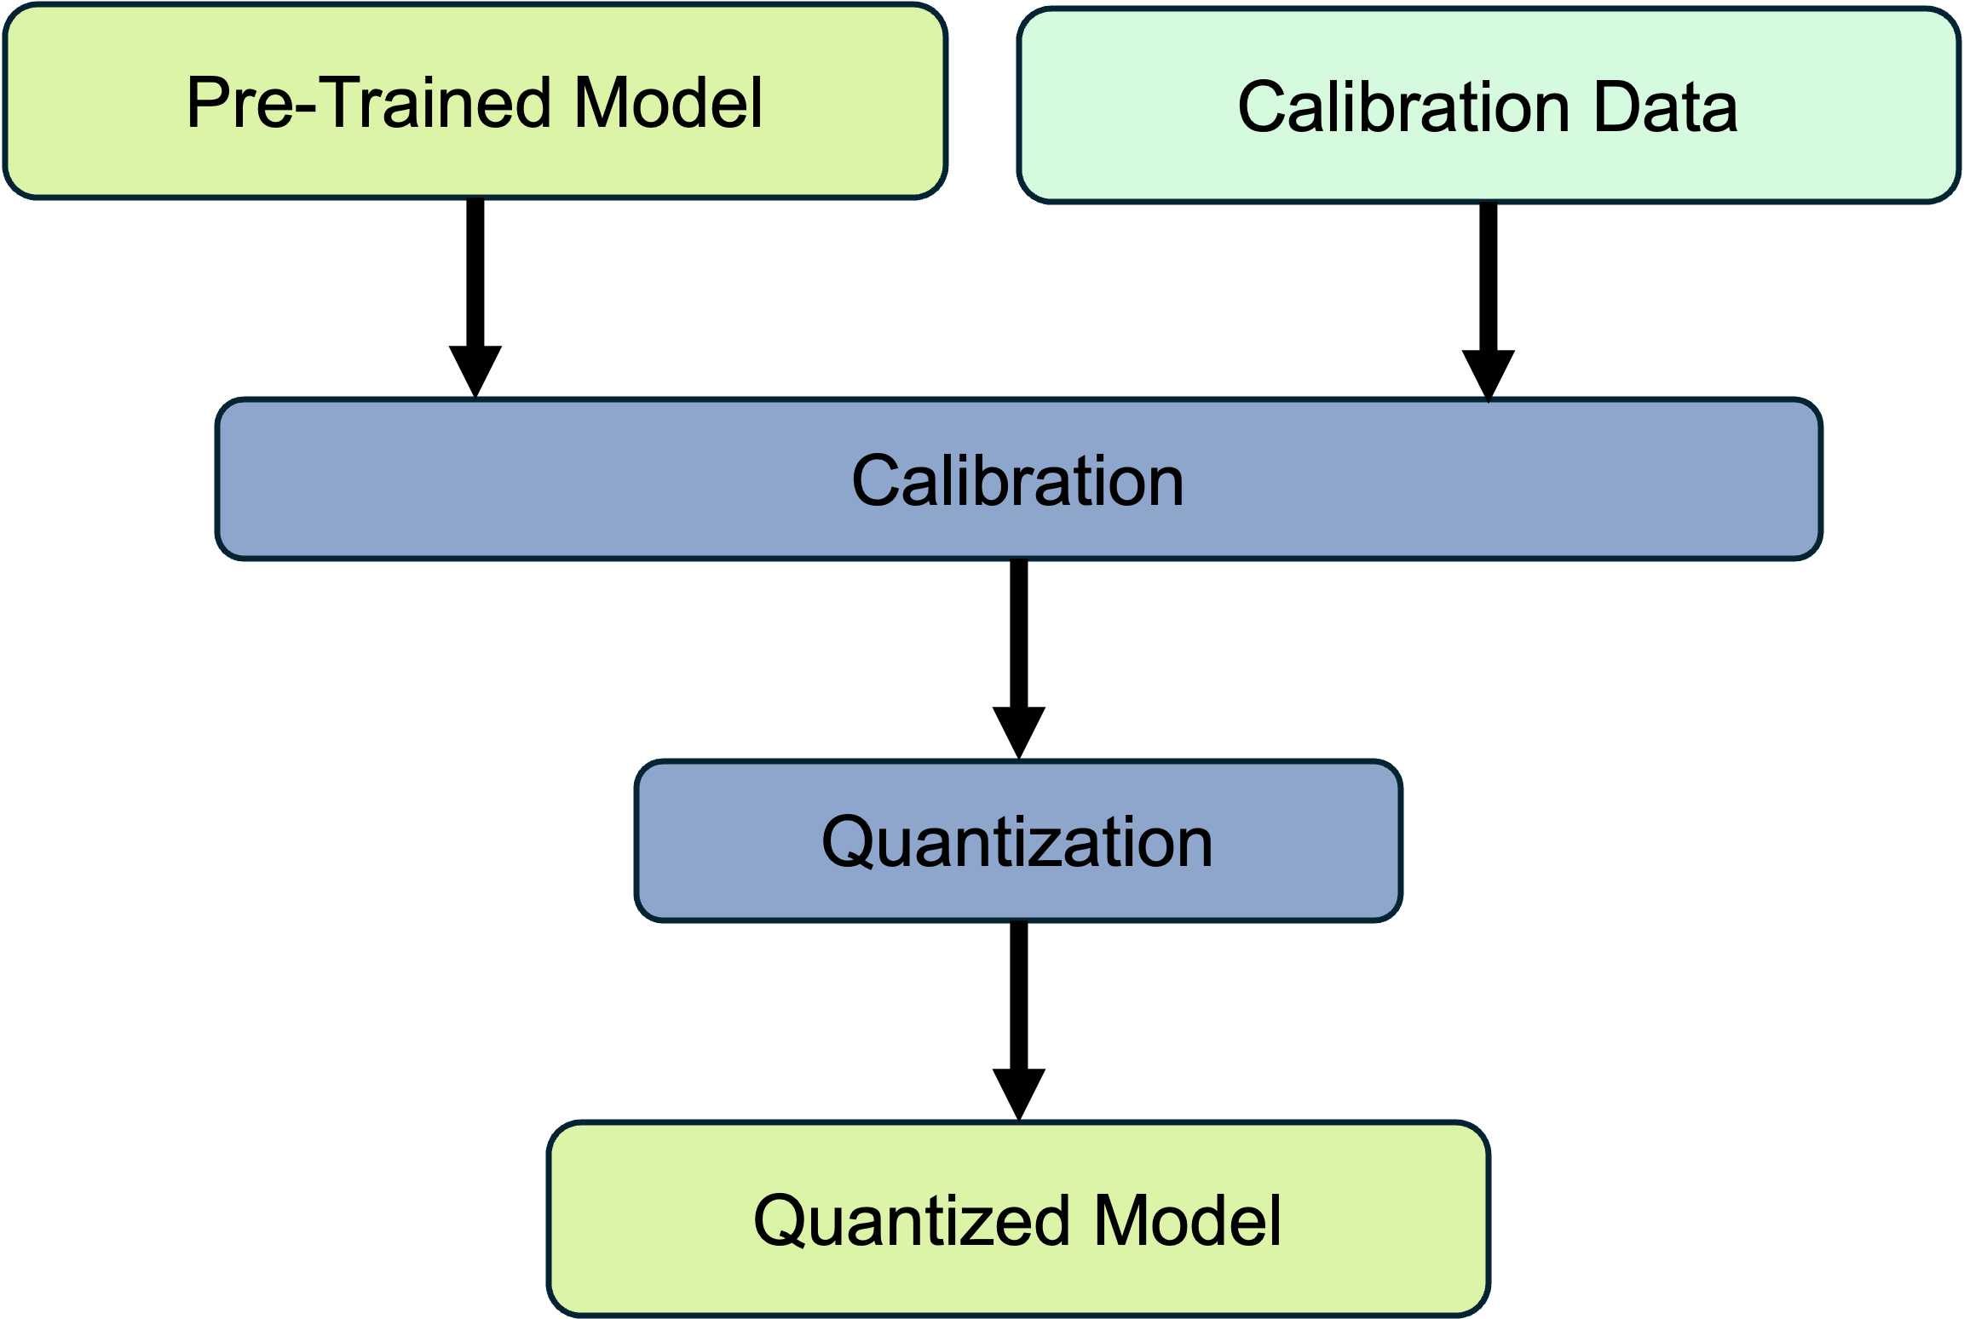
Quantization: Mapping Schemes
Quantization-aware training vs. post-training quantization
Quantization-Aware Training
Post-Training Quantization
Quantize during training’s forward pass
Backward pass stays FP32 for gradients
Model learns to cope with low precision
Slower, but best accuracy under constraints
Applied after the model is fully trained
Calibrates on a small dataset — no retraining
Faster and simpler to apply
Ideal when data is limited or unavailable
QAT
PTQ
Best when: accuracy is critical and training data is available.
Best when: training data is limited & fast deployment is required.

Slide 16
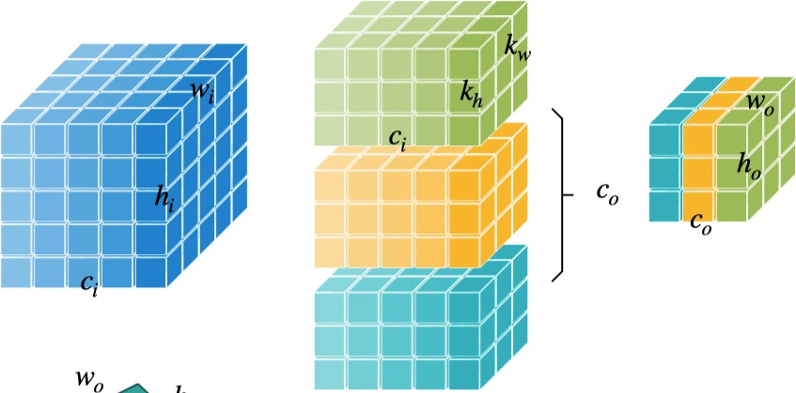
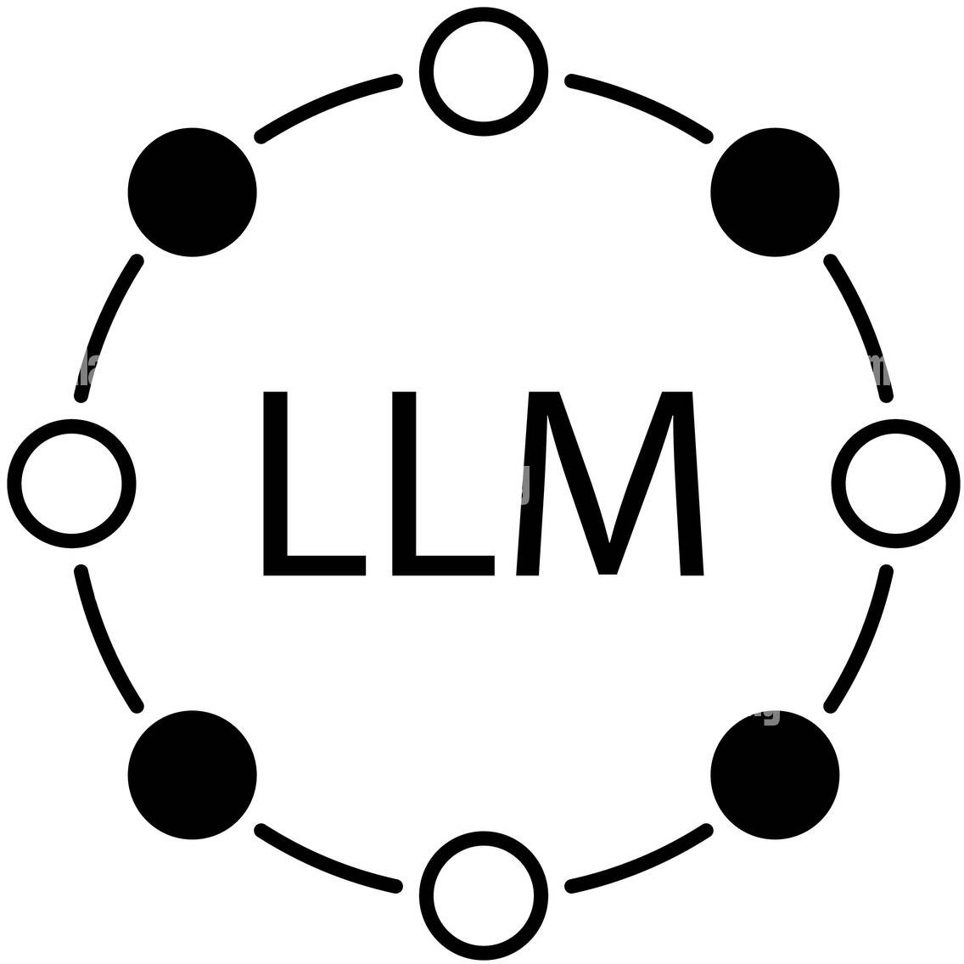
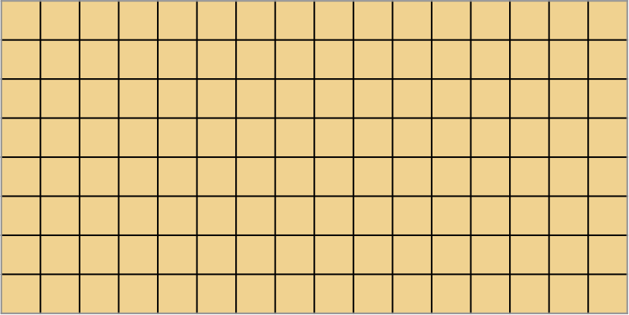

Quantization: Granularity
Per-Tensor Quantization
Per-Channel Quantization
Group Quantization
One scaling factor to scale the whole tensor
One scaling factor to scale one channel
Multi-level scaling scheme

Slide 17






Quantization: State-of-the-art Techniques
BinaryConnect
k-means quantization
Courbariaux et al. — restrict weights to −1 / +1, simplifying deep-learning hardware.
Gong et al. — cluster FC-layer weights: up to 24× compression, ~1% accuracy loss on ImageNet.
Q-ViT | APQ-ViT
Mixed-precision
Bring QAT & accurate PTQ to vision transformers (info rectification, block-wise calibration).
Tang et al. — learnable scale factors pick per-layer bit-widths: high bits for sensitive layers.
Q-BERT
SmoothQuant | AWQ
First to quantize BERT — group-wise, Hessian-based mixed precision.
MIT Han Lab — 8-bit LLMs by smoothing outliers; AWQ preserves 1% salient weights (Jetson Orin, Pi4).
Matthieu Courbariaux, Yoshua Bengio, and Jean-Pierre David. "BinaryConnect: Training deep neural networks with binary weights during propagations". In: Advances in Neural Information Processing Systems 28 (2015).
Yunchao Gong et al. "Compressing deep convolutional networks using vector quantization". In: arXiv preprint arXiv:1412.6115 (2014).
Yanjing Li et al. "Q-ViT: Accurate and fully quantized low-bit vision transformer". In: Advances in Neural Information Processing Systems 35 (2022), pp. 34451–34463.
Yifu Ding et al. "Towards accurate post-training quantization for vision transformer". In: Proceedings of the 30th ACM International Conference on Multimedia. 2022, pp. 5380–5388.
Chen Tang et al. "Mixed-precision neural network quantization via learned layer-wise importance". In: European Conference on Computer Vision. Springer. 2022, pp. 259–275.
Sheng Shen et al. "Q-BERT: Hessian based ultra low precision quantization of BERT". In: Proceedings of the AAAI Conference on Artificial Intelligence 34.05 (2020), pp. 8815–8821.
Guangxuan Xiao et al. "SmoothQuant: Accurate and efficient post-training quantization for large language models". In: International Conference on Machine Learning. PMLR. 2023, pp. 38087–38099.
Ji Lin et al. "AWQ: Activation-aware weight quantization for on-device LLM compression and acceleration". In: Proceedings of Machine Learning and Systems 6 (2024), pp. 87–100.

Slide 18
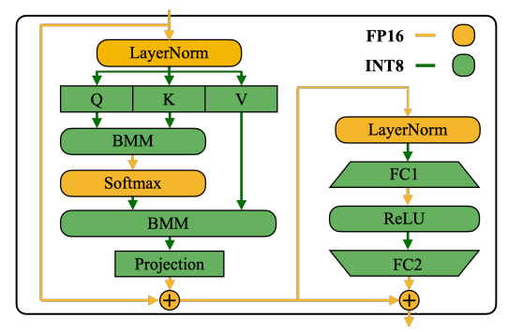


Quantization: SmoothQuant
Core concept. In LLMs the hard part of PTQ is the activations, not the weights. A mathematically equivalent transformation migrates the difficulty from outlier-heavy activations onto the smooth weights — enabling 8-bit weights & activations (W8A8) with no retraining.
The problem
Activation outliers in a few channels stretch the quant range and wreck 8-bit accuracy.
The fix
Scale outlier activations down, weights up by the same s — product unchanged.
Result
Training-free W8A8 up to 175B+ params, with real latency & memory gains.
SmoothQuant’s precision mapping for a Transformer block.
Guangxuan Xiao et al. "SmoothQuant: Accurate and efficient post-training quantization for large language models". In: International Conference on Machine Learning. PMLR. 2023, pp. 38087–38099.

Slide 19
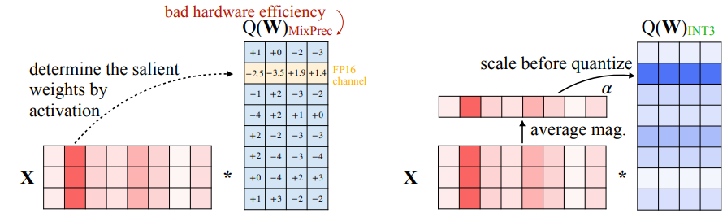



Quantization: AWQ
Core concept. Activation-aware Weight Quantization extends SmoothQuant (MIT Han Lab) toward low-bit, weight-only LLM compression. It preserves the ~1% of salient weights — identified by the activation distribution while quantizing the rest to a uniform low bit-width.
Salient by activation
Weights tied to big activation channels matter most — protect that 1%.
Uniform low-bit
Per-channel scaling protects salient weights; everything quantized to 4-bit.
(a) Keep 1% salient weights in FP16 (PPL 13.0)
(b) Scale the weights before quantization (PPL 13.0)
Built for edge
Runs on Jetson Orin & Raspberry Pi 4; used in TinyChat (course project).
AWQ performs per-channel scaling to protect the salient weights and reduce quantization error.
Ji Lin et al. "AWQ: Activation-aware weight quantization for on-device LLM compression and acceleration". In: Proceedings of Machine Learning and Systems 6 (2024), pp. 87–100.

Slide 20
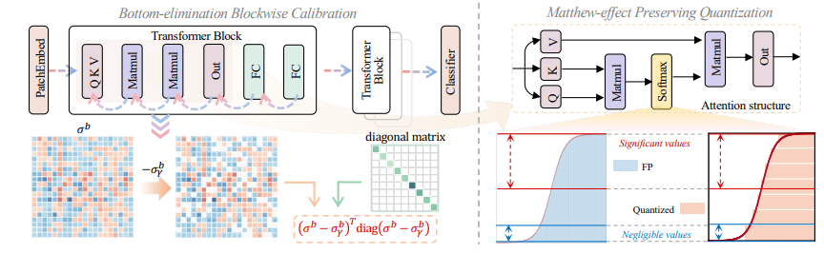



Quantization: APQViT
Core concept. An accurate PTQ framework for vision transformers. It adds unified block-wise calibration (optimizing error block-by-block) and a Matthew-Effect Preserving Quantization for the softmax, so the skewed attention ranking survives low-bit quantization — no retraining.
Block-wise calibration
Calibrate per transformer block, capturing accumulated error across attention + MLP.
Softmax preserved
Keeps the “rich-get-richer” attention ordering that naive low-bit quant flattens.
Accurate PTQ
Overview of APQ-ViT.
Quantizes ViTs accurately without any retraining step.
Yifu Ding et al. "Towards accurate post-training quantization for vision transformer". In: Proceedings of the 30th ACM International Conference on Multimedia. 2022, pp. 5380–5388.

Slide 21
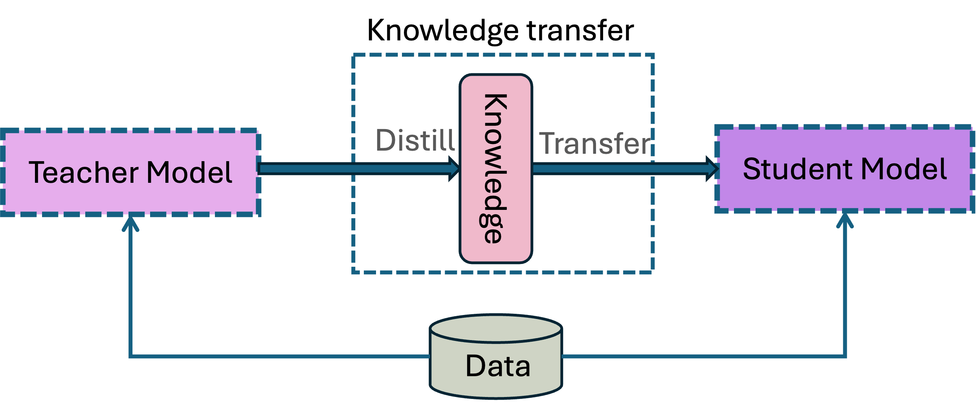

Knowledge Distillation
Teacher teaches student
1
Train the teacher
A large, accurate network is trained, then frozen.
2
Transfer knowledge
Its soft outputs + the true labels train a smaller student.
Overview of Knowledge Distillation (KD).
3
Two-loss objective
Distill Loss (teacher soft targets) + Student Loss (ground-truth labels).
The student rivals the teacher at a fraction of the size — and can even match an ensemble.

Slide 22
Knowledge Distillation: Distill Output Logits
The simplest and widely used
Softmax(T = τ)
Soft labels
distill loss
Soft predictions
Cross entropy loss
𝔼(−p_{t} log p_{s})
L2 loss
Teacher Network
Input
Softmax(T = τ)
Softmax(T = 1)
Hard predictions
2₎
2
Student Network
𝔼( p_{t} − p_{s}
Label
student loss
The overall loss function, including distillation and student loss is:
L(x; θ) = α * L_{ce}(y, σ(z_{s}; T = 1)) + L_{ce}(σ(z_{t}; T = τ), σ(z_{s}; T = τ))
Where x is the input, θ is the student network parameter, L_{ce} is the cross-entropy loss function, Y is the ground truth label, σ is the softmax function parameterized by the temperature T(controls probability distribution). α is the coefficient. z_{s}, z_{t} are the logits of the students and teacher respectively.
In other words, the loss function is a weighted average of cross-entropy loss and KL divergence.
Hinton, G. (2015). Distilling the Knowledge in a Neural Network. arXiv preprint arXiv:1503.02531.
Ba, J., & Caruana, R. (2014). Do deep nets really need to be deep?. Advances in neural information processing systems, 27.

Slide 23



Knowledge Distillation: Schemes
Pre-trained
Teacher Network
Teacher Network
To be trained
Teacher/Student Network
Self distillation
Student Network
Student Network
Offline distillation
Online distillation
Distillation Schemes

Slide 24


Combined Techniques
Each method has trade-offs — so researchers combine them. Distillation is the common glue: it regularizes the student against the shocks of pruning and quantization.
Deep Compression
Prune + Distill
Han et al. — prune + quantize + Huffman coding, together slashing storage.
Aghli & Ribeiro — selective weight pruning, then KD on the un-pruned layers; handles ResNet dependencies.
Unified ViT
Bayesian Bits
Yu et al. — layer pruning + layer skipping + KD in one budget-constrained objective; ViT shrinks to 50% FLOPs.
Qualcomm — joint mixed-precision quantization + pruning via learnable stochastic gates.
Song Han, Huizi Mao, and William J Dally. "Deep compression: Compressing deep neural networks with pruning, trained quantization and Huffman coding". In: arXiv preprint arXiv:1510.00149 (2015).
Nima Aghli and Eraldo Ribeiro. "Combining weight pruning and knowledge distillation for CNN compression". In: Proceedings of the IEEE/CVF Conference on Computer Vision and Pattern Recognition. 2021, pp. 3191–3198.
Andrey Kuzmin et al. "Pruning vs quantization: Which is better?" In: Advances in Neural Information Processing Systems 36 (2024).

Slide 25
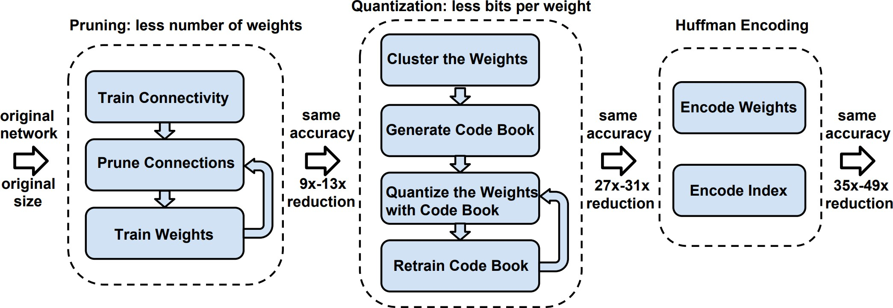
Combined Techniques
Deep Compression (prune + quantize + Huffman coding)
No accuracy loss
On AlexNet & VGG-16, the pipeline compressed 35–49× with no drop in ImageNet accuracy — the headline result.
Faster
Fewer weights and cheaper memory access mean lower latency and energy — ideal for edge inference.
Overview of deep compression
Template
It set the pattern for combined compression: prune, then quantize, then code — reused across CNNs, ViTs.
Han, S., Mao, H., & Dally, W. J. (2015). Deep compression: Compressing deep neural networks with pruning, trained quantization and huffman coding. arXiv preprint arXiv:1510.00149.

Slide 26
Summary
Deep models are too big for edge devices; compression shrinks them and speeds up inference at low cost.
Pruning removes redundant weights/filters, then retrain — structured pruning gives real hardware speedups.
Quantization lowers numeric precision from FP32 to INT8 for a roughly 4× smaller model, using QAT when accuracy matters and PTQ when speed does.
Knowledge distillation lets a frozen teacher train a compact student that keeps most of the accuracy.
Combining techniques compounds the gains, as in Deep Compression which prunes, quantizes, and codes together as the modern default.

Slide 27


Project
Using model compression techniques, optimizing large language models (LLMs) on edge devices (e.g., your laptop). A good example can be found at GitHub: https://github.com/mit-han-lab/tinychat-tutorial?tab=readme-ov-file.
Tasks
Expected outcomes
1
Set up TinyChat Clone the tutorial repo and install the toolchain on your laptop.
~4× smaller 4-bit weights shrink the model to roughly a quarter of its FP16 footprint.
2
Quantize with AWQ Apply Activation-aware Weight Quantization — protect the salient 1% of weights, pack the rest to 4-bit.
Fits in laptop RAM A quantized 7B-class model runs in the memory of a typical laptop.
3
Deploy & run inference Load the quantized model and chat with it locally — no GPU cluster, no cloud.
Interactive latency Lower precision + smaller memory traffic give usable token throughput on CPU/edge GPU.
4
Measure & compare Benchmark model size, memory, latency and output quality vs. the FP16 baseline.
Minimal quality loss AWQ’s salient-weight protection keeps generation quality close to the baseline.
Example: quantize Llama-2-7B with AWQ to 4-bit, then run TinyChat locally. Resource: https://github.com/mit-han-lab/tinychat-tutorial

Slide 28
References
LeCun, Y., Denker, J., & Solla, S. (1989). Optimal brain damage. Advances in neural information processing systems, 2.
Han, S., Pool, J., Tran, J., & Dally, W. (2015). Learning both weights and connections for efficient neural network. Advances in neural information processing systems, 28.
Han, S. (2017). Efficient methods and hardware for deep learning (Doctoral dissertation, Stanford University).
Matthieu Courbariaux, Yoshua Bengio, and Jean-Pierre David. "BinaryConnect: Training deep neural networks with binary weights during propagations". In: Advances in Neural Information Processing Systems 28 (2015).
Yunchao Gong et al. "Compressing deep convolutional networks using vector quantization". In: arXiv preprint arXiv:1412.6115 (2014).
Yanjing Li et al. "Q-ViT: Accurate and fully quantized low-bit vision transformer". In: Advances in Neural Information Processing Systems 35 (2022), pp. 34451–34463.
Yifu Ding et al. "Towards accurate post-training quantization for vision transformer". In: Proceedings of the 30th ACM International Conference on Multimedia. 2022, pp. 5380–5388.
Chen Tang et al. "Mixed-precision neural network quantization via learned layer-wise importance". In: European Conference on Computer Vision. Springer. 2022, pp. 259–275.
Sheng Shen et al. "Q-BERT: Hessian based ultra low precision quantization of BERT". In: Proceedings of the AAAI Conference on Artificial Intelligence 34.05 (2020), pp. 8815–8821.
Guangxuan Xiao et al. "SmoothQuant: Accurate and efficient post-training quantization for large language models". In: International Conference on Machine Learning. PMLR. 2023, pp. 38087–38099.
Ji Lin et al. "AWQ: Activation-aware weight quantization for on-device LLM compression and acceleration". In: Proceedings of Machine Learning and Systems 6 (2024), pp. 87–100.
Cristian Bucilua, Rich Caruana, and Alexandru Niculescu-Mizil. "Model compression". In: Proceedings of the 12th ACM SIGKDD International Conference on Knowledge Discovery and Data Mining. 2006, pp. 535–541.
Tianqi Chen, Ian Goodfellow, and Jonathon Shlens. "Net2net: Accelerating learning via knowledge transfer". In: arXiv preprint arXiv:1511.05641 (2015).
Shangquan Sun et al. "Logit standardization in knowledge distillation". In: Proceedings of the IEEE/CVF Conference on Computer Vision and Pattern Recognition (CVPR). 2024, pp. 15731–15740.
Song Han, Huizi Mao, and William J Dally. "Deep compression: Compressing deep neural networks with pruning, trained quantization and Huffman coding". In: arXiv preprint arXiv:1510.00149 (2015).
Nima Aghli and Eraldo Ribeiro. "Combining weight pruning and knowledge distillation for CNN compression". In: Proceedings of the IEEE/CVF Conference on Computer Vision and Pattern Recognition. 2021, pp. 3191–3198.
Andrey Kuzmin et al. "Pruning vs quantization: Which is better?" In: Advances in Neural Information Processing Systems 36 (2024).

