Slide 1
Edge Intelligence III: Codesign & Edge Systems
Chapter 4
Topic: Low-rank approximation | HW-SW codesign | Lightweight Models | Training & Inference

Slide 2
Outline
Low-Rank Approximation
Lightweight Models
Training & Inference
Factor big weight matrices
SVD & rank intuition
Fewer params, less compute
MobileNet, SqueezeNet
Tiny models: Bonsai, FastGRNN
MobileViT hybrids
Edge training architectures
CLONE collaborative learning
TensorRT & collaborative infer
HW-SW Codesign
Acceleration Techniques
Summary & Practice
Co-develop model + chip
CODEBench, TransPIM
FPGA & multimodal codesign
Model simplification
Auto-ViT-Acc
ViA FPGA accelerator

Slide 3

Low-Rank Approximation
Factor the Weight Matrix
Original weight W
Low-rank factors U x V
m x n full rank | dense
Rank k << min(m, n)
What is rank?
The number of linearly independent rows/columns — a measure of how much unique information a matrix holds. Correlated rows → low rank → compressible.
≈
V
k x n
m . n parameters
U
Only k (m + n) parameters
m x k
Denton et al. SVD on FC layers → 3× conv speedup, <1% precision loss.
Decompose one big multiplication into two small ones
Correlated rows mean W is effectively low-rank- SVD or factorization recovers it, cutting compute.
Denil et al. Low-rank cuts the number of dynamic parameters.
Sainath et al. Low-rank factorization on the final DNN layer for acoustic models.
Emily L Denton et al. "Exploiting linear structure within convolutional networks for efficient evaluation". In: Advances in Neural Information Processing Systems 27 (2014).
Misha Denil et al. "Predicting parameters in deep learning". In: Advances in Neural Information Processing Systems 26 (2013).
Tara N Sainath et al. "Low-rank matrix factorization for deep neural network training with high-dimensional output targets". In: 2013 IEEE International Conference on Acoustics, Speech and Signal Processing. IEEE. 2013, pp. 6655–6659.

Slide 4
Low-Rank Approximation: Singular Value Decomposition (SVD)
SVD provides fewer parameters with less compute
Original weight W
Truncated Singular Value Decomposition
Efficiency Gain
m x n full rank | dense
Parameters
Truncate to rank r
Σᵣ
Before mn After r(m +n)
Example
Vᵣᵀ
W = 1024 × 1024
1,048,576
r = 128
262,144
m × r
r × r
r × n
m . n parameters
U_{r}
≈ 75% fewer parameters
For deployment, absorb Σᵣ into either factor: A = UᵣΣᵣ, B = Vᵣᵀ
Compute
O(mn) → O[r(m+n)]
One large multiply becomes two smaller multiplies
SVD preserves the dominant structure of W while discarding low-information directions.
Less memory • Fewer MACs • Faster inference

Slide 5
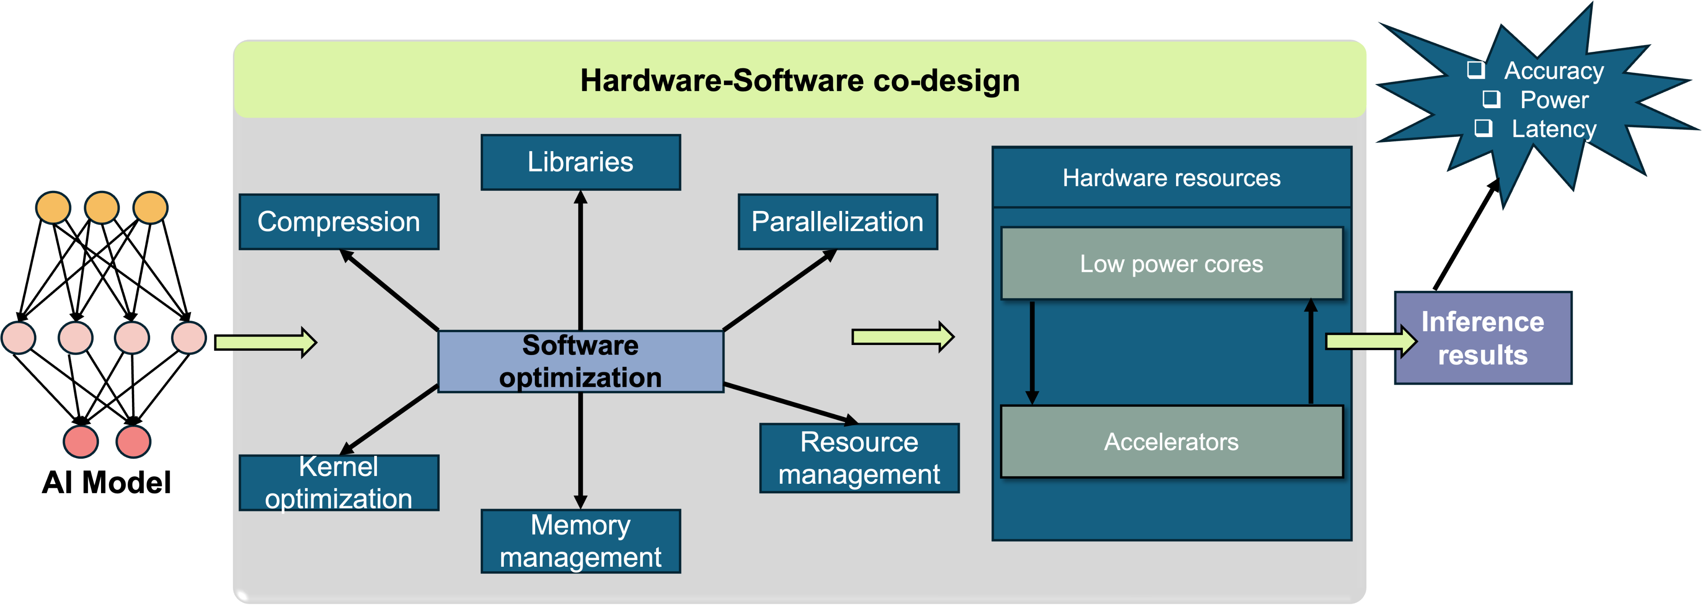


Hardware-Software (HW-SW) Codesign
Model and hardware should be designed together for edge
Software part
Compression, kernel & memory optimization, parallelization, resource management, libraries.
Hardware part
Overview of hw-sw codesign
Low-power cores, accelerators & hardware resources tuned to the workload.
The idea.
Software and hardware are developed simultaneously to maximize an edge device’s performance, efficiency and scalability.

Slide 6
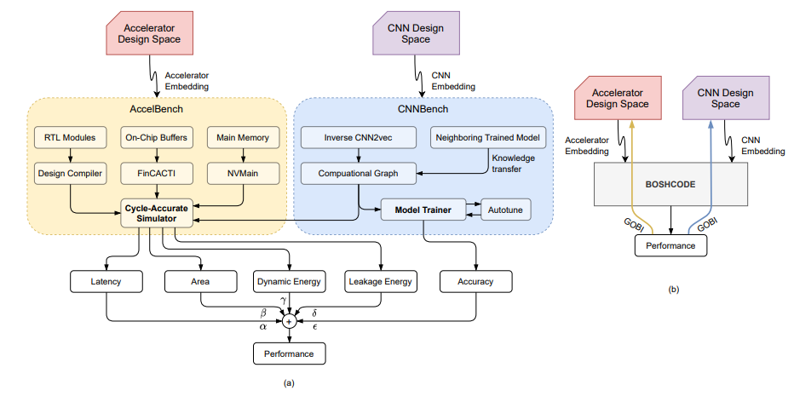
HW-SW Codesign: Frameworks
CODEBench
CODEBench
Pairs CNNBench (Bayesian architecture search) with AccelBench (cycle-accurate accelerator sim). Beats SOTA on ImageNet & Cifar for accuracy, latency and energy.
CODEBench pipeline that includes CNNBench, AccelBench, and a novel co-design method, BOSHCODE: (a) The CNN and accelerator design spaces are sampled for novel CNN-accelerator pairs that are simulated using the CNNBench and AccelBench frameworks. (b) BOSHCODE learns a surrogate function from these design spaces to predict the performance of each CNN-accelerator pair, implementing GOBI to predict the next pair to be simulated in the active learning framework.
Shikhar Tuli et al. “CODEBench: A neural architecture and hardware accelerator co-design framework”. In: ACM Transactions on Embedded Computing Systems 22. 3 (2023), pp. 1–30.

Slide 7
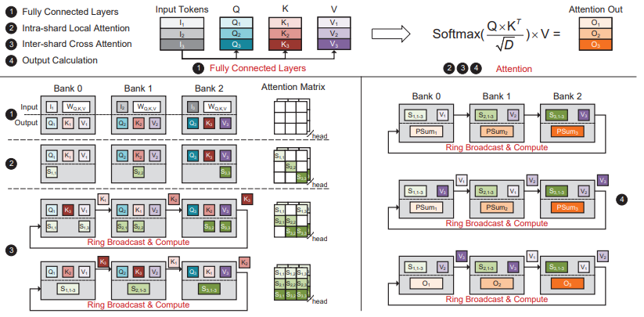
HW-SW Codesign: Frameworks
TransPIM
TransPIM
software–hardware codesign for transformers via processing-in-memory. Token-based dataflow + light HBM tweaks give 2.0× the throughput of ASIC accelerators.
Token-based data sharding scheme and the dataflow of Transformer encoder in TransPIM.
Minxuan Zhou et al. “TransPIM: A memory-based acceleration via software-hardware codesign for transformer”. In: 2022 IEEE International Symposium on High-PerformanceComputer Architecture (HPCA). IEEE. 2022, pp. 1071–1085.

Slide 8

HW-SW Codesign: Frameworks
Additional
FPGA codesign
Multimodal & AV
Custom PEs (systolic arrays) map models onto reconfigurable fabric. Anupreetham et al. reach 8× detection throughput; Sparse-YOLO targets YOLOv2 on CPU+FPGA.
Li et al. weigh BEVDet (camera) vs. PointPillars (LiDAR) on FPGA/GPU. Hao & Chen survey codesign for multimodal multitask autonomous systems.
Cong Hao and Deming Chen. “Software/hardware co-design for multi-modal multi-task learning in autonomous systems”. In: 2021 IEEE 3rd International Conference on Artificial Intelligence Circuits and Systems (AICAS). IEEE. 2021, pp. 1–5.

Slide 9


Lightweight Models
Resource-constrained edge devices are limited in compute, memory, storage, energy and bandwidth. So, models must be small by design. Two approaches:
Human-designed
Neural Architecture search
Expert-crafted efficient architectures
Let AI find the best architecture
Depth-wise separable convolutions (MobileNets)
Group convolutions (Xception)
Proven, but time-consuming to design
Automated search: NASNet, AmoebaNet
Competitive — sometimes superior — accuracy
Limited by heavy hardware requirements

Slide 10
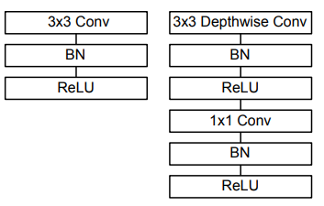
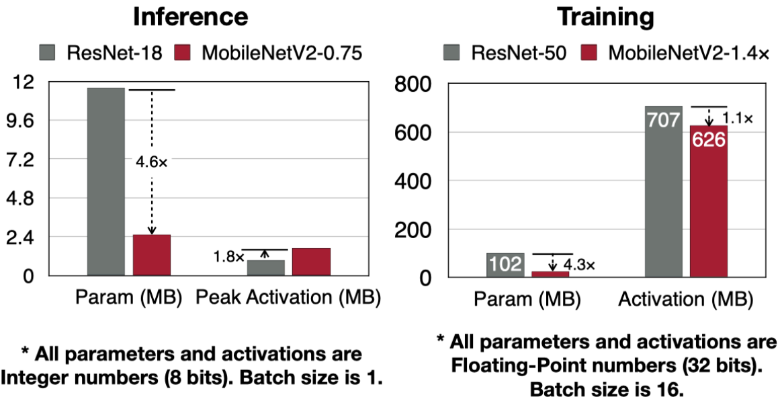
Lightweight Models
Problem: compared to normal convolution, depthwise convolution has a much lower capacity
Solution: Increase the depthwise convolution’s input and output channels to improve its capacity
Mobilenets
      convolution’s cost only grows linearly, so the cost is still affordable.
However, this design is not memory-efficient for both inference and training.
Left: Standard convolutional layer with batchnorm and ReLU. Right: Depthwise Separable convolutions with Depthwise and Pointwise layers followed by batchnorm and ReLU.
Sandler, M., Howard, A., Zhu, M., Zhmoginov, A., & Chen, L. C. (2018). Mobilenetv2: Inverted residuals and linear bottlenecks. In Proceedings of the IEEE conference on computer vision and pattern recognition (pp. 4510-4520).

Slide 11
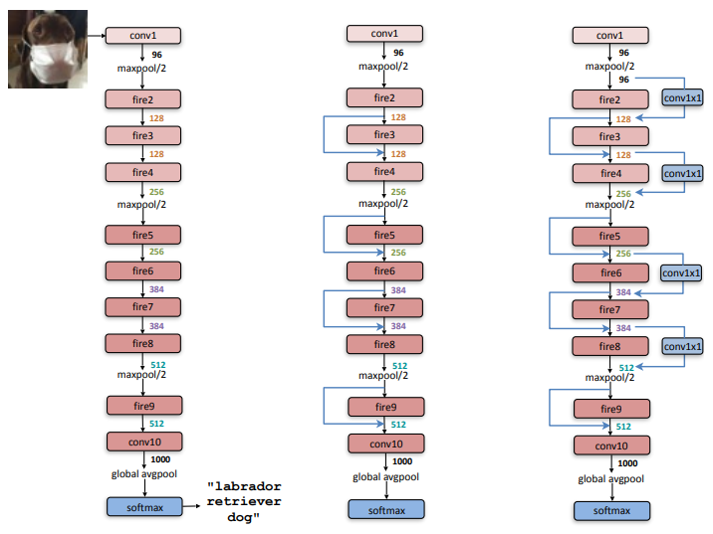

Lightweight Models
SqueezeNet
SqueezeNet
AlexNet-level accuracy with 50× fewer parameters (510× smaller).
(a) SqueezeNet
(b) SqueezeNet with simple bypass
(c) SqueezeNet with complex bypass
Iandola, Forrest N., et al. "SqueezeNet: AlexNet-level accuracy with 50x fewer parameters and< 0.5 MB model size." arXiv preprint arXiv:1602.07360 (2016).

Slide 12
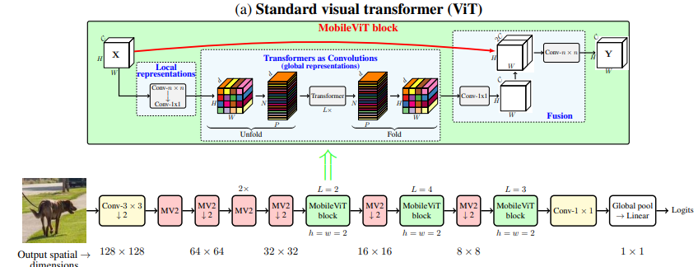
Lightweight Models
MobileViT
MobileViT
MobileViT
MobileViTV2
Combines CNNs with Transformers to capture both local features and global context efficiently on mobile devices.
Improves MobileViT with separable self-attention, reducing computational cost and improving efficiency while maintaining strong accuracy.
Mehta, Sachin, and Mohammad Rastegari. "Mobilevit: light-weight, general-purpose, and mobile-friendly vision transformer." arXiv preprint arXiv:2110.02178 (2021).

Slide 13



Lightweight Models
Additional studies
Xception / Flattened
Bonsai / ProtoNN
EMI-RNN / FastGRNN
Depth-wise separable & 1-D filters for fast, compact feedforward nets.
Microsoft — tree & KNN models that fit tiny IoT devices (2 KB RAM Arduino).
Kilobyte-sized RNNs — 72× less compute than LSTM, +1% accuracy.

Slide 14


Acceleration Techniques
Overparameterization
ViT acceleration on FPGA
Training needs many parameters to capture model fluctuations — but inference needs far fewer. So the model can be simplified after training, before edge deployment.
Auto-ViT-Acc
Mixed precision across transformer blocks; 0.47–1.36% higher Top-1 at the same bit-width.
Less computation → lower power & time
Smaller footprint → lower-end devices
Complementary to hardware acceleration
ViA
Half-layer mapping + reuse engines beat NVIDIA Tesla V100 on energy efficiency.

Slide 15
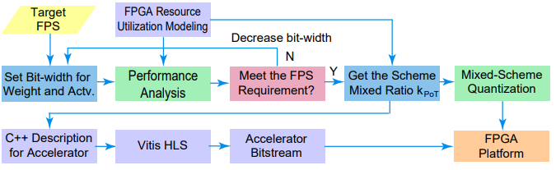
Acceleration Techniques : ViT acceleration on FPGA
Auto-ViT-Acc
Overview of Auto-ViT-Acc framework
Uses mixed-scheme quantization combining fixed-point + Power-of-Two (PoT) quantization.
Achieves 56.8 FPS vs. 10 FPS (~5.6× higher) than the FP32 FPGA baseline for DeiT-Base, with only 0.71% accuracy drop on ImageNet.
Li, Zhengang, et al. "Auto-vit-acc: An fpga-aware automatic acceleration framework for vision transformer with mixed-scheme quantization." 2022 32nd International Conference on Field-Programmable Logic and Applications (FPL). IEEE, 2022.

Slide 16
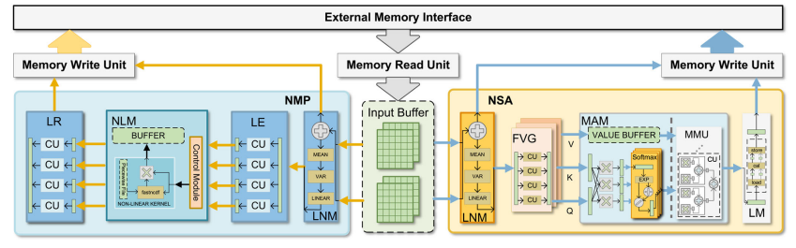
Acceleration Techniques : ViT acceleration on FPGA
ViA
Overview of Auto-ViT-Acc framework
ViT-specific FPGA accelerator designed around the actual computation flow of Vision Transformers.
Reports about 5.2× higher energy efficiency than NVIDIA Tesla V100 and 4–10× improvement over prior FPGA accelerators.
T. Wang et al., "ViA: A Novel Vision-Transformer Accelerator Based on FPGA," in IEEE Transactions on Computer-Aided Design of Integrated Circuits and Systems, vol. 41, no. 11, pp. 4088-4099, Nov. 2022, doi: 10.1109/TCAD.2022.3197489

Slide 17



Training & Inference on Edge
Where and How Models Learn
Architecture
Why train at the edge?
Centralized
Client edges request services from a central server / cloud (client–server).
Privacy Data stays local instead of going to a central server.
Decentralized
Peer-to-peer — edges share and consume resources directly, no central server.
Personalization Models adapt to the data each device actually sees.
Optimization goals
Processing efficiency — transfer learning, cache features, learn from peers
Communication efficiency — fewer, smaller updates; gradient quantization & sparsification
Robustness Less dependence on the network; resilient services.

Slide 18
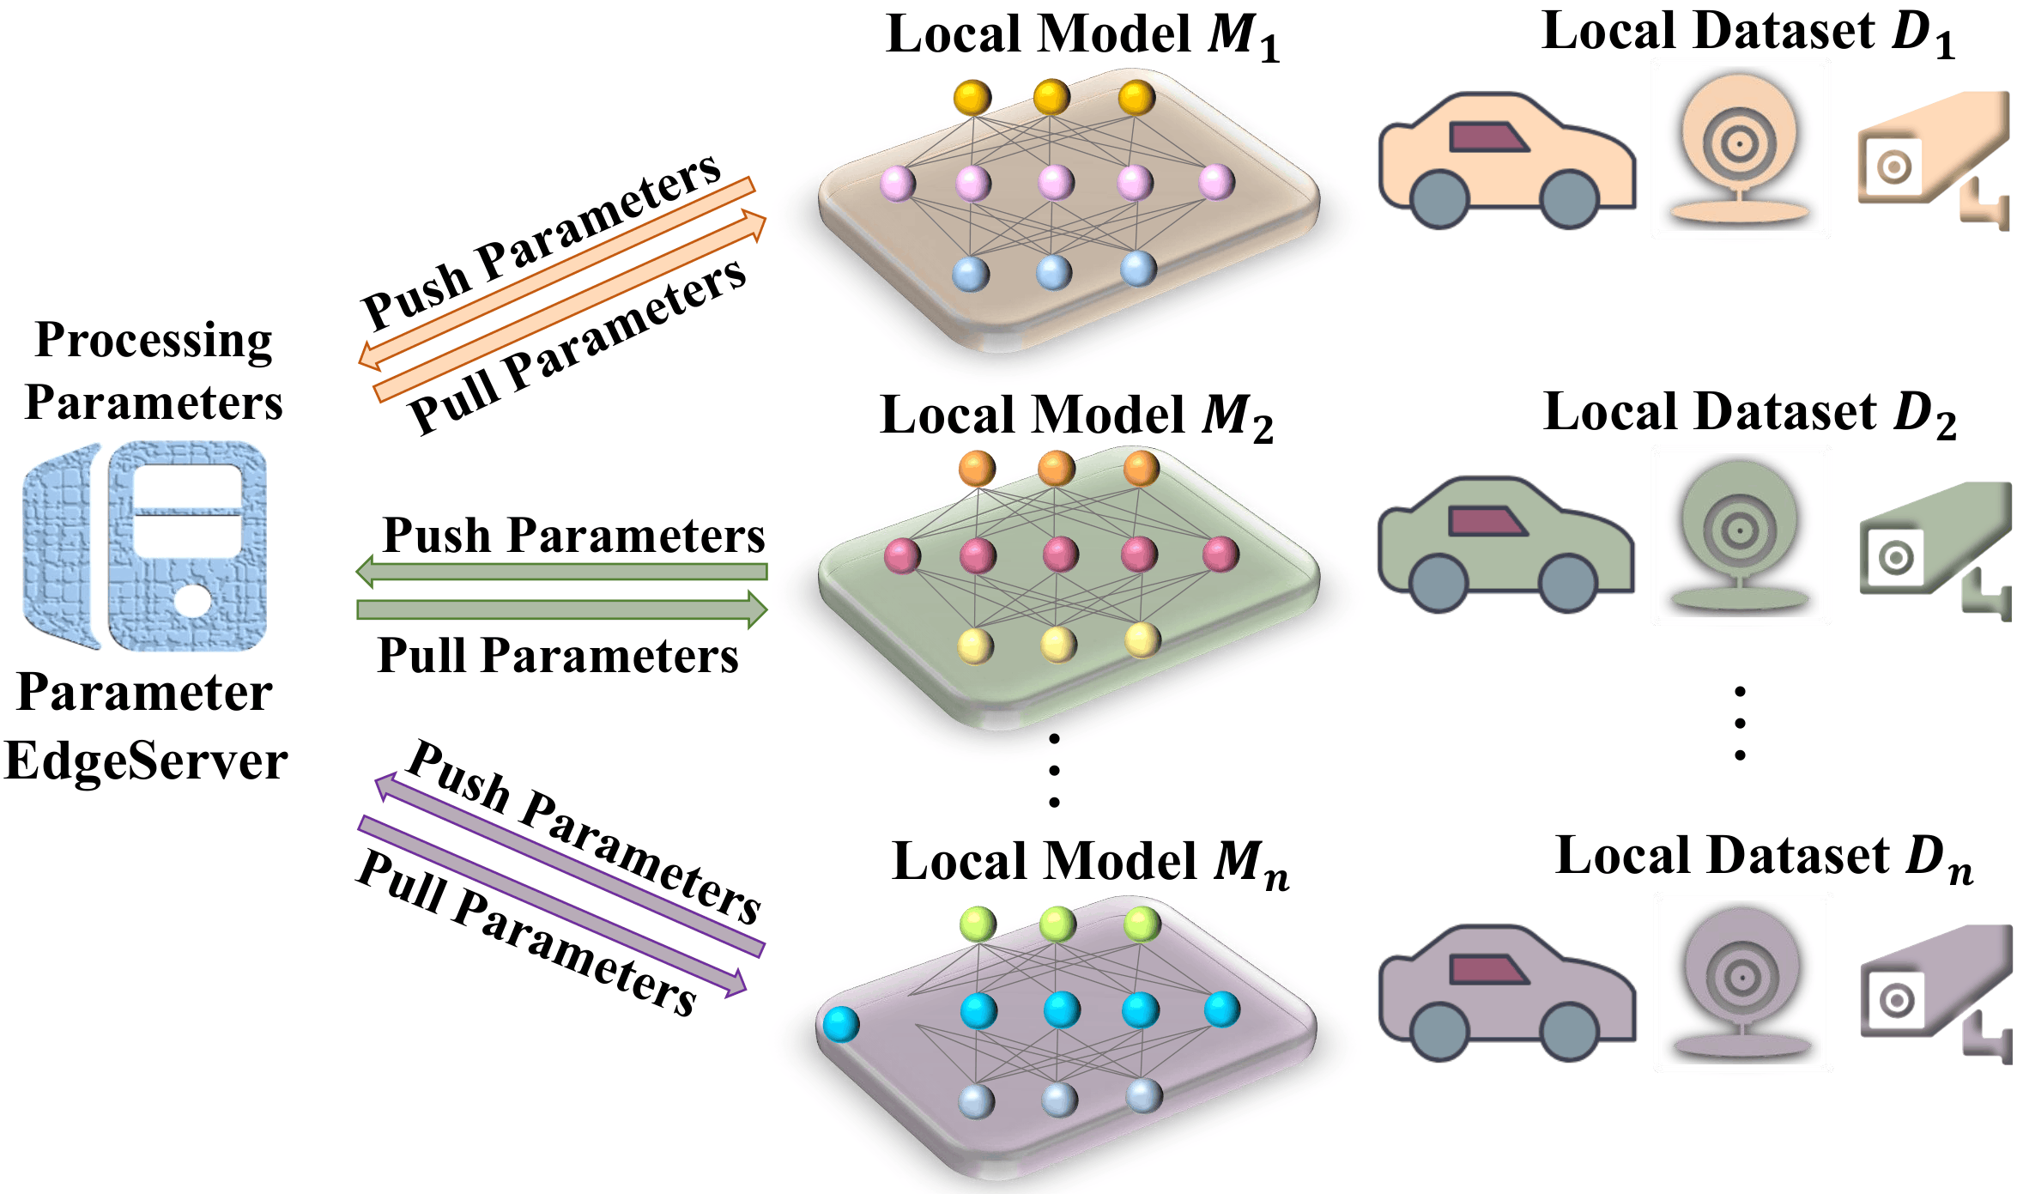


Training & Inference on Edge: Collaborative Training
Clone: learning on the edges
The idea. Each edge node trains on its own private data, then sends parameters to a central Parameter EdgeServer that aggregates and returns them.
Local data stays put
Nodes train on private datasets D₁…Dₙ — raw data never leaves the device.
Push / pull parameters
Only model parameters travel to and from the EdgeServer.
Clone framework
Lower latency & privacy
Demonstrated on connected vehicles — faster and more private than cloud training.
Sidi Lu, Yongtao Yao, and Weisong Shi. “CLONE: Collaborative learning on the edges”. In: IEEE Internet of Things Journal 8. 13 (2020), pp. 10222–10236.

Slide 19
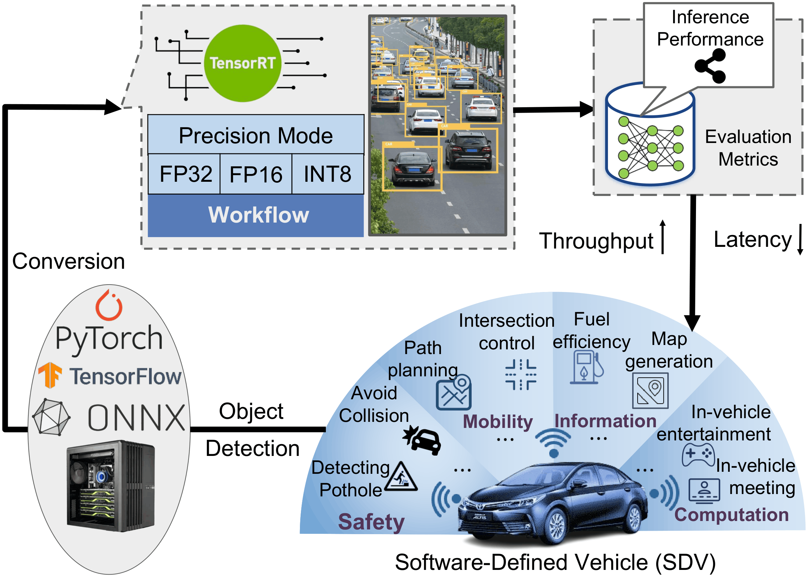

Training & Inference on Edge: Inference on Edge
Running Models Under Tight Budgets
Optimization tool: TensorRT.
Converts PyTorch / TF / ONNX models and runs them in FP32, FP16 or INT8 precision modes to accelerate inference on edge devices.
Bridging task needs and device limits
Model design Lightweight nets (human-designed or searched) that fit edge hardware.
Model compression Prune, quantize, distill, low-rank — reuse of Lecture 5 techniques.
TensorRT-enabled framework for a Software-Defined Vehicle
Optimization tools TensorRT precision modes trade accuracy for throughput & latency.
Sumaiya et al. “Enhancing real-time inference performance for time-critical software-defined vehicles”. In: 2024 IEEE International Conference on Mobility, Operations, Services and Technologies (MOST). IEEE. 2024, pp. 101–113.

Slide 20
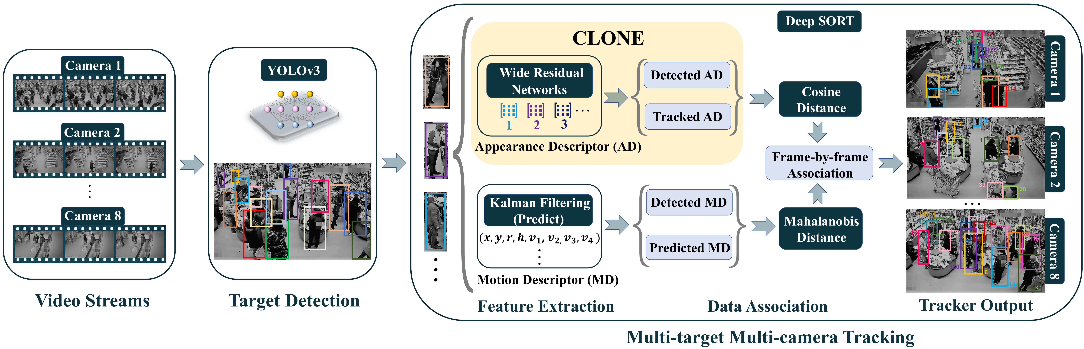



Training & Inference on Edge: Collaborative Inference
Many Cameras, One Tracker
Collaborative inference pipeline for multitarget multicamera tracking
Capture
Detect
Describe
Associate
Multiple camera video streams
YOLOv3 finds & boxes targets
Appearance (AD) + motion (MD) descriptors
Cosine + Mahalanobis distance match IDs
Figure 4.19 — Collaborative inference pipeline for multitarget multicamera tracking (Lu et al.).
Sidi Lu, Yongtao Yao, and Weisong Shi. “CLONE: Collaborative learning on the edges”. In: IEEE Internet of Things Journal 8. 13 (2020), pp. 10222–10236.

Slide 21
Summary
Low-rank factorization reduces redundant weights and computation with minimal accuracy loss.
Model–hardware codesign balances performance requirements with available hardware resources.
Lightweight model design creates compact architectures suitable for edge deployment.
Edge training and inference keep data local while enabling efficient and fast execution.

Slide 22
Practice
How does integrating hardware accelerators impact the design of machine learning models for edge deployment?
1
Discuss the role of software-hardware codesign in optimizing resource-constrained edge computing environments.
2

Slide 23
References
Emily L Denton et al. "Exploiting linear structure within convolutional networks for efficient evaluation". In: Advances in Neural Information Processing Systems 27 (2014).
Misha Denil et al. "Predicting parameters in deep learning". In: Advances in Neural Information Processing Systems 26 (2013).
Tara N Sainath et al. "Low-rank matrix factorization for deep neural network training with high-dimensional output targets". In: 2013 IEEE International Conference on Acoustics, Speech and Signal Processing. IEEE. 2013, pp. 6655–6659.
Shikhar Tuli et al. “CODEBench: A neural architecture and hardware accelerator co-design framework”. In: ACM Transactions on Embedded Computing Systems 22. 3 (2023), pp. 1–30.
Minxuan Zhou et al. “TransPIM: A memory-based acceleration via software-hardware codesign for transformer”. In: 2022 IEEE International Symposium on High-PerformanceComputer Architecture (HPCA). IEEE. 2022, pp. 1071–1085.
Cong Hao and Deming Chen. “Software/hardware co-design for multi-modal multi-task learning in autonomous systems”. In: 2021 IEEE 3rd International Conference on Artificial Intelligence Circuits and Systems (AICAS). IEEE. 2021, pp. 1–5.
Sandler, M., Howard, A., Zhu, M., Zhmoginov, A., & Chen, L. C. (2018). Mobilenetv2: Inverted residuals and linear bottlenecks. In Proceedings of the IEEE conference on computer vision and pattern recognition (pp. 4510-4520).
Mehta, Sachin, and Mohammad Rastegari. "Mobilevit: light-weight, general-purpose, and mobile-friendly vision transformer." arXiv preprint arXiv:2110.02178 (2021).
Li, Zhengang, et al. "Auto-vit-acc: An fpga-aware automatic acceleration framework for vision transformer with mixed-scheme quantization." 2022 32nd International Conference on Field-Programmable Logic and Applications (FPL). IEEE, 2022.
T. Wang et al., "ViA: A Novel Vision-Transformer Accelerator Based on FPGA," in IEEE Transactions on Computer-Aided Design of Integrated Circuits and Systems, vol. 41, no. 11, pp. 4088-4099, Nov. 2022, doi: 10.1109/TCAD.2022.3197489.
Sidi Lu, Yongtao Yao, and Weisong Shi. “CLONE: Collaborative learning on the edges”. In: IEEE Internet of Things Journal 8. 13 (2020), pp. 10222–10236.
Sumaiya et al. “Enhancing real-time inference performance for time-critical software-defined vehicles”. In: 2024 IEEE International Conference on Mobility, Operations, Services and Technologies (MOST). IEEE. 2024, pp. 101–113.

