Slide 1
Challenges in Edge Computing I: Programmability, Naming & Resource Optimization
Chapter 5
Topic: Programmability | Naming & Data | Resources | Metrics

Slide 2
Outline
Programmability
Resource Allocation
Summary & Practice
Firework, OpenStack++
FocusStack, SpanEdge
Partitioning: PDG, static/dynamic
Scheduling strategies
Data offloading
Load balancing
Naming & Data
Optimization Metrics
DNS limits at the edge
NDN & MobilityFirst
edgeOS naming + data abstraction
Latency & bandwidth
Energy consumption
Cost trade-offs

Slide 3


Programmability: Challenge
Why edge is hard to program
Cloud model
Edge model
Infrastructure is transparent
Programmer bears the complexity
Write once, deploy to the cloud
One homogeneous target platform
Provider maintains the servers
User need not know the internals
Tasks migrate from cloud to edge nodes
Heterogeneous platforms & runtimes
MapReduce & Spark don’t fit
Needs new programming models

Slide 4



Programmability: Programming Models
Four frameworks that tame the edge
Heterogeneous edges need purpose-built programming models. Four influential frameworks — each explored next.
01
Firework
02
OpenStack++
Zhang et al.
Ha & Satyanarayanan
A virtual shared data view over distributed sources; computation flows cut what’s transmitted.
A programming model for the cloudlet architecture, tailored to mobile environments.
03
FocusStack
04
SpanEdge
Amento et al.
Sajjad et al.
Finds edge devices with enough resources, then deploys & tracks apps across mobile IoT devices.
Unifies cloud & near-edge nodes; developers mark which parts run near the data source.
Quan Zhang et al. "Firework: Big data sharing and processing in collaborative edge environment". In: 2016 Fourth IEEE Workshop on Hot Topics in Web Systems and Technologies (HotWeb). IEEE. 2016, pp. 20–25.
Kiryong Ha and Mahadev Satyanarayanan. OpenStack++ for cloudlet deployment. Technical report CMU-CS-15-123. School of Computer Science, Carnegie Mellon University, 2015.
Brian Amento et al. "FocusStack: Orchestrating edge clouds using location-based focus of attention". In: 2016 IEEE/ACM Symposium on Edge Computing (SEC). IEEE. 2016, pp. 179–191.
Hooman Peiro Sajjad et al. "SpanEdge: Towards unifying stream processing over central and near-the-edge data centers". In: 2016 IEEE/ACM Symposium on Edge Computing (SEC). IEEE. 2016, pp. 168–178.

Slide 5
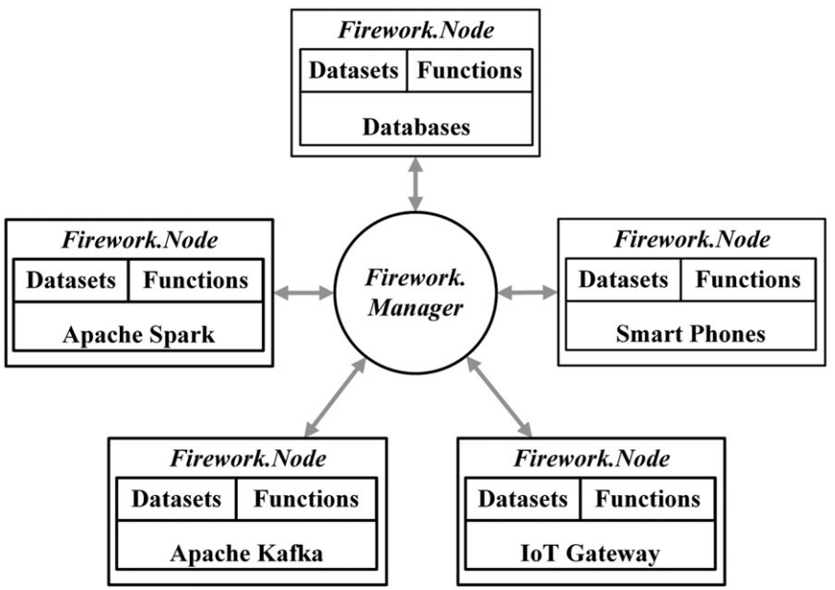




Programmability: Firework
A programming model for big-data sharing & processing in a collaborative edge environment.
Key objectives
Virtual shared data view Fuse distributed data sources behind predefined interfaces.
Datasets + functions Each node exposes accessible datasets and functions on them.
Privacy-preserving Functions share only knowledge — output ≥1000× smaller than raw.
Computation flows Process data along its path to cut what’s transmitted.
Edge computing paradigm: the Firework model (managers + nodes).
Quan Zhang et al. "Firework: Big data sharing and processing in collaborative edge environment". In: 2016 Fourth IEEE Workshop on Hot Topics in Web Systems and Technologies (HotWeb). IEEE. 2016, pp. 20–25.

Slide 6
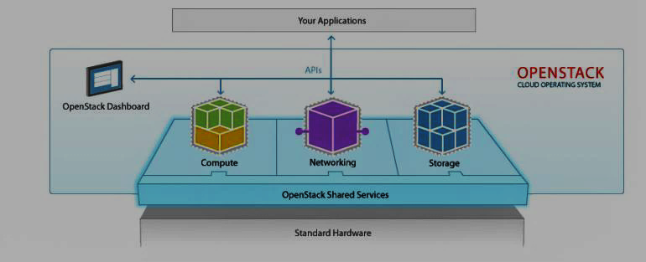




Programmability: Openstack++
A programming model for the cloudlet architecture, tailored to mobile environments.
Key objectives
Cloudlet deployment Extend OpenStack APIs to provision nearby cloudlets.
VM-based provisioning Package apps as VM overlays pushed to the cloudlet.
Low-latency offload Mobile apps offload compute to a one-hop cloudlet.
OpenStack Software Overview Diagram (Source)
VM handoff Migrate the VM as the mobile user moves.
Kiryong Ha and Mahadev Satyanarayanan. OpenStack++ for cloudlet deployment. Technical report CMU-CS-15-123. School of Computer Science, Carnegie Mellon University, 2015.

Slide 7
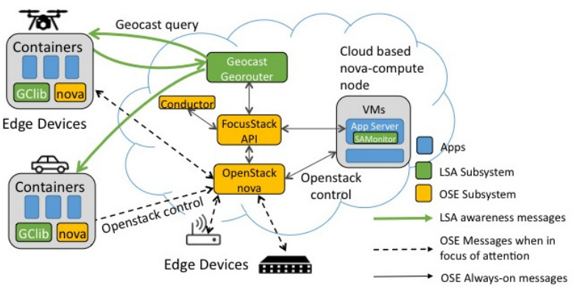



Programmability: FocusStack
Deploy diverse, complex apps across mobile IoT edge devices — as an IaaS cloud.
Key objectives
Location-based awareness LSA over a geographic addressing network.
Focus of attention Only track & message healthy devices in the target area.
Container deployment Place containers onto in-focus devices with enough resources.
FocusStack Architecture (Source)
Efficient control plane Untracked devices don’t drain resources or messaging.
Location-based situation awareness (LSA)
Query only healthy devices in the target area deploy containers to them track just those in focus
Brian Amento et al. "FocusStack: Orchestrating edge clouds using location-based focus of attention". In: 2016 IEEE/ACM Symposium on Edge Computing (SEC). IEEE. 2016, pp. 179–191.

Slide 8
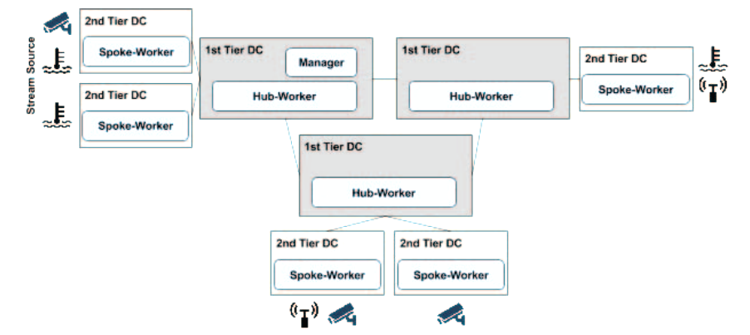



Programmability: SpanEdge
Unify stream processing across central and near-the-edge data centers.
Key objectives
Two-tier workers Hub-workers in the cloud (T1); spoke-workers at the edge (T2).
Local vs. global tasks Local tasks run near the source; global tasks aggregate results.
Minimize WAN latency Scheduler places tasks to cut wide-area network delay.
SpanEdge Architecture (Source)
Source-agnostic dev Developers mark what runs near data, not where data lives.
Local tasks run near the source
Master–worker: a Manager schedules tasks onto hub- and spoke-workers.
Hooman Peiro Sajjad et al. "SpanEdge: Towards unifying stream processing over central and near-the-edge data centers". In: 2016 IEEE/ACM Symposium on Edge Computing (SEC). IEEE. 2016, pp. 168–178.

Slide 9



Programmability: Program Partitioning
Splitting apps across edge nodes
A standalone app must be decomposed into components — preserving semantics — and placed across heterogeneous cloud-edge and edge-edge nodes, weighing resources, energy and latency.
Static partitioning
Dynamic partitioning
Decided at compile time
Decided at run time
Fixed at compilation — as in MPI programming and GPGPU-based heterogeneous multicore computing.
Adapts during execution to changing resources, network conditions and node availability.
Program Dependence Graph (PDG).
Keeps the app’s component nodes but adds edge-specific weights — heterogeneous resource availability, location distance, communication cost — and new dependencies: resource-availability, location-mobility and response-time. Drives partitioning across static, dynamic, cloud-edge and edge-edge phases.

Slide 10
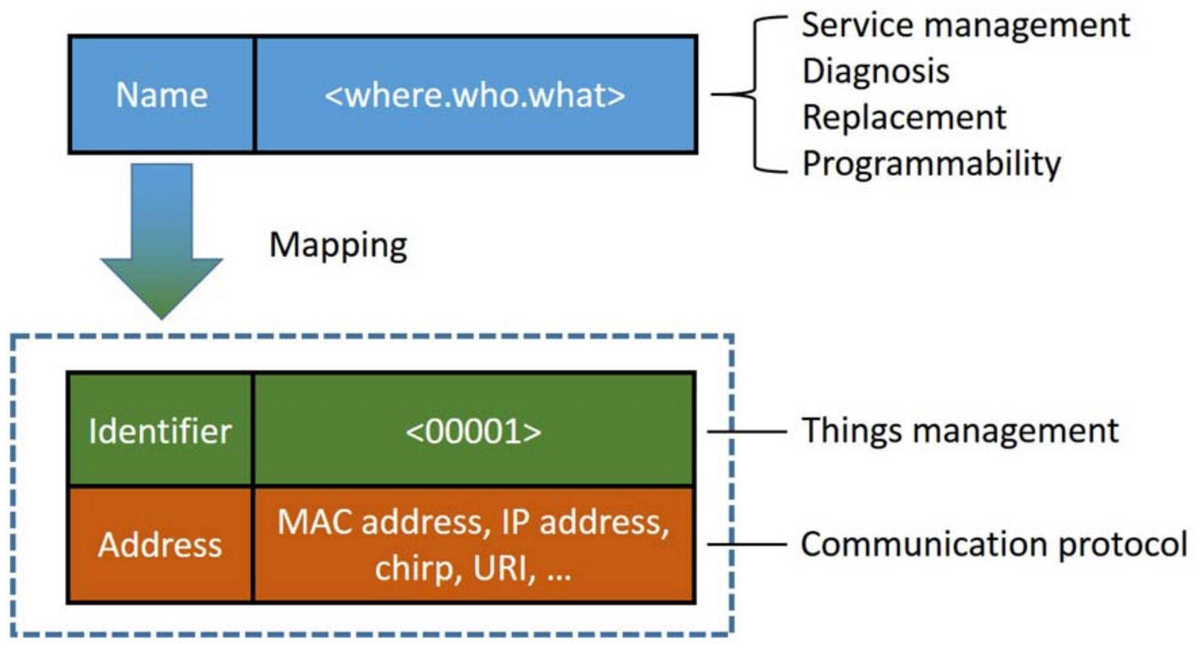


Naming & Data: Naming Convention
Naming billions of moving devices
Why DNS & IP fall short.
Traditional DNS / URIs lack the flexibility for dynamic edge networks; IP-based schemes are too heavy for resource-constrained, highly mobile devices.
NDN
Named Data Networking. Hierarchical, content-centric names; scalable & human-friendly but bridging to Bluetooth/ZigBee needs proxies & raises isolation concerns.
edgeOS naming: a human-friendly name (where.who.what) maps to identifiers & addresses (Shi et al.).
MobilityFirst
edgeOS naming. Names carry location, role & data description — e.g. “kitchen.oven2.temperature3” — simplifying diagnosis, replacement and privacy while mapping to IP/MAC underneath.
Separates names from addresses. Great for mobility, but its global unique identifier (GUID) is impractical for fixed homes and unfriendly for service management.
Weisong Shi et al. “Edge computing: Vision and challenges”. In: IEEE Internet of Things Journal 3. 5 (2016), pp. 637–646.

Slide 11
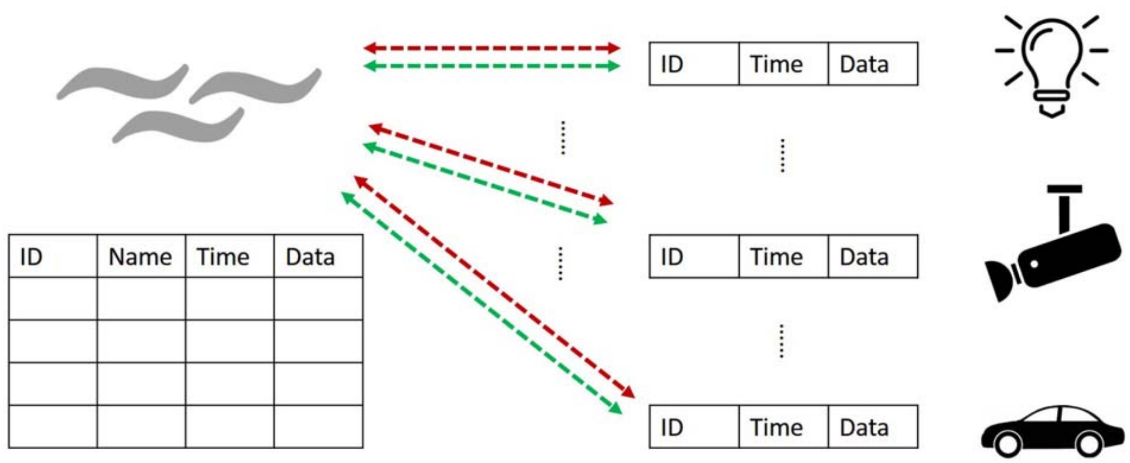



Naming & Data: Data Abstraction
Three challenges of abstracting edge data
Gateways preprocess data (denoising, event detection, privacy) into a standardized table — e.g. 0000, 12:34:56 PM, 01 Jan 2016, kitchen.oven2.temperature3, 78 — before serving upper layers.
Data abstraction in edge computing: heterogeneous devices → a unified data table
Diversity of formats
Degree of abstraction
Applicability
Devices emit different formats; a unified table hides raw specifics for privacy — but that also hides detail apps may need.
Filter too much and services starve; keep too much and storage suffers — and edge data is often unreliable.
Apps need read/write access, but heterogeneous device representations & operations block a truly general abstraction.
Weisong Shi et al. “Edge computing: Vision and challenges”. In: IEEE Internet of Things Journal 3. 5 (2016), pp. 637–646.

Slide 12


Resource Allocation: Scheduling
Mapping tasks to scarce resources
Three delay-based strategies
Graph-theory formulation.
Represent each app as a graph (nodes = components, edges = communication) and resources as a graph (nodes = servers). Scheduling becomes a mapping between the two, adapting as resources, network and user location change.
Shortest transmission time first
Pick the node that moves the task’s data fastest.
Shortest queue length first
Send to the least-backed-up node.
Must also handle heterogeneity, application diversity, and the overhead of user mobility while maximizing utilization and provider benefit.
Shortest scheduling delay first
Minimize total time before execution starts.
All three exploit the edge’s core advantage: lower data-transmission latency.

Slide 13
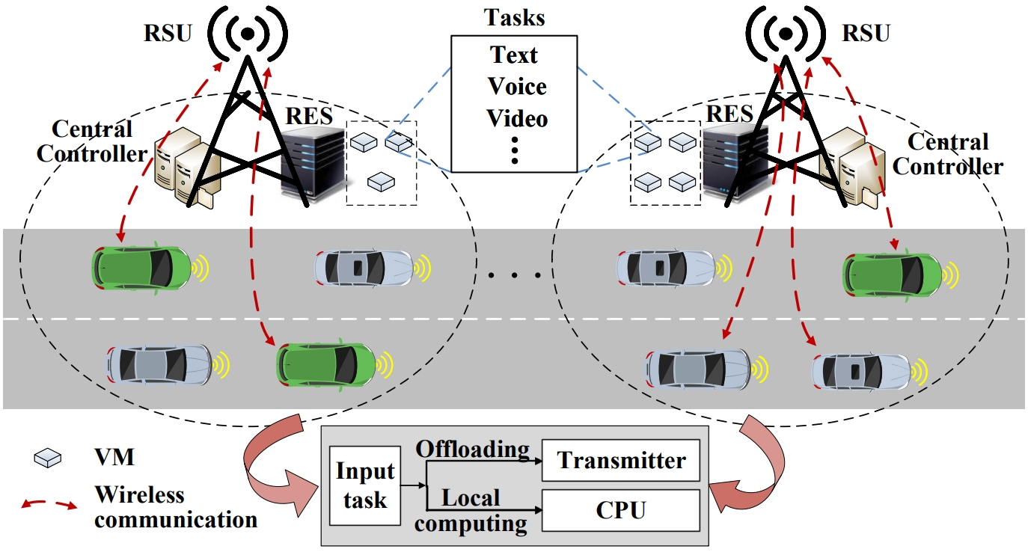


Resource Allocation: Offloading & Load Balancing
Two offloading modes
Full offloading
Move the whole task to the edge/server. Optimize for delay (if energy allows) or minimize energy under a delay constraint, using queue, resource-utilization & routing info.
Partial offloading
Offloading framework for vehicle-edge collaboration
Split the task into blocks; offload only selected ones. Choice depends on data volume, device utilization, channel conditions & energy — jointly optimizing comms + compute.
Load balancing
Distribute workload across far/mid/near-edge layers, keep links stable, and use AI + SDN to orchestrate routing across the whole edge network.
Quyuan Luo et al. “Minimizing the delay and cost of computation offloading for vehicular edge computing”. In: IEEE Transactions on Services Computing 15. 5 (2021), pp. 2897–2909.

Slide 14



Optimization Metrics
Different layers have different capabilities, so where a load runs is a design choice — evenly spread, piled on one layer, or pushed entirely to edge or cloud. Four metrics decide:
Latency
Bandwidth
Run at the nearest capable layer — but the closest layer isn’t always optimal if it’s busy.
High bandwidth cuts transmission delay; local preprocessing shrinks the upload volume.
Energy
Cost
Offload when transmission energy < local compute energy; the battery is the tightest resource.
Providers weigh profit vs. affordability — charge by data location, balance concurrent loads.

Slide 15
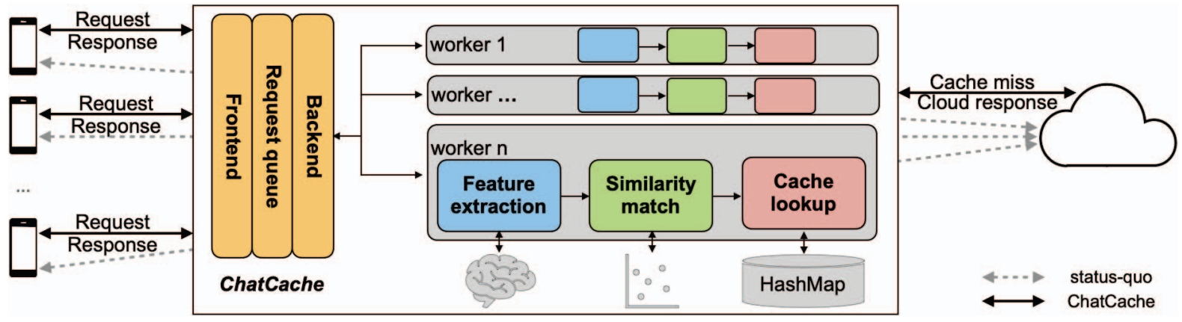
Optimization Metrics: ChatCache
Caching at the edge
> 91.7%
lower user-perceived latency for voice requests
The design of ChatCache: a hierarchical edge cache
> 81.6%
A scalable edge system with a hierarchical cache serving both single and multiple users — feature extraction, similarity match, and cache lookup intercept requests before they reach the cloud.
lower latency for text requests
Metrics interact — energy limits can force a load to a layer where latency suffers, so weight and prioritize per workload.
Lanyu Xu, Arun Iyengar, and Weisong Shi. “ChatCache: A hierarchical semantic redundancy cache system for conversational services at edge”. In: 2021 IEEE 14th International Conference on Cloud Computing (CLOUD). IEEE. 2021, pp. 85–95.

Slide 16


Technical Challenges in Edge Computing
Challenge
Description
Programmability
Developing & deploying apps on heterogeneous edge nodes needs new programming models.
Program partitioning
Split apps across edge nodes, weighing resources, energy consumption and response latency.
Naming conventions
Efficient, standardized naming for dynamic, heterogeneous edge environments.
Data abstraction
Preprocess at the gateway; handle format diversity, abstraction level and reliability.
Scheduling strategies
Optimize resource use, cut latency and boost task processing in heterogeneous settings.
Offloading & load balancing
Distribute data & tasks across devices to prevent overload, cut latency and add reliability.
Optimization metrics
Use latency, bandwidth, energy and cost to optimize load across edge and cloud layers.

Slide 17
Summary
New models — Firework, OpenStack++, FocusStack, SpanEdge plus PDG-driven partitioning.
DNS/IP don’t fit; NDN, MobilityFirst & edgeOS help. Data abstraction has three open challenges.
Schedule by graph mapping & delay, offload fully or partially, balance load with AI + SDN.
Latency, bandwidth, energy and cost interact — weight them per workload.

Slide 18
Practice
How does edge caching contribute to reducing latency in edge computing?
1
Compare NDN, MobilityFirst and edgeOS naming — when is each a fit?
2
How would you weight latency, bandwidth, energy and cost for a given workload?
3

Slide 19


Project
Explore resource allocation strategies in edge-cloud environments and implement a resource allocation mechanism that dynamically balances workloads between edge devices and the cloud, based on real-time conditions like network latency and device capabilities. Use simulation tools such as CloudSim (https://github.com/Cloudslab/cloudsim) or iFogSim (https://github.com/Cloudslab/iFogSim) to model the edge-cloud environment and implement the resource allocation mechanism. Evaluate the mechanism's effectiveness by running simulations with varying network conditions, task complexities, and resource constraints.
Tasks
Measures
1
Model the environment Set up an edge–cloud topology in CloudSim or iFogSim — devices, brokers, cloud datacenter.
Latency End-to-end response time as network delay and task size vary.
2
Design the policy Write an allocation rule that routes each task by live latency, device load and capability.
Energy Device vs. cloud energy under each allocation decision.
3
Balance dynamically Offload to the cloud when the edge is saturated; keep latency-critical tasks local.
Utilization & balance How evenly load spreads — and whether any node overloads.
4
Run & evaluate Sweep network conditions, task complexity and resource limits; measure latency, energy & utilization.
Adaptivity How well the policy tracks changing real-time conditions.
Example: in iFogSim, route face-detection frames to the fog when latency < 50 ms, else to the cloud; compare vs. cloud-only. CloudSim · iFogSim (github.com/Cloudslab)

Slide 20
References
Quan Zhang et al. "Firework: Big data sharing and processing in collaborative edge environment". In: 2016 Fourth IEEE Workshop on Hot Topics in Web Systems and Technologies (HotWeb). IEEE. 2016, pp. 20–25.
Kiryong Ha and Mahadev Satyanarayanan. OpenStack++ for cloudlet deployment. Technical report CMU-CS-15-123. School of Computer Science, Carnegie Mellon University, 2015.
Brian Amento et al. "FocusStack: Orchestrating edge clouds using location-based focus of attention". In: 2016 IEEE/ACM Symposium on Edge Computing (SEC). IEEE. 2016, pp. 179–191.
Hooman Peiro Sajjad et al. "SpanEdge: Towards unifying stream processing over central and near-the-edge data centers". In: 2016 IEEE/ACM Symposium on Edge Computing (SEC). IEEE. 2016, pp. 168–178.
Weisong Shi et al. “Edge computing: Vision and challenges”. In: IEEE Internet of Things Journal 3. 5 (2016), pp. 637–646.
Quyuan Luo et al. “Minimizing the delay and cost of computation offloading for vehicular edge computing”. In: IEEE Transactions on Services Computing 15. 5 (2021), pp. 2897–2909.
Lanyu Xu et al.. “ChatCache: A hierarchical semantic redundancy cache system for conversational services at edge”. In: 2021 IEEE 14th International Conference on Cloud Computing (CLOUD). IEEE. 2021, pp. 85–95.

