Slide 1
Challenges in Edge Computing II: Security/Privacy, Deployment, Foundations
Chapter 5
Topic: Security | Service Management | Deployment | Foundations

Slide 2
Outline
Security & Privacy
Deployment
Summary & Practice
Sensor security
ShadowNet, TEEs, KLRA
Blockchain data sharing
Edge node placement
LF Edge, EdgeX, Akraino
HW / SW selection
Service Management
Foundations & Business
The DEIR model
Differentiation, extensibility
Isolation, reliability, EdgeWare
CAP theorem
Multi-objective optimization
Business models & challenges

Slide 3



Security & Privacy
Three Privacy Challenges
Homes and IoT systems capture enormous private data. Computing near the source protects it but three challenges remain.
Awareness in society
Data collector = owner
Lack of tools
Users under-protect data: 49% of home WiFi is insecure, 80% keep default router passwords, 89% of public hotspots are insecure.
Devices both collect and own data. Keep it local, let users control provider access, and delete highly sensitive data.
Edge devices are resource-limited and highly dynamic; existing security methods don’t fit. Platforms like Open mHealth are early steps.
Weisong Shi et al. “Edge computing: Vision and challenges”. In: IEEE Internet of Things Journal 3. 5 (2016), pp. 637–646.

Slide 4




Security & Privacy: Sensor Security
Attacking the senses of the edge
Autonomous vehicles and smart devices perceive the world through sensors — attackers manipulate or obstruct sensor data without ever touching the compute system.
Cameras
GNSS / INS
Fooled by counterfeit signs, signals or fake objects; blinded by high-brightness IR lasers.
GNSS jammed or spoofed by fake signals; INS misled by strong magnetic interference.
LiDAR
Ultrasonic / Radar
Deceived by absorbent/reflective surfaces or manipulated laser pulses → wrong distances.
Passive perception & last-line defense — spoofed & jammed by specialized signal generators.

Slide 5




Security & Privacy: Network & Platforms
Defending edge networks & systems
ShadowNet
SDN security
Bhardwaj et al. — edge functions monitor IoT traffic to preempt IoT-DDoS. Detects 10× faster, blocks 82% of traffic before it hits the Internet.
Yi et al. — SDN improves monitoring, intrusion detection and access control across the edge network.
TEEs
KLRA
Ning et al. — Intel SGX, ARM TrustZone & AMD SEV bring trusted execution to heterogeneous edges with minimal overhead.
Li et al. — Kernel-Level Resource Auditing for IoT/edge OSs; watches system behavior and raises alerts on anomalies.
Ketan Bhardwaj, Joaquin Chung Miranda, and Ada Gavrilovska. "Towards IoT-DDoS prevention using edge computing". In: USENIX Workshop on Hot Topics in Edge Computing (HotEdge 18). 2018.
Shanhe Yi, Zhengrui Qin, and Qun Li. "Security and privacy issues of fog computing: A survey". In: Wireless Algorithms, Systems, and Applications (WASA). Springer. 2015, pp. 685–695.
Zhenyu Ning et al. "Preliminary study of trusted execution environments on heterogeneous edge platforms". In: 2018 IEEE/ACM Symposium on Edge Computing (SEC). IEEE. 2018, pp. 421–426.
Peng Li et al. "KLRA: A kernel level resource auditing tool for IoT operating system security". In: 2018 IEEE/ACM Symposium on Edge Computing (SEC). IEEE. 2018, pp. 427–432.

Slide 6
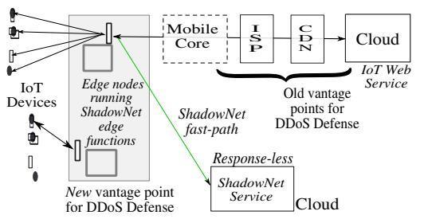




Security & Privacy: ShadowNet
Defending edge networks & systems
Key objectives
Edge-based DDoS detection moves attack detection closer to IoT traffic sources instead of relying only on centralized cloud defenses.
Application-level IoT DDoS attacks, where malicious traffic can appear legitimate and is difficult for traditional defenses to identify.
Distributed edge infrastructure to detect and stop attacks earlier, reducing their impact before traffic reaches core Internet services.
ShadowNet Overview Diagram (Source)
Emphasizes faster detection and traffic reduction, reporting up to 10× faster detection in preliminary results.
Ketan Bhardwaj, Joaquin Chung Miranda, and Ada Gavrilovska. "Towards IoT-DDoS prevention using edge computing". In: USENIX Workshop on Hot Topics in Edge Computing (HotEdge 18). 2018.

Slide 7
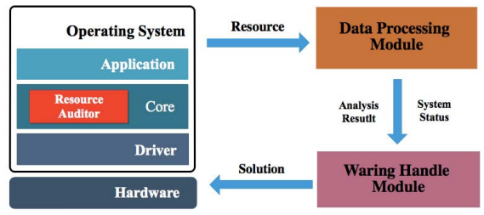
Security & Privacy: KLRA
Defending edge networks & systems
Key objectives
Kernel-level auditing monitors security-sensitive resource events directly inside the IoT operating system kernel.
Resource consumption monitoring tracks how system resources are used and identifies abnormal usage patterns.
Behavior-based detection analyzes resource-usage patterns that may indicate malicious or abnormal activities.
KLRA Overview Diagram (Source)
Edge/IoT security focus improves device-level visibility before threats propagate through the larger edge infrastructure.
Peng Li et al. "KLRA: A kernel level resource auditing tool for IoT operating system security". In: 2018 IEEE/ACM Symposium on Edge Computing (SEC). IEEE. 2018, pp. 427–432.

Slide 8
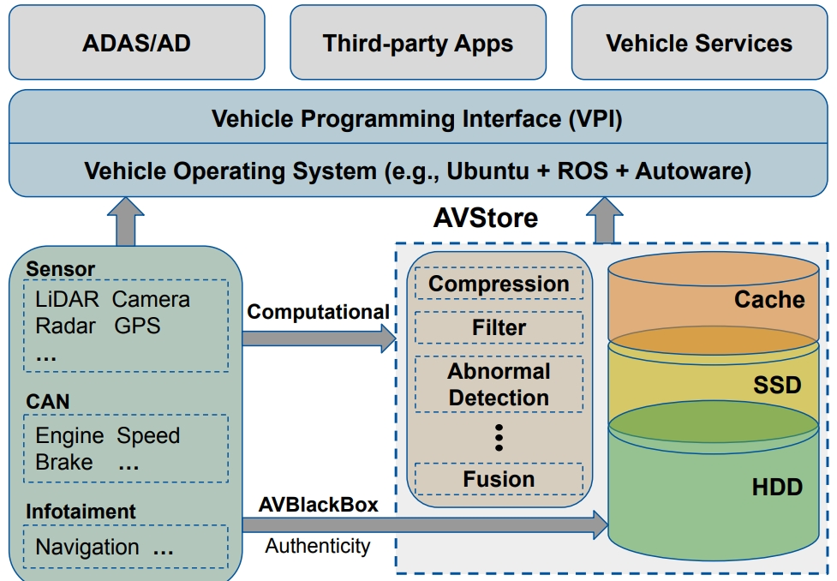



Security & Privacy: Data Sharing
Blockchain for Secure Sharing
Blockchain in edge computing
Tamper-proof storage
Blockchain makes edge data tamper-proof; IPFS stores data off-chain, keeping only the hash on-chain to shrink volume.
New business models
Enables monetizing edge services — but systematic integration research is still lacking.
Access control
Storage system architecture for autonomous-vehicle data
Combine attribute-based access control with blockchain — but public visibility to all nodes raises privacy concerns.
Edge integration breaks data silos but complicates secure sharing — many interfaces widen the attack surface, and weak devices can’t run heavy security algorithms.
Yuxin Wang et al. “Quantitative analysis of storage requirement for autonomous vehicles”. In: Proceedings of the 16th ACM Workshop on Hot Topics in Storage and File Systems. 2024, pp. 71–78.

Slide 9




Service Management: The DEIR Model
Any reliable edge system exhibits four characteristics — Differentiation, Extensibility, Isolation, Reliability.
D
E
I
R
Differentiation
Extensibility
Isolation
Reliability
Services have different priorities — device diagnostics & failure alarms, or fall/heart-failure monitoring, outrank entertainment.
IoT devices are highly dynamic — new or replacement devices must integrate seamlessly into existing services.
One app’s failure shouldn’t crash shared resources; removing an app shouldn’t break the device; third parties can’t reach private data.
From service, system and data views — detect failures, keep topology, and cope with unreliable sensing & communication.
Weisong Shi et al. “Edge computing: Vision and challenges”. In: IEEE Internet of Things Journal 3. 5 (2016), pp. 637–646.

Slide 10
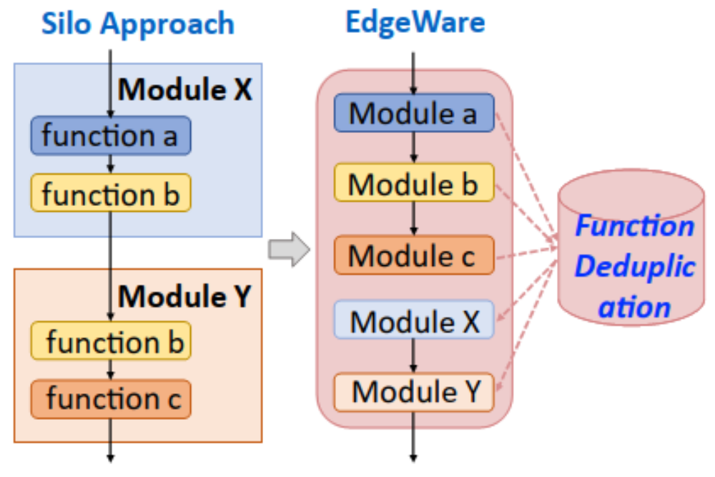




Service Management: Middleware
EdgeWare: managing edge services
EdgeWare: Four key features
Open-source, extensible, flexible middleware for edge service execution.
On-demand model switching Easily transition & upgrade ML models.
Consolidation & dedup Eliminate redundant recurring functions; maximize reuse.
Function consolidation & deduplication: services become reusable function modules
Event-driven apps Reduce workload with event-triggered execution.
Function cache. A “function cache” manages the lifecycle of edge services, so limited resources dynamically support what’s needed.
Dynamic workflows Extend functionality via customizable workflows.
Sidi Lu et al. “EdgeWare: Toward extensible and flexible middleware for connected vehicle services”. In: CCF Transactions on High Performance Computing 4. 3 (2022), pp. 339–356.

Slide 11


Deployment & Integration: Node Deployment
Placing & trusting edge nodes
Selecting edge nodes
Choosing edge data
Ensuring reliability
Choose nodes along the cloud-to-endpoint path to cut latency & bandwidth. Base stations can serve as nodes; direct backbone connections reduce delay.
Overlapping data sources give many solutions — e.g. vehicle speed from cameras, traffic lights or roadside units. Pick the source that minimizes latency & maximizes availability.
Exposed nodes (e.g. smart cameras) fail in wind, snow or wear. Physical infrastructure & spatial-temporal backups protect device and data reliability.

Slide 12


Deployment & Integration: AI on the Edge
Deploying AI models under constraints
Edge devices have limited compute & storage. Two complementary approaches make AI deployable — boost the hardware or shrink & split the model.
Intelligence devices
Intelligence models
General modules: CPUs, GPUs, FPGAs
Customized AI processors per application
More source data → higher accuracy & timely decisions
Optimizing full edge-AI complementarity is still hard
Model partition
Split the network across devices — independent, device-device, or device-server collaboration.
Model size reduction
Weight pruning removes low-impact neurons; quantization uses fewer bits to speed operations.

Slide 13


Deployment & Integration: Integration
LF Edge: Open-Source Deployment
Edge devices have limited compute & storage. Two complementary approaches make AI deployable — boost the hardware or shrink & split the model.
EdgeX Foundry
Akraino Edge Stack
IoT interoperability framework
Blueprints for edge infrastructure
Modular reference architecture: ingest, normalize, analyze, share
Protocols: MQTT, REST, BLE
Enhanced security; smart cities, retail, manufacturing
Open-source blueprints for 5G, AI, IoT
Low latency, high availability, scalability
VMs, containers, microservices; zero-touch provisioning
The Linux Foundation. LF Edge: Building an Open Source Framework for the Edge. https://lfe dge.org/. Accessed: 2024-08-30. 2024.

Slide 14
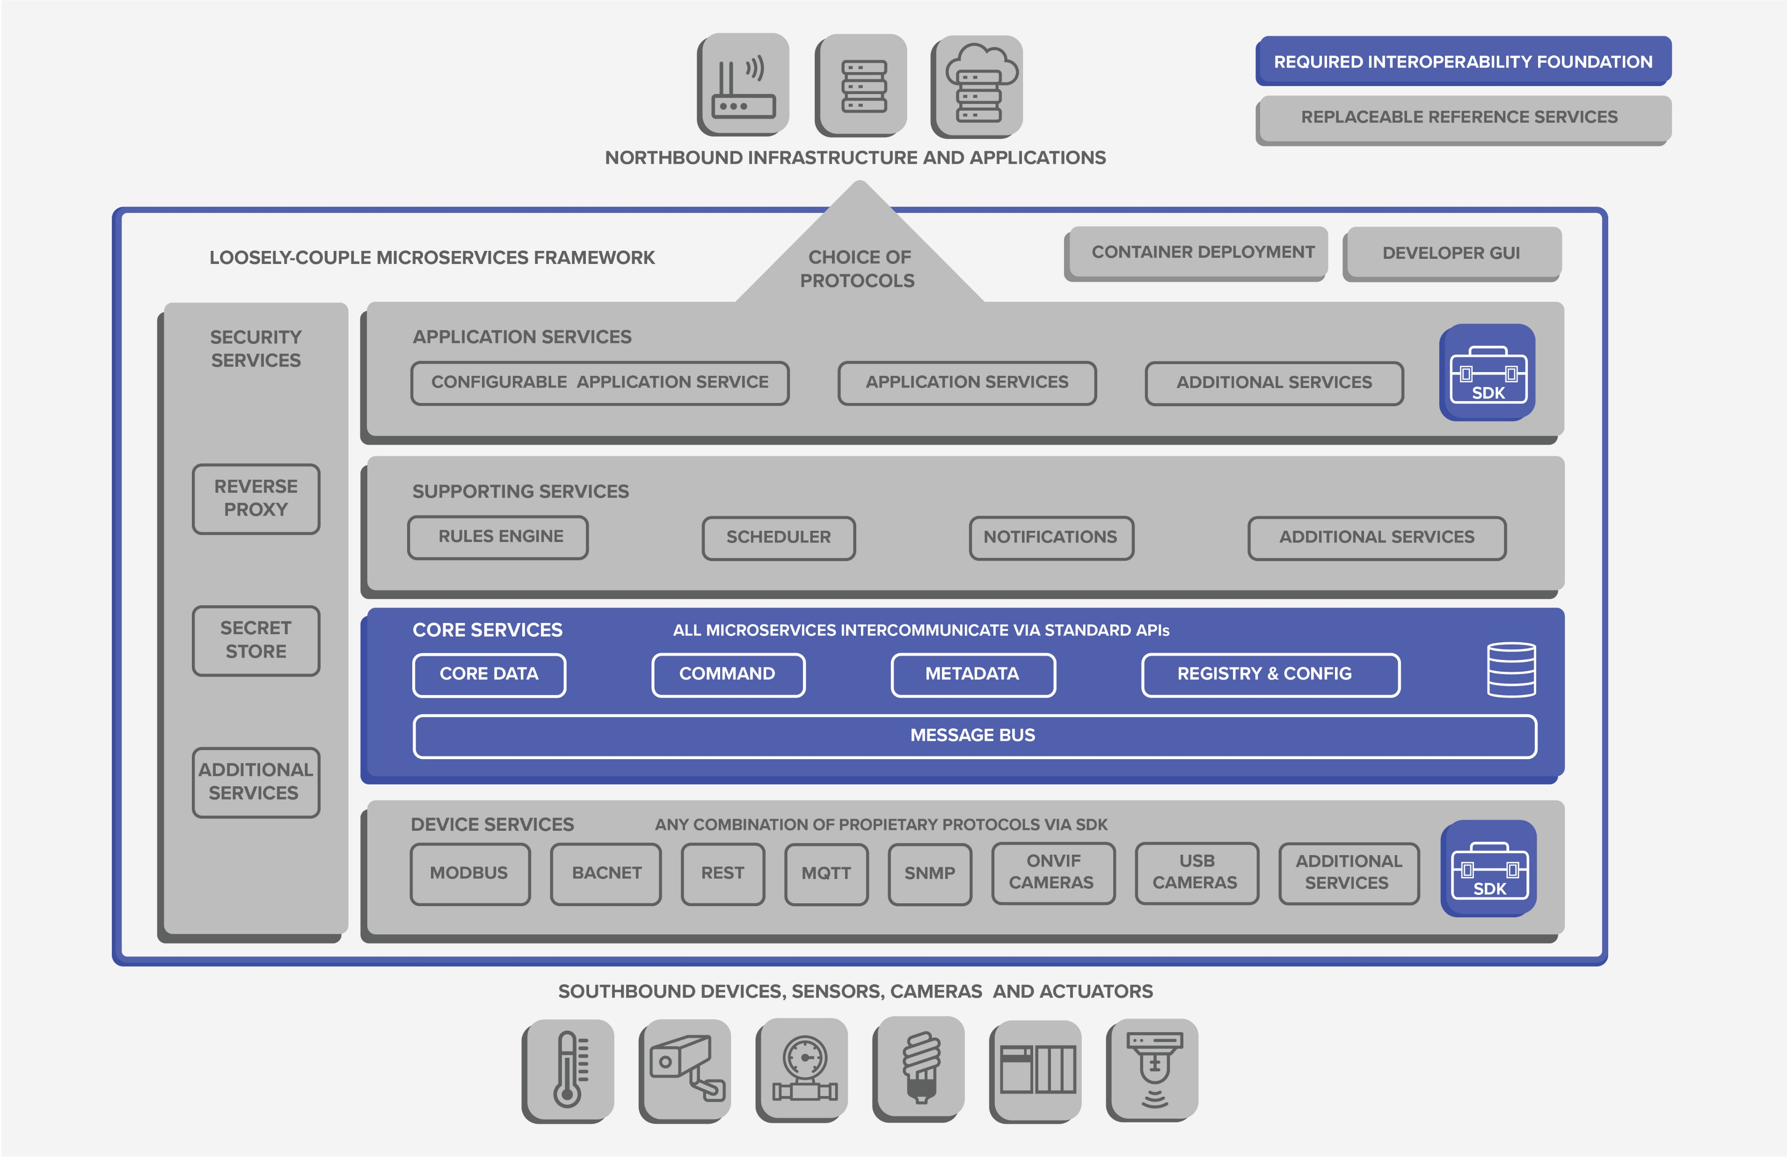
Deployment & Integration: Integration
EdgeX Foundry
EdgeX Foundry platform architecture (Source)
The Linux Foundation. Edge Foundary: An Open Edge Platform. https://www.edgexfoundry.org/. Accessed: 2026-08-29. 2026.

Slide 15


Deployment & Integration: Selection
Choosing Hardware & Software
Edge systems are fragmented and heterogeneous. Finding the optimal model–framework–hardware combination means real cost and trial-and-error.
Hardware variety
Software frameworks
CPUs, GPUs, FPGAs, ASICs — and huge spread even within a family (NVIDIA Drive PX2 vs. Jetson TX2).
TensorFlow, PyTorch and others — each performs differently on different hardware.
Combinatorial choice
Need for tooling
Many models × frameworks × hardware, each with distinct accuracy, power and cost profiles.
Analyze compute needs first; tools that profile performance & power and recommend combos are badly needed.

Slide 16




Foundations & Business: Theory
Theoretical Foundations
CAP theorem
Multi-objective optimization
Brewer’s hypothesis (PODC 2000), later proven — a cornerstone of distributed systems, especially distributed storage.
A mature theory is still emerging. It must jointly optimize across four dimensions:
Computing
Communication
Consistency Every read sees the latest write.
Load-balancing theory across cloud & edge.
Maximize edge-cloud transmission bandwidth.
Availability Every request gets a response.
Storage
Energy
Partition tolerance Works despite network splits.
Distributed storage foundations.
Lyapunov-based efficiency & reliability models.

Slide 17



Foundations & Business: Business
From Service-Driven to Data-Driven
Cloud model
Edge model
Service-driven & unidirectional
Data-driven & multilateral
Users buy on-demand, scalable, virtualized resources — IT infrastructure, software, services — center-to-user.
Spans IT + CT and many roles (platforms, connectivity, chips, sensors, apps). Requests submit data to owners — user-to-center and user-to-user.
The open challenge.
Edge value depends on many stakeholders. The Firework model reframes each request as a data request to its owner, shifting from a one-way center-to-user flow to a multilateral one. Integrating existing cloud business models into a workable multilateral edge model is the key unsolved problem.

Slide 18





Technical Challenges in Edge Computing
Challenge
Description
Hardware and software selection
Selecting appropriate hardware and software considering computational requirements, performance, and power consumption.
Integration with vertical industries
Selecting optimal edge nodes to minimize communication delays and computational overhead, and ensuring reliability.
Edge nodes deployment
Selecting optimal edge nodes to minimize communication delays and computational overhead, and ensuring reliability.
Execution of AI models on resource-constrained edge devices
Training and deploying AI models on edge devices with limited computing resources, enhancing performance and reducing latency.
Edge service management
Ensuring reliable and flexible edge service management, handling dynamic and heterogeneous IoT devices and applications.
Theoretical foundations
Establishing robust theoretical foundations for multiobjective optimization in computing, communication, storage, and energy.
Business models
Developing data-driven business models for edge computing, integrating existing cloud models and involving multiple stakeholders.

Slide 19
Summary
Security and privacy protect edge devices, networks, and data using mechanisms such as ShadowNet, TEEs, KLRA, and blockchain.
Service management improves reliability and reuse of decentralized services through DEIR and middleware such as EdgeWare.
Deployment focuses on edge-node placement, trust, resource constraints, and integration platforms such as EdgeX and Akraino.
Foundations and business use CAP theory and multi-objective optimization while enabling a shift toward data-driven edge services.

Slide 20
Practice
1
What are the challenges in implementing resource management in large-scale edge computing environments?
How do sensor attacks (camera, GNSS, LiDAR) threaten autonomous edge devices?
2
How does the CAP theorem constrain edge storage design?
3

Slide 21



Project
Explore the integration of edge computing with existing software and hardware solutions in a specific industry (e.g., manufacturing, healthcare, and 5G) and develop a prototype that demonstrates this integration. Use open-source frameworks like EdgeX Foundry (http s://lfedge.org/projects/edgex-foundry/) to integrate edge computing with selected software and hardware solutions.
Tasks
What to demonstrate
1
Pick an industry Choose a vertical & its standards — factory sensors, patient monitors, or a 5G base station.
Interoperability Heterogeneous devices & apps talking through one framework.
2
Stand up EdgeX Deploy EdgeX Foundry; connect devices via MQTT, REST or BLE device services.
Local processing Data ingested, normalized and analyzed at the edge.
3
Build the pipeline Ingest → normalize → analyze at the edge; export results or events to an app or cloud.
Data protection Sensitive data kept local; secured device & export services.
4
Demonstrate & assess Show the working prototype; evaluate latency, interoperability & data protection vs. cloud-only.
Modularity Swap device services or add analytics without a rebuild.
Example: a smart-factory demo — EdgeX reads a temperature/vibration sensor over Modbus, flags anomalies locally, alerts a dashboard. lfedge.org · EdgeX Foundry

Slide 22
References
Weisong Shi et al. “Edge computing: Vision and challenges”. In: IEEE Internet of Things Journal 3. 5 (2016), pp. 637–646.
Ketan Bhardwaj, Joaquin Chung Miranda, and Ada Gavrilovska. "Towards IoT-DDoS prevention using edge computing". In: USENIX Workshop on Hot Topics in Edge Computing (HotEdge 18). 2018.
Shanhe Yi, Zhengrui Qin, and Qun Li. "Security and privacy issues of fog computing: A survey". In: Wireless Algorithms, Systems, and Applications (WASA). Springer. 2015, pp. 685–695.
Zhenyu Ning et al. "Preliminary study of trusted execution environments on heterogeneous edge platforms". In: 2018 IEEE/ACM Symposium on Edge Computing (SEC). IEEE. 2018, pp. 421–426.
Peng Li et al. "KLRA: A kernel level resource auditing tool for IoT operating system security". In: 2018 IEEE/ACM Symposium on Edge Computing (SEC). IEEE. 2018, pp. 427–432.
Yuxin Wang et al. “Quantitative analysis of storage requirement for autonomous vehicles”. In: Proceedings of the 16th ACM Workshop on Hot Topics in Storage and File Systems. 2024, pp. 71–78.
Sidi Lu et al. “EdgeWare: Toward extensible and flexible middleware for connected vehicle services”. In: CCF Transactions on High Performance Computing 4. 3 (2022), pp. 339–356.
The Linux Foundation. LF Edge: Building an Open Source Framework for the Edge. https://lfe dge.org/. Accessed: 2024-08-30. 2024.
The Linux Foundation. Edge Foundary: An Open Edge Platform. https://www.edgexfoundry.org/. Accessed: 2026-08-29. 2026.

