Slide 1
Challenges in Edge Computing I
Chapter 7
Topic: Manufacturing | Telecom | Healthcare | Smart cities

Slide 2
Outline
Manufacturing
Healthcare
Summary & Practice
Predictive maintenance
4-domain architecture
LSTM anomaly detection
IoMT monitoring
Remote patient care
Data privacy
Telecommunications
Smart Cities
Edge cloud computing
URLLC & mm-wave
5G / VR / V2X
ADMM & situational awareness
YOLO + SORT
DRL & DECIoT

Slide 3
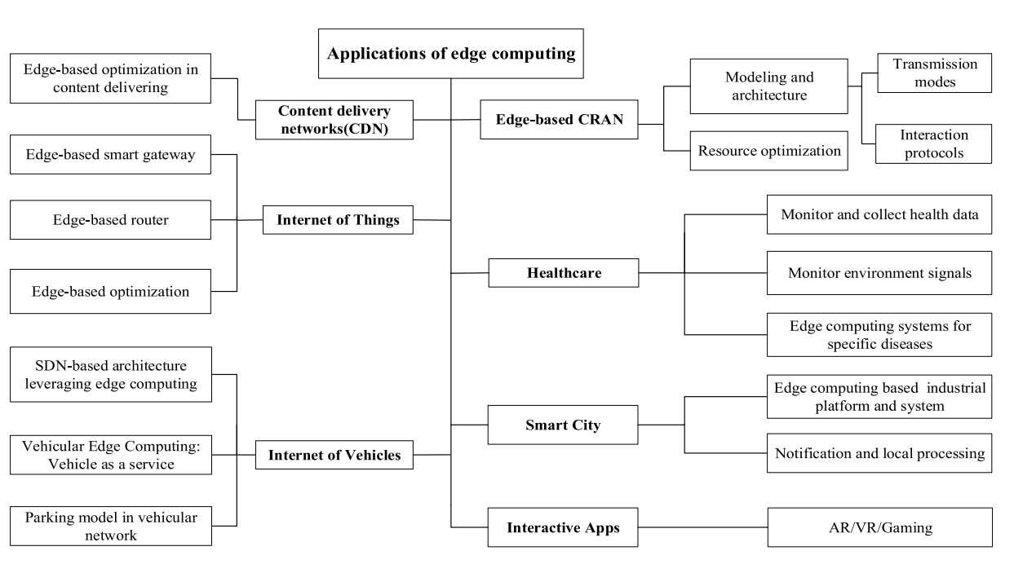




Overview
Where Edge Computing Applies
Cross-cutting benefits
Lower latency
Real-time decisions near the data
Less bandwidth
Send only what matters upstream
Privacy
Sensitive data stays local
A taxonomy of edge computing applications
Resilience
Works despite weak connectivity
By processing data at the source, edge computing brings low latency, bandwidth savings, privacy and real-time decisions to industry after industry. This lecture covers four.
Yongli Zhao et al. “Edge computing and networking: A survey on infrastructures and applications”. In: IEEE Access 7 (2019), pp. 101213–101230.

Slide 4
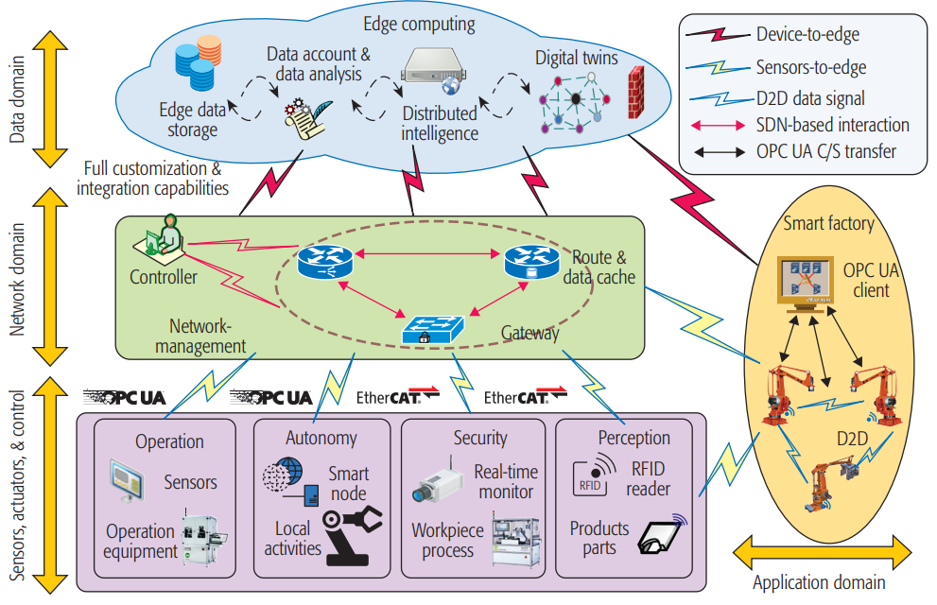




Manufacturing
Four domain manufacturing model
Four domains
Devices Sensors, robots, RFID — the physical shop floor.
Network SDN + time-sensitive networking (TSN) for real-time data flow.
Data Cleaning, feature extraction, distributed intelligence.
Applications Intelligent process management & digital twins.
Case study: smart-factory active maintenance cut network load 60%.
Edge computing in IoT-based manufacturing
Baotong Chen et al. “Edge computing in IoT-based manufacturing”. In: IEEE Communications Magazine 56. 9 (2018), pp. 103–109.

Slide 5




Manufacturing
Four domain manufacturing model
Challenges in manufacturing domain
Flexible middleware
Middleware must flex across diverse machines & vendors.
Diverse protocols
Managing many communication protocols on one floor.
Real-time + security
Guaranteeing real-time processing without weakening security.
Limited edge resources
Reliability despite constrained compute & unstable cloud links.
Edge computing in IoT-based manufacturing
Baotong Chen et al. “Edge computing in IoT-based manufacturing”. In: IEEE Communications Magazine 56. 9 (2018), pp. 103–109.

Slide 6


Manufacturing: Use Cases
Predictive maintenance & anomaly detection
LSTM anomaly detection
Autoencoder fault detection
Discrete-workshop approach: energy-data preprocessing + an LSTM production-anomaly model catch spindle failure & tool wear — just 3.5% detection error.
An edge-cloud-app framework with a distributed stacked sparse autoencoder models nonlinear sensor relations for real-time fault detection.
Cyber-physical production
Why the edge wins
Edge acts as an intermediary between machines. Local cloud services preprocess AR-device data for real-time human-machine interaction.
Rapid autonomous decisions, lower latency & network load, privacy, and resilience despite unstable cloud links.
Jumyung Um et al. “Edge computing in smart production”. In: Advances in Service and Industrial Robotics: Proceedings of the 28th International Conference on Robotics in AlpeAdria-Danube Region (RAAD 2019) 28. Springer, 2020, pp. 144–152.
Wenjin Yu et al. “Edge computing-assisted IoT framework with an autoencoder for fault detection in manufacturing predictive maintenance”. In: IEEE Transactions on Industrial Informatics 19. 4 (2022), pp. 5701–5710.
Chaoyang Zhang and Weixi Ji. “Edge computing enabled production anomalies detection and energy-efficient production decision approach for discrete manufacturing workshops”. In: IEEE Access 8 (2020), pp. 158197–158207.

Slide 7
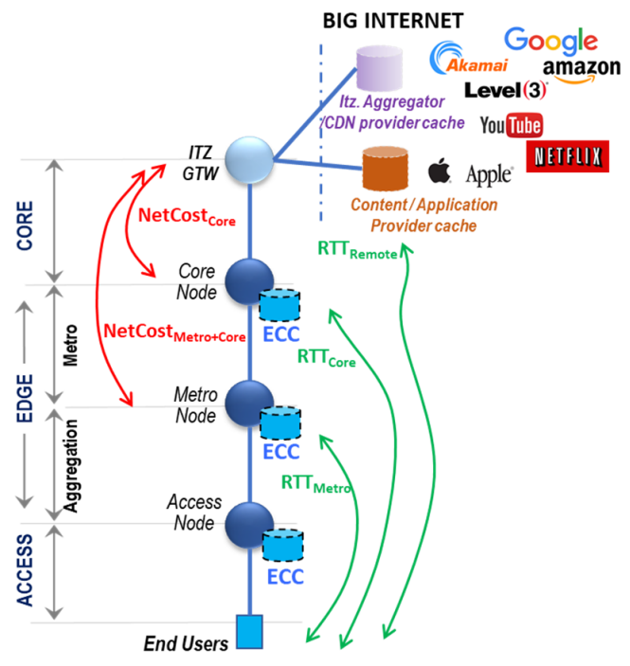

Telecommunications
Compute Along the Network Hierarchy
Edge Cloud Computing (ECC).
Distribute apps & content toward end-users across core, metro and access nodes. New services (4K/8K, 360° VR, autonomous driving) demand tight KPIs and lower cost.
Better KPIs Higher throughput, lower latency, less video delay — improving QoE by moving content closer.
Lower TCO Offload peak traffic from the core to edge nodes, cutting total cost of ownership.
Less congestion Local delivery reduces backbone load for traditional & emerging broadband.
Edge cloud computing in telecom: ECC at core, metro & access nodes
Gianfranco Ciccarella et al. “Edge cloud computing in telecommunications: Case studies on performance improvement and TCO saving”. In: 2019 4th International Conference on Fog and Mobile Edge Computing (FMEC). IEEE, 2019, pp. 113–120.

Slide 8
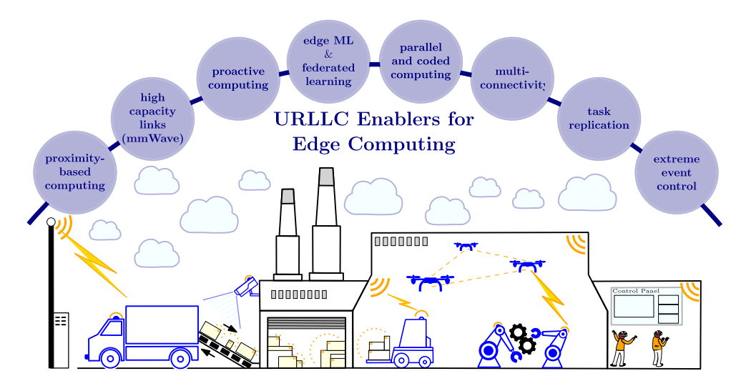




Telecommunications: URLLC
Ultra-reliable low-latency edge
Enablers
mm-wave links High-capacity millimeter-wave for huge bandwidth.
Proximity computing Process next to the user for minimal delay.
Edge ML Proactive, parallel & coded computing at the edge.
Breakdown of key URLLC enablers for edge computing, exemplified over an Industry 4.0/Smart Factory ecosystem that includes cyber–physical systems, IoT, and MEC.
Wireless edge with latency & reliability guarantees. Centralized cloud can’t meet latency-sensitive demands — a distributed edge architecture brings compute & storage to the network edge for mission-critical apps.
Mohammed S Elbamby et al. “Wireless edge computing with latency and reliability guarantees”. In: Proceedings of the IEEE 107. 8 (2019), pp. 1717–1737.

Slide 9


Telecommunications: URLLC
Ultra-reliable low-latency edge
Mission-critical applications
VR / AR Immersive experiences needing tiny motion-to-photon latency.
V2X Vehicle-to-everything for safety & coordination.
Edge AI Timely, reliable inference at the network edge.
Breakdown of key URLLC enablers for edge computing, exemplified over an Industry 4.0/Smart Factory ecosystem that includes cyber–physical systems, IoT, and MEC.
Wireless edge with latency & reliability guarantees. Centralized cloud can’t meet latency-sensitive demands — a distributed edge architecture brings compute & storage to the network edge for mission-critical apps.
Mohammed S Elbamby et al. “Wireless edge computing with latency and reliability guarantees”. In: Proceedings of the IEEE 107. 8 (2019), pp. 1717–1737.

Slide 10



Telecommunications: Challenges
Stringent KPIs
Latency + reliability
New services (4K/8K, 360° VR, AV) demand tight latency & throughput.
Centralized cloud can’t meet mission-critical URLLC targets.
mm-wave coverage
Cost of ownership
Balancing edge deployment against total cost of ownership.
High-capacity links need dense, proximity-based deployment.

Slide 11
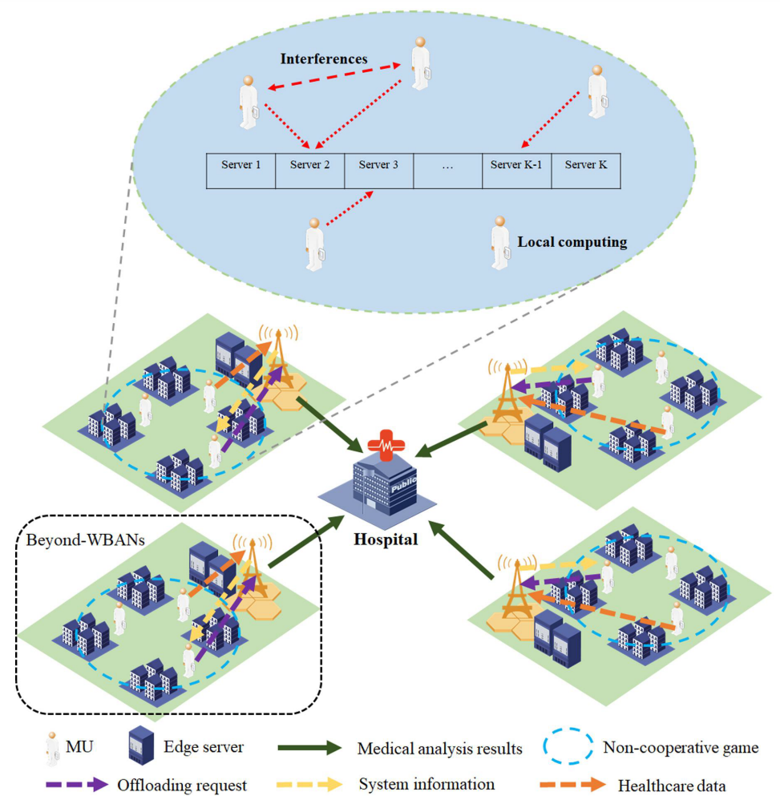


Healthcare: IOMT
Edge computing for connected health
IoMT + edge.
Cloud can’t keep up with medical-device data volumes. Processing near the source cuts latency & energy and keeps sensitive data private — for responsive, efficient care.
Remote monitoring
Real-time analytics in smart-city health; wearables & remote patient monitoring.
Elderly care
RO-SmartAgeing — a six-layer IoHT stack: edge processing, fog pre-processing, cloud analytics.
Resource games
WBAN cooperative game + beyond-WBAN offloading minimize latency & energy.
Edge computing in healthcare: WBANs, edge servers & the hospital
Peiran Dong et al. “Edge computing based healthcare systems: Enabling decentralized health monitoring in Internet of medical Things”. In: IEEE Network 34. 5 (2020), pp. 254–261.

Slide 12
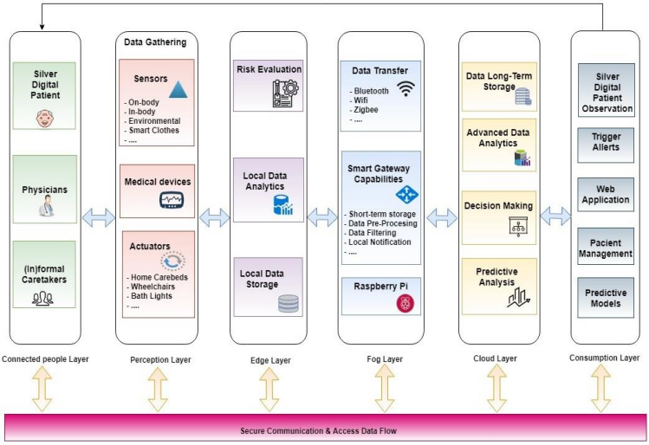
Healthcare: RO-SmartAgeing
Edge computing for connected health
Key Characteristics
IoHT + edge computing for senior monitoring to improve responsiveness of remote healthcare applications.
Uses a six-layer architecture with Connected People, Perception, Edge, Fog, Cloud, and Consumption layers.
The fog layer handles preprocessing and aggregation, while the cloud provides long-term storage, predictive analytics, and deeper decision support.
Supports real-time health parameter monitoring and visualization, demonstrated using pulse data.
A proposed architecture for monitoring section of RO-Smart Ageing system
Marilena Ianculescu et al. “IoHT and edge computing, warrants of optimal responsiveness of monitoring applications for seniors. A case study”. In: 2019 22nd International Conference on Control Systems and Computer Science (CSCS). IEEE, 2019, pp. 655–661.

Slide 13
Healthcare: Benefits & Privacy
Faster, safer, more private care
Real-time responsiveness
Data privacy & security
Process data at the source for timely analytics — critical for remote monitoring, telemedicine & emergencies.
Keep sensitive health data local, minimizing exposure vs. cloud storage & transmission.
Efficiency
Future directions
Edge does initial processing; only critical info goes to the cloud — less load, lower energy & cost.
Edge + AI/ML, blockchain EHRs for privacy, intelligent spectrum allocation, scalability & interoperability.

Slide 14


Healthcare: Challenges
Diverse sensitive data
Privacy & security
Handling large volumes of varied, private health data.
Protecting patient data across many edge devices.
Integration
Energy & Age of Info
Fitting edge devices into existing healthcare infrastructure.
Minimizing latency, energy dissipation & data staleness.

Slide 15
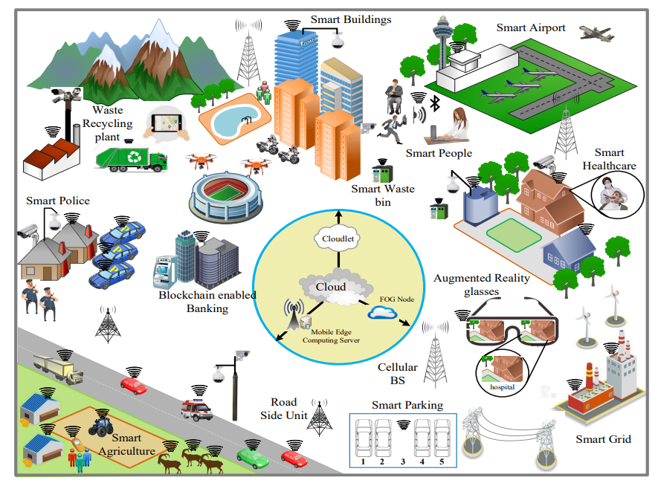

Smart Cities
A city full of edge applications
Cities generate enormous, heterogeneous IoT data. Edge & fog process it near the source, sending only what matters upstream.
Traffic & transport Real-time monitoring, public-vehicle scheduling.
Energy & buildings Smart grids, building climate, energy scheduling.
Public safety Surveillance, situational awareness, emergencies.
High-level view of an IoT-based smart city
Latif U Khan et al. “Edge-computing-enabled smart cities: A comprehensive survey”. In: IEEE Internet of Things Journal 7. 10 (2020), pp. 10200–10232.

Slide 16



Smart Cities: Techniques
Four ways the edge runs the city
ADMM
Situational awareness
Alternating Direction Method of Multipliers splits big-data work across edge servers — distributed, parallel processing that offloads the central cloud.
Hossain et al. process raw IoT data at the edge into “situation images” (S-images), sending only essentials to the cloud for faster, accurate response.
YOLO + SORT
DRL & DECIoT
Barthélemy et al. run YOLOv3 detection + SORT tracking on smart CCTV sensors — only metadata leaves the camera, saving bandwidth & protecting privacy.
Liu et al. use deep RL for IoT energy scheduling; Maltezos et al. build DECIoT, a distributed edge platform for public-safety microservices.
Bin Cao et al. "Incorporating intelligence in fog computing for big data analysis in smart cities". In: IEEE Transactions on Industrial Informatics 13.5 (2017), pp. 2140–2150.
SK Alamgir Hossain et al. "Edge computing framework for enabling situation awareness in IoT based smart city". In: Journal of Parallel and Distributed Computing 122 (2018), pp. 226–237.
Johan Barthélemy et al. "Edge-computing video analytics for real-time traffic monitoring in a smart city". In: Sensors 19.9 (2019), p. 2048.
Yi Liu et al. "Intelligent edge computing for IoT-based energy management in smart cities". In: IEEE Network 33.2 (2019), pp. 111–117.
Evangelos Maltezos et al. "Public safety in smart cities under the edge computing concept". In: 2021 IEEE International Mediterranean Conference on Communications and Networking (MeditCom). IEEE. 2021, pp. 88–93.

Slide 17
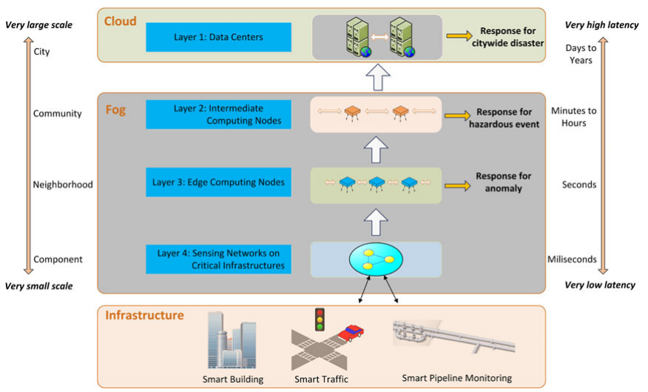
Smart Cities: Techniques
ADMM
Key Characteristics
Hierarchical fog computing architecture distributes computation across sensing, edge, intermediate fog, and cloud layers.
Intelligence is pushed toward the edge for feature extraction, anomaly detection, event recognition, and fast local control.
Uses a smart pipeline monitoring case study with fiber-optic sensors and machine learning.
Four-layer Fog Computing architecture in smart cities (source)
Greatly reduces communication overhead by sending only high-level features; transmitted data can be about 0.02% of the raw data size.
Bin Cao et al. "Incorporating intelligence in fog computing for big data analysis in smart cities". In: IEEE Transactions on Industrial Informatics 13.5 (2017), pp. 2140–2150.

Slide 18
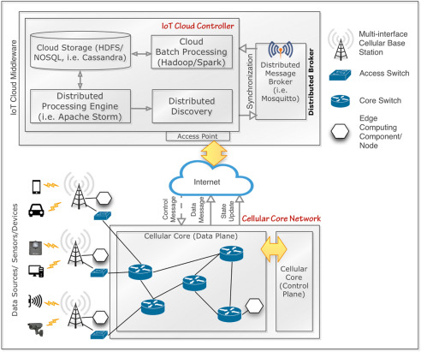
Smart Cities: Techniques
Situational awareness
Key Characteristics
Edge-based IoT data processing moves computation closer to heterogeneous smart-city sensors instead of sending all raw data to the cloud.
Focuses on situation awareness, converting low-level IoT observations into higher-level information for city decision-makers.
Introduces a situation image (s-image) to represent and identify the current situation.
Uses a four-part architecture with Device Module, Edge Network, IoT Cloud Middleware, and Subscribers.
Situational awareness (source)
SK Alamgir Hossain et al. "Edge computing framework for enabling situation awareness in IoT based smart city". In: Journal of Parallel and Distributed Computing 122 (2018), pp. 226–237.

Slide 19
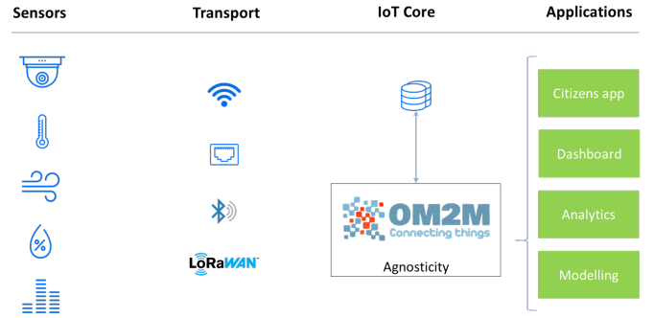
Smart Cities: Techniques
YOLO + Sort
Key Characteristics
Edge-based video analytics processes CCTV streams locally instead of sending raw video to the cloud.
Performs real-time multimodal traffic monitoring for vehicles, pedestrians, and cyclists.
Combines YOLOv3 for object detection with SORT for real-time tracking.
YOLO + SORT (source)
Introduces the Agnosticity framework for interoperable collection, storage, and access of data from multiple sensors.
Johan Barthélemy et al. "Edge-computing video analytics for real-time traffic monitoring in a smart city". In: Sensors 19.9 (2019), p. 2048.

Slide 20
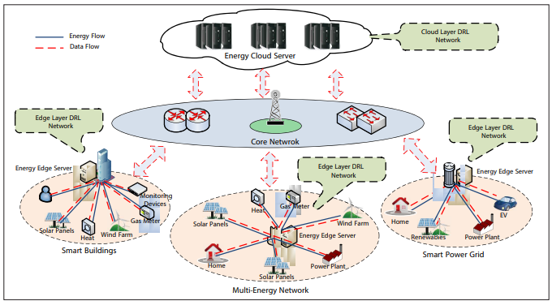
Smart Cities: Techniques
Energy management for smart cities
Key Characteristics
IoT + edge computing + deep reinforcement learning for intelligent energy management in smart cities.
Proposes a four-layer software model with sensing, network, cognition, and application layers.
Introduces Edge DRL and Cooperative DRL scheduling methods for optimizing energy use.
The IoT-based energy management architecture for smart cities (source)
Achieves lower energy cost and lower delay than traditional cloud-only scheduling.
Yi Liu et al. "Intelligent edge computing for IoT-based energy management in smart cities". In: IEEE Network 33.2 (2019), pp. 111–117.

Slide 21
Smart Cities: Challenges
Heterogeneous sources
Data privacy
Fusing data from many diverse city sensors in real time.
Protecting citizen data across a distributed edge.
Resource allocation
Fault tolerance
Balancing workloads, energy & fairness among fog nodes.
Adaptive, resilient control despite failures & disturbances.

Slide 22
Summary
In manufacturing domain, a four-domain architecture enables predictive maintenance & LSTM/autoencoder anomaly detection — cutting network load and downtime.
In telecommunications, edge cloud computing improves KPIs & TCO; URLLC with mm-wave enables VR, V2X and edge AI.
In healthcare, IoMT + edge delivers real-time remote monitoring and elderly care, while keeping health data private.
In smart cities, ADMM, situational awareness, YOLO+SORT, DRL and DECIoT power traffic, energy and public-safety services.

Slide 23
Practice
1
How does edge computing improve operational efficiency in the manufacturing sector?
Describe the role of edge computing in enhancing real-time patient monitoring and diagnostics in healthcare.
2
How does edge computing support the deployment and efficiency of 5G networks in the telecommunications industry?
3
4
Discuss the impact of edge computing on public safety and resource management in smart cities.
3
How does edge computing facilitate predictive maintenance in manufacturing environments?
5

Slide 24




Project
Analyze and present a case study of a successful edge computing implementation in a specific industry.
How to plan it
Example cases to start from
1
Pick an industry & case Choose a real deployment — a smart factory, a telecom operator, a hospital, a smart-city pilot.
Manufacturing Chen et al. — smart factory that cut network load 60%.
2
State the problem What did cloud-only fail at — latency, bandwidth, privacy, reliability?
Telecom Ciccarella et al. — ECC improving KPIs & saving TCO.
3
Map the architecture Show the edge design: devices, edge nodes, network, cloud, and the data flow.
Healthcare RO-SmartAgeing— six-layer IoHT senior monitoring.
4
Report the outcomes Quantify the gains (latency, cost, accuracy) and name the remaining challenges.
Smart city Barthélemy et al. [7] — YOLO+SORT traffic pilot, Liverpool NSW.
Deliverable: a short report + presentation — problem, edge architecture diagram, measured results, and lessons learned vs. a cloud-only baseline.
Baotong Chen et al. “Edge computing in IoT-based manufacturing”. In: IEEE Communications Magazine 56. 9 (2018), pp. 103–109.
Gianfranco Ciccarella et al. “Edge cloud computing in telecommunications: Case studies on performance improvement and TCO saving”. In: 2019 4th International Conference on Fog and Mobile Edge Computing (FMEC). IEEE, 2019, pp. 113–120.
Marilena Ianculescu et al. “IoHT and edge computing, warrants of optimal responsiveness of monitoring applications for seniors. A case study”. In: 2019 22nd International Conference on Control Systems and Computer Science (CSCS). IEEE, 2019, pp. 655–661.
Johan Barthélemy et al. "Edge-computing video analytics for real-time traffic monitoring in a smart city". In: Sensors 19.9 (2019), p. 2048.

Slide 25
References
Yongli Zhao et al. “Edge computing and networking: A survey on infrastructures and applications”. In: IEEE Access 7 (2019), pp. 101213–101230.
Baotong Chen et al. “Edge computing in IoT-based manufacturing”. In: IEEE Communications Magazine 56. 9 (2018), pp. 103–109.
Jumyung Um et al. “Edge computing in smart production”. In: Advances in Service and Industrial Robotics: Proceedings of the 28th International Conference on Robotics in AlpeAdria-Danube Region (RAAD 2019) 28. Springer, 2020, pp. 144–152.
Wenjin Yu et al. “Edge computing-assisted IoT framework with an autoencoder for fault detection in manufacturing predictive maintenance”. In: IEEE Transactions on Industrial Informatics 19. 4 (2022), pp. 5701–5710.
Chaoyang Zhang and Weixi Ji. “Edge computing enabled production anomalies detection and energy-efficient production decision approach for discrete manufacturing workshops”. In: IEEE Access 8 (2020), pp. 158197–158207.
Gianfranco Ciccarella et al. “Edge cloud computing in telecommunications: Case studies on performance improvement and TCO saving”. In: 2019 4th International Conference on Fog and Mobile Edge Computing (FMEC). IEEE, 2019, pp. 113–120.
Mohammed S Elbamby et al. “Wireless edge computing with latency and reliability guarantees”. In: Proceedings of the IEEE 107. 8 (2019), pp. 1717–1737.
Peiran Dong et al. “Edge computing based healthcare systems: Enabling decentralized health monitoring in Internet of medical Things”. In: IEEE Network 34. 5 (2020), pp. 254–261.
Marilena Ianculescu et al. “IoHT and edge computing, warrants of optimal responsiveness of monitoring applications for seniors. A case study”. In: 2019 22nd International Conference on Control Systems and Computer Science (CSCS). IEEE, 2019, pp. 655–661.
Bin Cao et al. "Incorporating intelligence in fog computing for big data analysis in smart cities". In: IEEE Transactions on Industrial Informatics 13.5 (2017), pp. 2140–2150.
SK Alamgir Hossain et al. "Edge computing framework for enabling situation awareness in IoT based smart city". In: Journal of Parallel and Distributed Computing 122 (2018), pp. 226–237.
Johan Barthélemy et al. "Edge-computing video analytics for real-time traffic monitoring in a smart city". In: Sensors 19.9 (2019), p. 2048.
Yi Liu et al. "Intelligent edge computing for IoT-based energy management in smart cities". In: IEEE Network 33.2 (2019), pp. 111–117.
Evangelos Maltezos et al. "Public safety in smart cities under the edge computing concept". In: 2021 IEEE International Mediterranean Conference on Communications and Networking (MeditCom). IEEE. 2021, pp. 88–93.

